Slide 1
Connecticut Green Bank Providing easy access to affordable capital National Development Banks and Climate Finance Inter-American Development Bank October 6, 2014

Slide 2
Why a Green Bank? Economic Development and Environmental Protection
2
Notes:
Macro Challenges
High energy costs – highest in the lower 48 states
Old and aging building stock
Government spending constrained
Faced with the impacts of a changing climate – grid reliability, resilient communities.
Halloween Nor-Easter
2011 Storm Alfred
10 deaths in Connecticut and 830,000 people without power for some nearly a week
Hurricane Sandy
2012
73 deaths
Nearly $70 billion in damage in the U.S. 2nd most behind Katrina
Category 2 storm in the Northeast

Slide 3
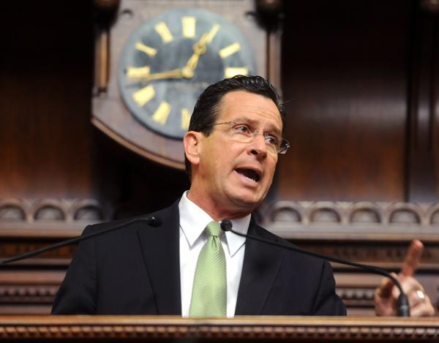
Connecticut Green Bank Expand Private Investment in Clean Energy
…transitioning programs away from government-funded grants, rebates, and other subsidies, and towards deploying private capital
…CEFIA was established in 2011 to develop programs that will leverage private sector capital to create long-term, sustainable financing for energy efficiency and clean energy to support residential, commercial, and industrial sector implementation of energy efficiency and clean energy measures.
3
Notes:
Talking Points
Beyond the traditional model
Attract private investment
Leadership is hard, but look at the results we have achieved
Slide Take-Away Message
CEFIA was created to push a market to scale by relying more on the private sector versus taxpayers footing a majority of the bill

Slide 4
Case in Point Residential Clean Energy Measures
Enable energy efficiency improvements for at least 15% of single family homes in the state by 2020 – approximately 150,000 homes at $10,000 to achieve 20% energy reduction would require an investment of $1.5 billion
Support the conversion from oil to natural gas for at least 200,000 households in the state in 8 years – at $7,500 for an average cost of conversion with equipment for an estimated investment of $1.5 billion
Estimate potential market of over 150,000 households to install solar PV in the state – at an average cost of $30,000 per system would require an investment of $4.5 billion
4
Notes:
Talking Points
Connecticut energy policy has ambitious goals and targets
Meeting these targets without over-subsidizing the market and using ratepayer or taxpayer resources will be a challenge
Attracting more private investment will enable Connecticut to meet its policy targets
Slide Take-Away Message
CEFIA’s role is to use the limited ratepayer and taxpayer resources we have to attract private investment in clean energy in Connecticut so that the state has a chance to achieve its ambitious policy objectives

Slide 5
Connecticut Green Bank About Us
Quasi-public organization – created by PA 11-80 and successor to the Connecticut Clean Energy Fund
Focus – finance clean energy (i.e. renewable energy, energy efficiency, and alternative fuel vehicles and infrastructure)
Balance Sheet – currently $120 million in assets
Support – supported by a $0.001/kWh surcharge on electric ratepayer bills that provides approximately $30 MM a year for investments, RGGI (EE and RE) about $5-$10 MM a year, federal competitive solicitations (i.e. SunShot Initiative) and non-competitive resources (i.e. ARRA-SEP), private capital, etc.
5
Notes:
Talking Points
Quasi Public status provides greater flexibility---which is important when attracting private capital and establishing partnerships.
Developing financing products in partnership with banks and financial institutions to support CT’s CE Goals.
1 primary revenue stream (electric ratepayer surcharge) and a couple other sources including active in federal competitive solicitations and some RGGI proceeds.
Slide Take-Away Message
CEFIA is an independent organization capitalized by ratepayers and taxpayers with the purpose of providing easy access to affordable capital

Slide 6
Connecticut Green Bank Financial Tools
Equity
Grants
Loans
Interest rate buy downs
Connecticut Green Bank
Subordinated debt
Third party insurance
Loan loss reserves
Energy savings performance contracts
On bill repayment
Commercial Property Assessed Clean Energy
6
Notes:
Talking Points
X
X
X
Slide Take-Away Message
x

Slide 7
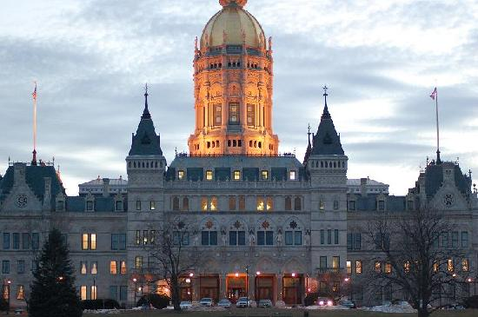
Connecticut Green Bank Mission and Goals
Support the Governor’s and legislature’s energy strategy to achieve cleaner, cheaper and more reliable sources of energy while creating jobs and supporting local economic development
Attract and deploy capital to finance the clean energy goals for Connecticut
Develop and implement strategies that bring down the cost of clean energy in order to make it more accessible and affordable to consumers
Reduce reliance on grants, rebates and other subsidies and move towards innovative low-cost financing of clean energy deployment
7
Notes:
Talking Points
Energy – Economy – Environment
Slide Take-Away Message
Bring together the energy and environmental goals of “cleaner, cheaper and more reliable sources of energy” with the economic development goals “creating jobs and supporting local economic development.”

Slide 8
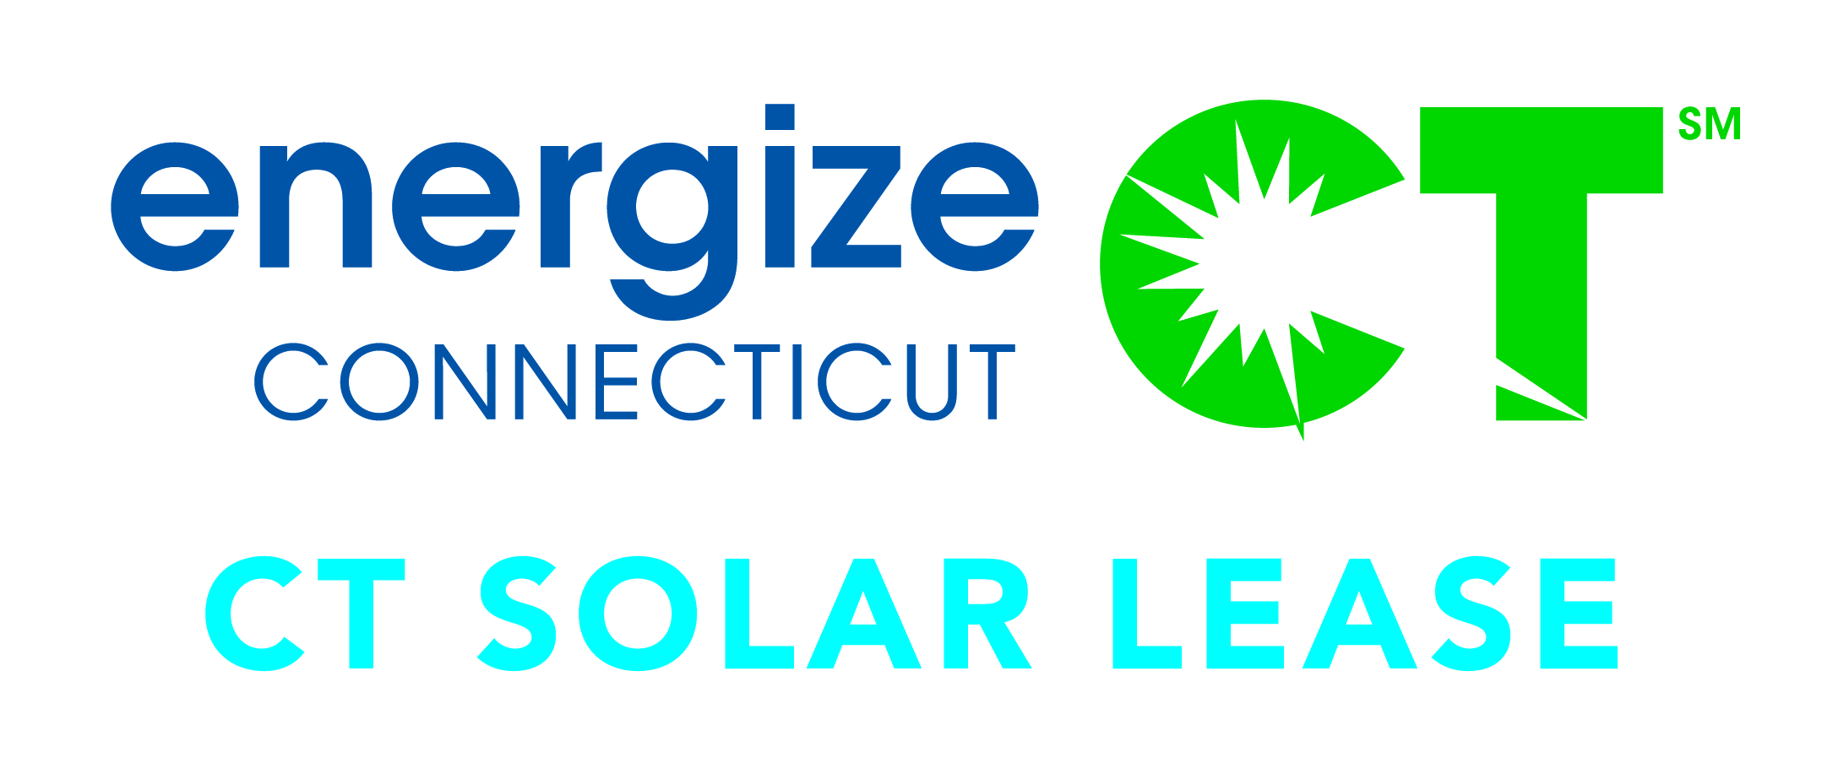
CT Solar Lease
Public-Private Partnership
Connecticut
Green Bank
CT Solar Lease provides local installers an important sales tool, while customers benefit from affordable, no-money-down financing and peace of mind.
Sub Debt
Equity
Loan Loss Reserve
PBI (incentive)
Developer services
Tax Equity
System, Insurance, Lease
CEFIA Holdings, LLC
System
Contractor
(SHW, Resi. or Comm. PV)
Debt Syndicate led by First Niagara
CT SLII, LLC
Debt
$
$
Install
Assurant
Lease Payments
Insurance, maintenance, “One Call” Resolution
AFC First
PV or SHW Customer
(Resi., Comm., or Muni)
8
Notes:
Talking Points
First in the nation tax equity investor and syndicate of debt provider public-private partnership for rooftop solar PV
$60 million public-private partnership
$23 million tax equity from US Bank through the federal ITC
$27 million syndicate of debt providers from First Niagara, Webster, Liberty, and People’s United banks
$10 million CEFIA as the member manager
Residential lease financing for solar PV and solar hot water systems
Commercial PPA for solar PV
Slide Take-Away Message
CEFIA is working hard to attract private capital investment in clean energy deployment in Connecticut

Slide 9
CT Solar Lease Customer Benefit
Immediately cash flow positive
(savings)
(20 years)
9
Notes:
Talking Points
Provides for cash flow positive from Day 1.
No $$ down
Worry free product that includes insurance, warranty and one-stop customer support
Built off of award winning CT Solar Lease 1
Slide Take-Away Message
Restructured Public-Private Lease Partnership supporting local installers that do not have access to large capital to support individual lease product

Slide 10
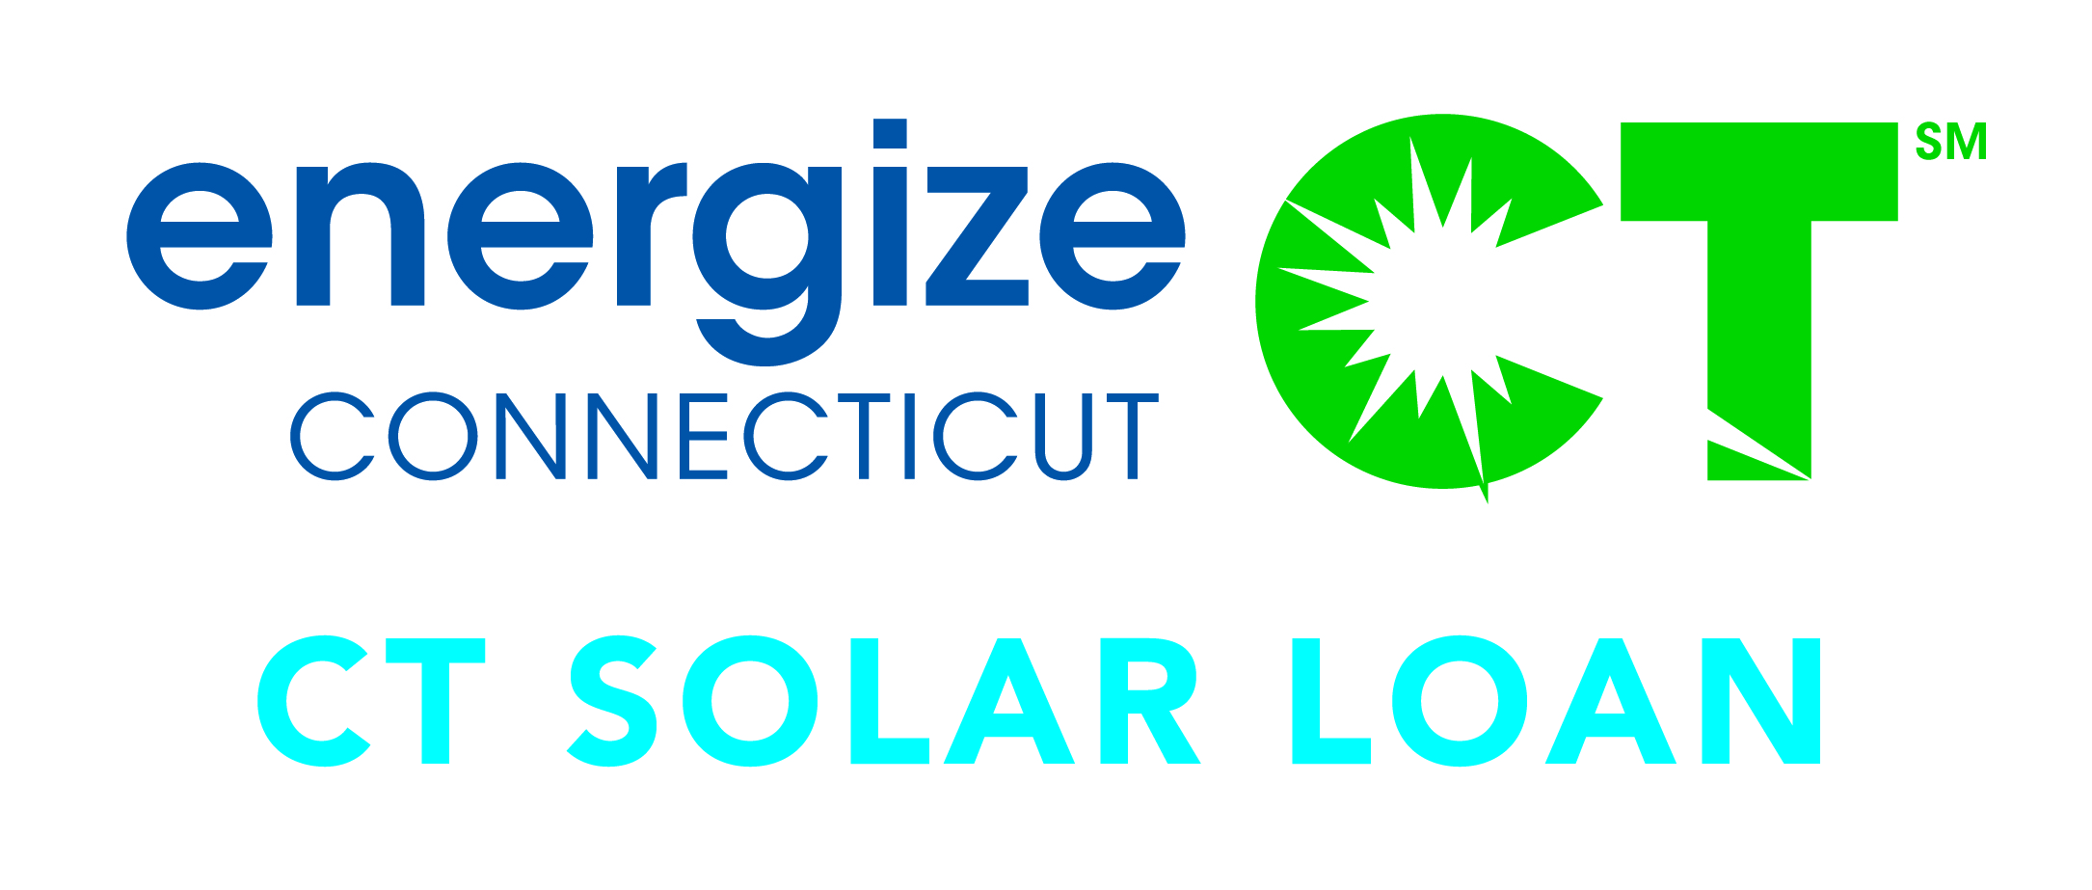
CT Solar Loan Crowd Funding Partnership
Connecticut
Green Bank
Crowdsourcing Platform
$ from loan repayments (20%)
Sub Debt
Debt
$
CEFIA
(CT Solar Loan LLC)
Sungage
$ from loan repayments (80%)
LLR
$ from loan repayments (100%)
$
Contract
PV Contractor
Monthly Loan Payment
Loan Agreement
CT Solar Loan provides local installers an important sales tool, while customers can take the 30% ITC and benefit from long-term, low cost capital that allows them to own PV
Install
Residential PV Customer
10

Slide 11
CT Solar Loan Customer Benefit
(savings)
Cash flow positive by year 3 due to lower monthly payments and re-amortization of loan using ITC
11
Notes:
Talking Points
1st of its kind---Specific Residential Solar Financing Product
Provides investment opportunity to homeowners
Cash Flow Positive by Year 3
Residential loan product for homeowners
Low monthly payments
Extended system and production warranties
Easy on-line credit pre-qualification
Multiple flexible alternatives if you move before end of loan
Offers the largest long-term return on investment
FICO scores ≥ 680, Debt to Income (DTI) Ratio ≤ 42%*
*FICOs ≥ 720 no DTI limit
Slide Take-Away Message
CT Solar Loan is a GREAT tool for homeowners looking to own solar PV and realize the wealth creation from it

Slide 12
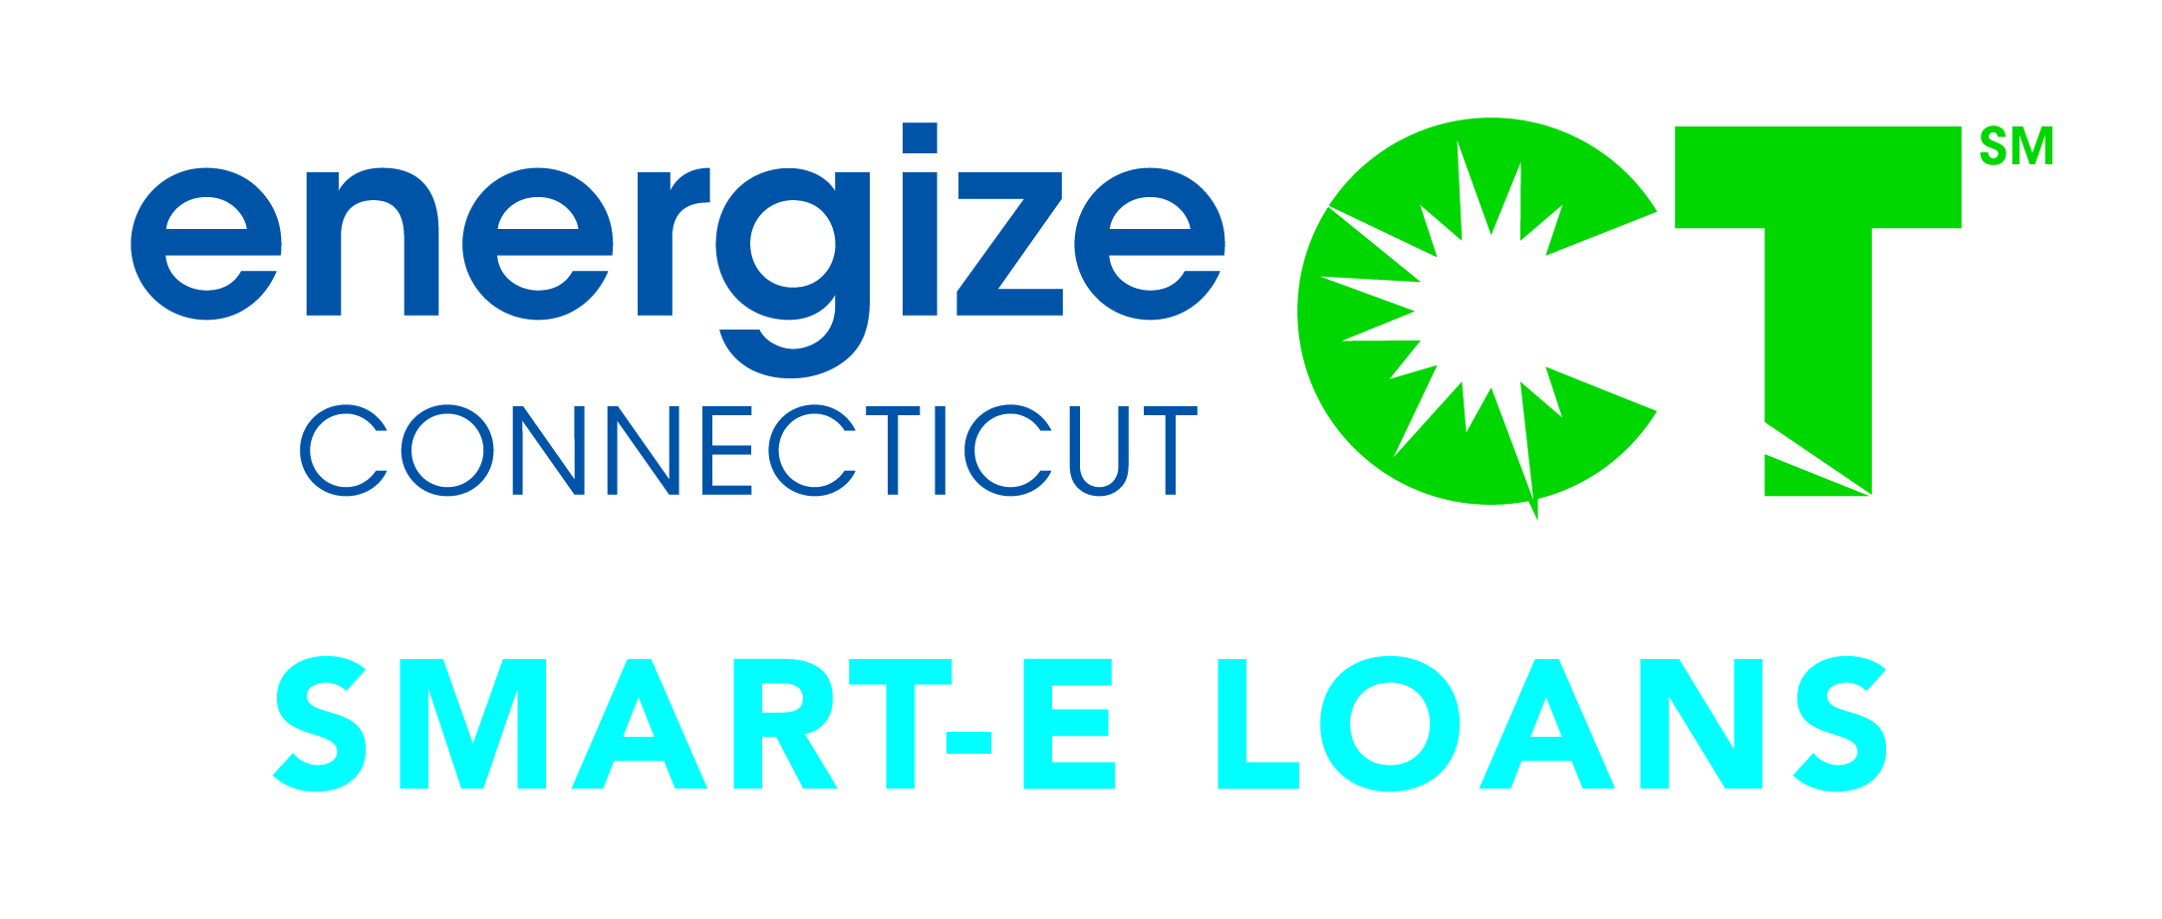
Smart-E Loan Public-Private Partnership
Community Banks and Credit Unions
Connecticut
Green Bank
Loan Loss Reserve tiered based on creditworthiness of borrower
Min. Underwriting Guidelines
Technical Project Approval
Technical Approval
PV, RE, EE or HVAC Contractor
$
Install
$
Residential PV, RE, EE, HVAC Customers
$
12

Slide 13
Smart-E Loan Customer Benefit
(savings)
Value of ITC essentially covers net payments due over 12 year term
(25 years)
13
Notes:
Talking Points
Not to exceed 6.99%
This is a Solar PV example
Slide Take-Away Message
Smart-E Loan is a great option for homeowners that need easy access to affordable capital for solar PV

Slide 14
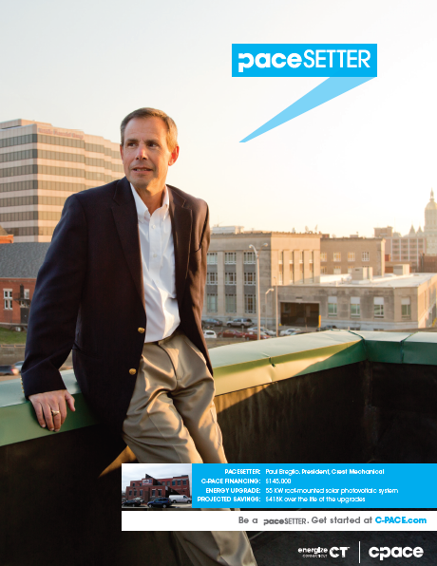
C-PACE A Public-Private Partnership
14

Slide 15
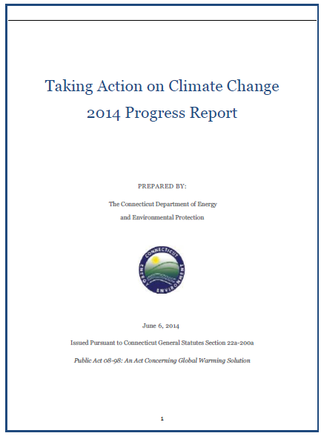
C-PACE and RGGI Forstone Capital (Deep Energy Efficiency Upgrades)
Terms – 20 years @ 5.5%
Project Cost – $2,462,000
Assessment – $166,563
Cost Savings – $241,900
15

Slide 16
Purpose of a Green Bank Sustainable Clean Energy Marketplace
1
Green Bank Financing with No Subsidies
Government Subsidies
Green Bank Financing with Reduced Subsidies
2
3
Private Sector Financing Only – FINAL GOAL
4
We are here
We want to be here:
Typical investors can buy clean energy bonds or products, supported by a pool of underlying projects. Clean energy upgrades (and therefore financing) is the norm for residents, businesses, and MUSH market
Ex: ABS (car, home, timeshare, education loans)
16

Slide 17
The Green Bank Model Works Doing More, Faster and with Less
 | FY 2000-FY 2011 (CCEF) | FY 2012-FY 2014 (CGB)
Years | 11 | 3
Energy (MW / Lifetime GWh) | 43.1 / 2,299 | 65.3 / 3,189
Total Investment ($ MM) | $334.2 | $350.2
Ratepayer Investment ($ MM) | $153.1 | $100.0
Ratepayer Investment as Loans (%) | 0 | 57
Jobs
↑
GHGs
↓
17
Notes:
Talking Points
Doing more with less and faster
“Green Bank” model is allowing for increased deployment while at the same time reducing ratepayer and taxpayer contributions
Great leverage at 10:1
Deploying nearly the same amount of clean energy in 1 year than what was done in the prior decade
Slide Take-Away Message
The “Green Bank” model works!

Slide 18
New York Green Bank Follows Connecticut’s Lead
“Through the New York Green Bank, we will leverage public dollars to attract private sector investment into building a new clean energy economy that will help make our state greener and create jobs…With this initiative, we will promote job growth and business development, improve resiliency and air quality, and lower costs for consumers while providing them with greater choices and value for their money.”
When fully capitalized, the Green Bank is expected to have a $1 billion balance sheet.
18
Notes:
Talking Points
We have and will continue to work with our colleagues at the NYGB to ensure collaborative opportunities are identified and acted upon
Slide Take-Away Message
CEFIA’s “Green Bank” model is working so well, that other states are beginning to follow Connecticut’s lead

Slide 19
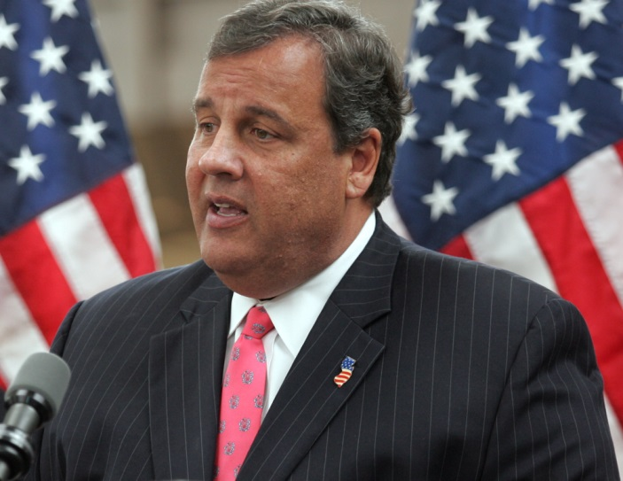
New Jersey Energy Resilience Bank Follows Connecticut’s Lead
“The launch of the Energy Resilience Bank, the first of its kind in the nation to focus on resilience, is yet another effort of the Christie Administration to increase energy resilience at critical facilities throughout New Jersey…Increasing energy resilience, whether through the Energy Resilience Bank, the BPU approved resiliency improvement measures implemented by utility companies or NJ’s Clean Energy Program, will minimize the potential impacts of future widespread power outages due to major storms like Superstorm Sandy.”
The bank is capitalized with $200 million through a federal Community Development Block Grant for Disaster Recovery as a result of Superstorm Sandy
19
Notes:
Talking Points
xxx
Slide Take-Away Message
xxx

Slide 20
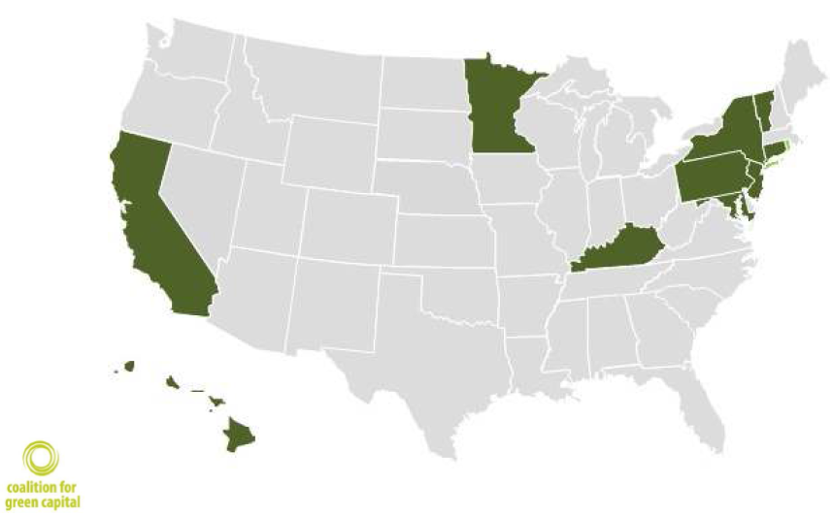
Green Bank Movement United States
20
Notes:
Talking Points
Complete or in process green banks or similar programs
Slide Take-Away Message
xxx

Slide 21
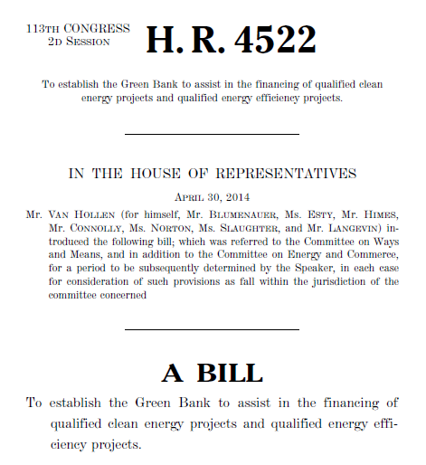
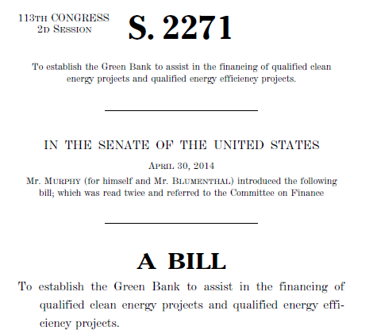
Green Bank Act of 2014 $50 Billion Federal Green Bank Modelled after CT
21
Notes:
Talking Points
We have and will continue to work with our colleagues at the NYGB to ensure collaborative opportunities are identified and acted upon
Slide Take-Away Message
CEFIA’s “Green Bank” model is working so well, that other states are beginning to follow Connecticut’s lead

Slide 22
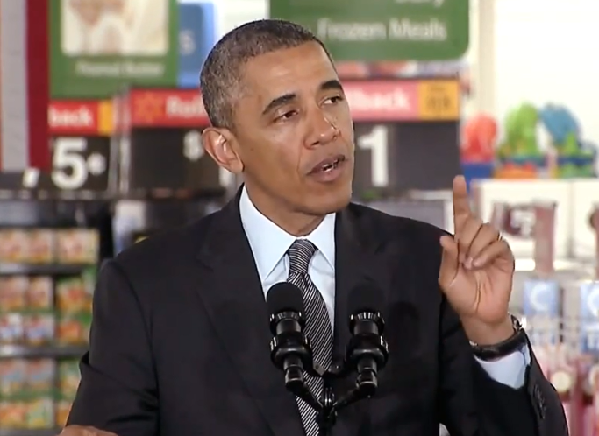
President Obama American Energy (May 9, 2014)
“We’ve got public banks like Connecticut’s Green Bank and private banks like Goldman Sachs ready to invest billions of dollars in renewable energy…
As Americans, we don’t look backwards. We look forward. We don’t fear the future, we seize it. We shape it. And when it comes to energy, we have a chance to shape that sector that is probably going to have more to do with how well our economy succeeds than just about any other.”
22

Slide 23
Thank You!
Bryan Garcia
Connecticut Green Bank
President and CEO
845 Brook Street
Rocky Hill, CT 06067 www.ctcleanenergy.com
bryan.garcia@ctcleanenergy.com (860) 257-2170

