Slide 1
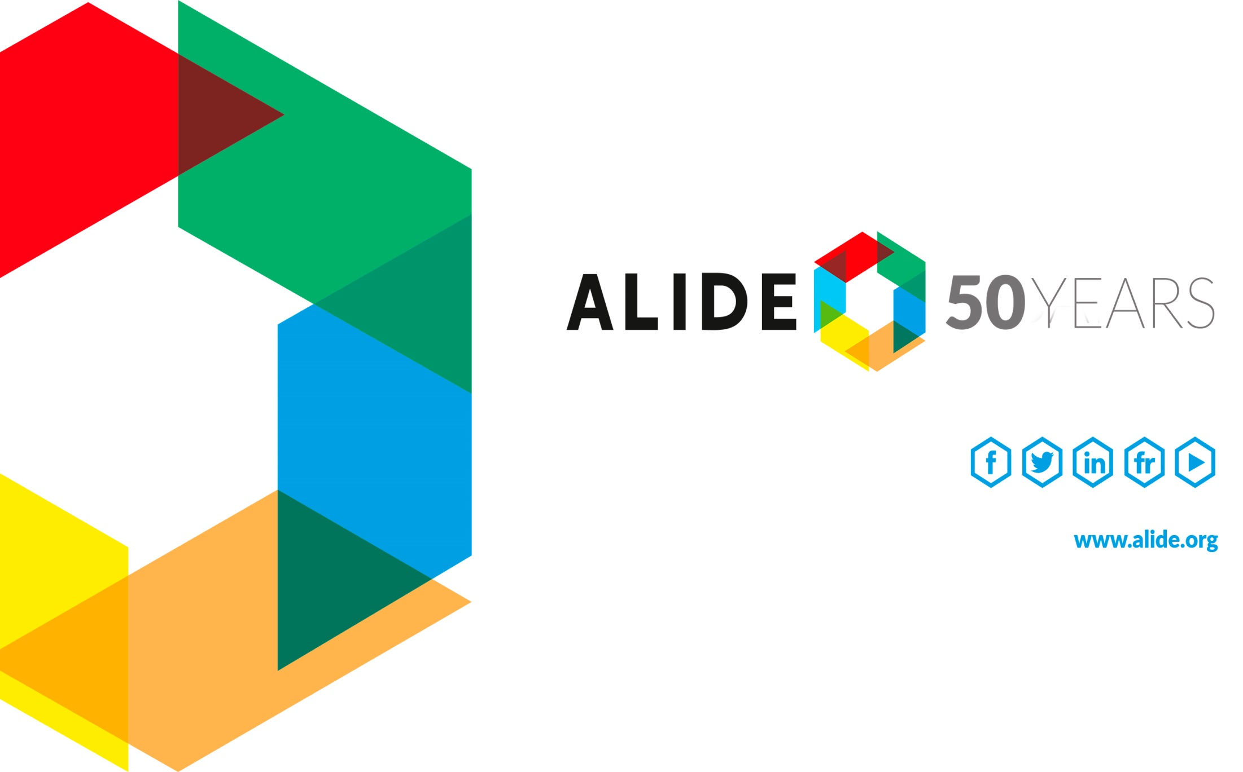

Slide 2
IDB GREEN FINANCE COLLABORATION WORKSHOP IN CHINA
FINANCIAL AND TECHNICAL COLLABORATION OPTIONS BETWEEN CHINA AND LATIN AMERICAN NATIONAL DEVELOPMENT BANKS
November 26-28, 2018, Beijing, China
Edgardo Alvarez
Secretary General
Latin American Association for Development Financing Institutions (ALIDE)

Slide 3
WHAT IS ALIDE?
The Latin American Association for Development Financing Institutions (ALIDE) is:
“The community of financial institutions that generates banking solutions for the Development of Latin America and the Caribbean”, with 50 years of existences.
ALIDE’s aim in the activities it promotes and develops is to achieve cohesion and to strengthen the actions and participation of financial institutions in the social and economic progress of the Region.
Community of financial institutions that generates solutions in banking for the development of Latin America and the Caribbean

Slide 4
LINES OF ACTION
Technological innovation at the service of financial and social inclusion, digital economy, Fintech or technological platforms based on the Internet; financial inclusion for SME’s, micro businesses, and small rural farmers.
FINANCIAL INCLUSION AND DIGITAL BANKING
Intelligent infrastructure, public-private partnerships to finance the infrastructure; project structuring, intelligent and sustainable cities; financing and access by local governments to banking services.
SOCIAL AND ECONOMIC INFRASTRUCTURE
INNOVATION AND
TECHNOLOGICAL DEVELOPMENT
Technological revolution and structural transformation of the Region, ecosystems of entrepreneurs, risk capital and seed capital for businesses and innovative firms.
Administrative systems for environmental and social risks, impact assessment, project structuring; green banking and eco-businesses; instruments for climate risk coverage; energy efficiency and renewable energy sources.
ENVIRONMENT AND
CLIMATE CHANGE
Community of financial institutions that generates solutions in banking for the development of Latin America and the Caribbean

Slide 5
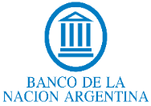
























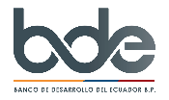





































ACTIVE MEMBERS
Community of financial institutions that generates solutions in banking for the development of Latin America and the Caribbean

Slide 6

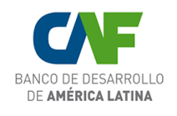

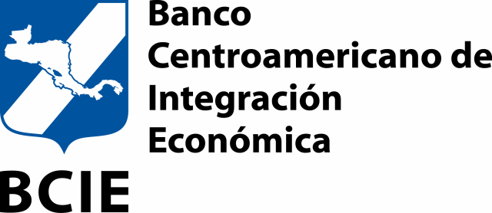












ASSOCIATE MEMBERS
Community of financial institutions that generates solutions in banking for the development of Latin America and the Caribbean

Slide 7

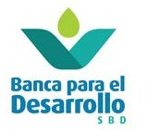





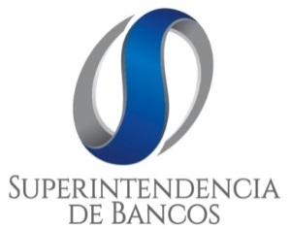

COLLABORATING MEMBERS
Community of financial institutions that generates solutions in banking for the development of Latin America and the Caribbean

Slide 8

ASSETS AND PORTFOLIO OF ALIDE’s DEVELOPMENT BANK MEMBERS
(Billion US$)
 | Assets | Portfolio
National Banks of LAC | 1,479 | 807
Regional Organizations of LAC | 181 | 126
Extraregional Banks and the EIB (*) | 3,923 | 2,740
Total | 5,583 | 3,673
*not included: AFD (France) and SGPM (Portugal)
Community of financial institutions that generates solutions in banking for the development of Latin America and the Caribbean

Slide 9
CHALLENGES FOR LAC
One of the most important challenges that Latin America and the Caribbean face in their economic processes, is to improve their insertion into the global economy, an aspect that limits the sustained growth of the region.
The internationalization of LATAM companies, the development of new markets and their linkage to global value chains are key elements in this challenge.
This becomes even more relevant in the context of a globalization process that faces tensions linked to protectionism and trade and regulatory imbalances.
Attract financial flows in order to finance sustainable green projects.
Community of financial institutions that generates solutions in banking for the development of Latin America and the Caribbean

Slide 10
ALIDE - COOPERATION & INVESTMENT
RELATIONSHIP BETWEEN ITS MEMBERS
ALIDE´s Role:
Boost trade, business and cooperation between NDB from LAC
with countries and development financial institutions outside the region.
As joint mechanism for action, coordination, cooperation, integration and service for development banking in LAC.
For the extra-regional banks, a platform to stablish links with the region’s development banks, establishing cooperation agreements for financing and technical assistance.
Encourage cooperation for the exchange of best practices, doing business and cooperation.
Community of financial institutions that generates solutions in banking for the development of Latin America and the Caribbean

Slide 11



CLIMATE CHANGE, FINANCING GREEN INVESTMENTS ACTIVITIES
Financing, capacity strengthening, technical studies, technical cooperation with non-reimbursable resources.
With the IDB, a 5-year program related to the environmental issue has been developed and a similar period related to PPPs for resilient infrastructure will begin.
Community of financial institutions that generates solutions in banking for the development of Latin America and the Caribbean

Slide 12
MEETING BETWEEN DEVELOPMENTS BANKS
Business and Trade Missions of Development Bankers: Could be done with China and other Asian countries, as we have done with India, Germany, France and Europe with the European Investment Bank.
ALIDE General Assembly as an opportunity for cooperation and business: A space to analyze and discuss the main topics related to development banks and economic trends, as well as to establish business relations and cooperation.
  The next meeting of the general assembly of ALIDE will take place in Madrid, Spain, May 20-22, 2019.
Community of financial institutions that generates solutions in banking for the development of Latin America and the Caribbean

