Slide 1
A Win-Win Green Finance Partnership
for Latin America and the Caribbean
拉美与加勒比海地区互惠共赢的
绿色金融伙伴
Inter-American Development Bank (IDB)
美洲开发银行
November 2018
2018年11月

Slide 2
IDB is a long-term trusted development partner of
Latin America and the Caribbean
美洲开发银行（IDB）是拉丁美洲和加勒比海地区广受信赖的
长期发展伙伴

Slide 3
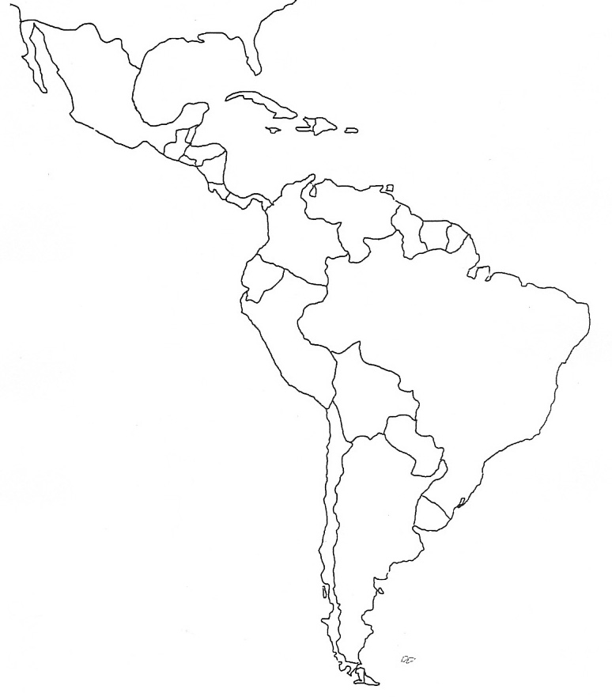
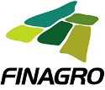
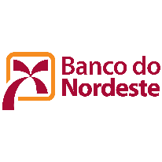
For the last 50 years,
the partnership network has grown synergies
美洲开发银行和拉美各国开发银行合作已达50年

Slide 4
The IDB partnership with National Development Banks has been very successful at Green Finance Innovation
美洲开发银行和国家开发银行在绿色金融创新领域的合作成绩斐然

Slide 5
IDB developed a Green Finance toolbox
of blending instruments
我们的绿色金融“工具箱
Guarantees
Credit Enhancements
Environmental & Social
Contingent Transfers
Projects Pipeline
Green Bonds
Public Private Partnership Framework
Conduits
Capacity Building
Loans
“The key is in the blend”
“融合方是关键”

Slide 6
IDB developed a Green Finance toolbox
of blending instruments
我们的绿色金融“工具箱
担保
信用增级
环境与社会
或有转移
项目拟议
绿色债券
政府和社会资本合作框架
渠道
能力建设
贷款
“The key is in the blend”
“融合方是关键”

Slide 7
Examples of Blended Finance
融合金融实例
Wind Energy
Hybrid and electric transport
Regional Energy Savings Insurance
Infrastructure Guarantee
Access to climate finance
Regional Green Bonds
Energy-Efficient Housing

Slide 8
Examples of Blended Finance
融合金融实例
风能
混合式和电力交通
区域性节能保险
基础设施担保
获得气候金融融资
区域性绿色债券
节能住宅

Slide 9
Together we will achieve a lot more
共同合作，更大进步。

Slide 10
Our value proposition 我们的价值主张
Strategic Partnership to jointly develop and implement
战略性伙伴关系，共同制定和实施
Green Finance instruments, that are:
具有以下特征的绿色金融工具：
Innovative 创新
Optimized 优化
Based on our Blending Technology
基于我们的融合技术
Tailored to the needs of our clients 量身定制

Slide 11
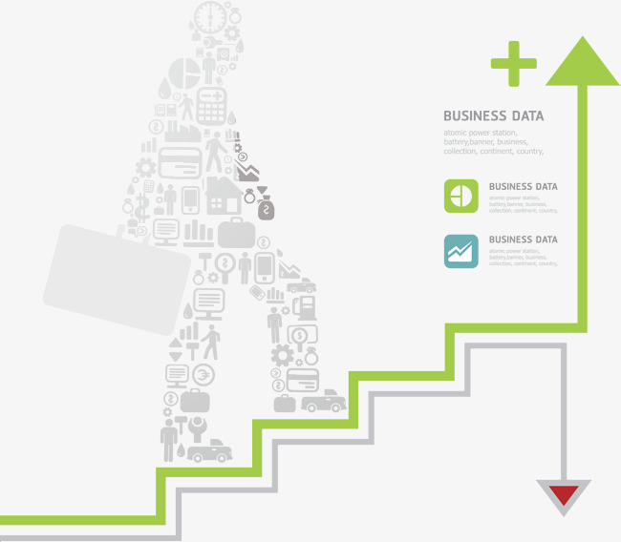
Let’s start the journey together
by taking the first steps
千里之行，始于足下
让我们携手共进

Slide 12
THANK YOU!
XIÈ XIE
Juan Ketterer
Division Chief
Connectivity, Markets and Finance
Inter-American Development Bank
juank@iadb.org

