Slide 1
Welcome to the Protected Agriculture Criteria - Mexico webinar
Don’t forget to connect your audio!
If you have trouble connecting your audio, please use the following instructions:
Click “Quick Start”
Then click “Audio Connection”
You have the two options:
Call on you phone
Call using your computer (recommended)
If you choose to use your phone,
dial in numbers and codes will be displayed
Notes:
Speaker: Sergiu

Slide 2
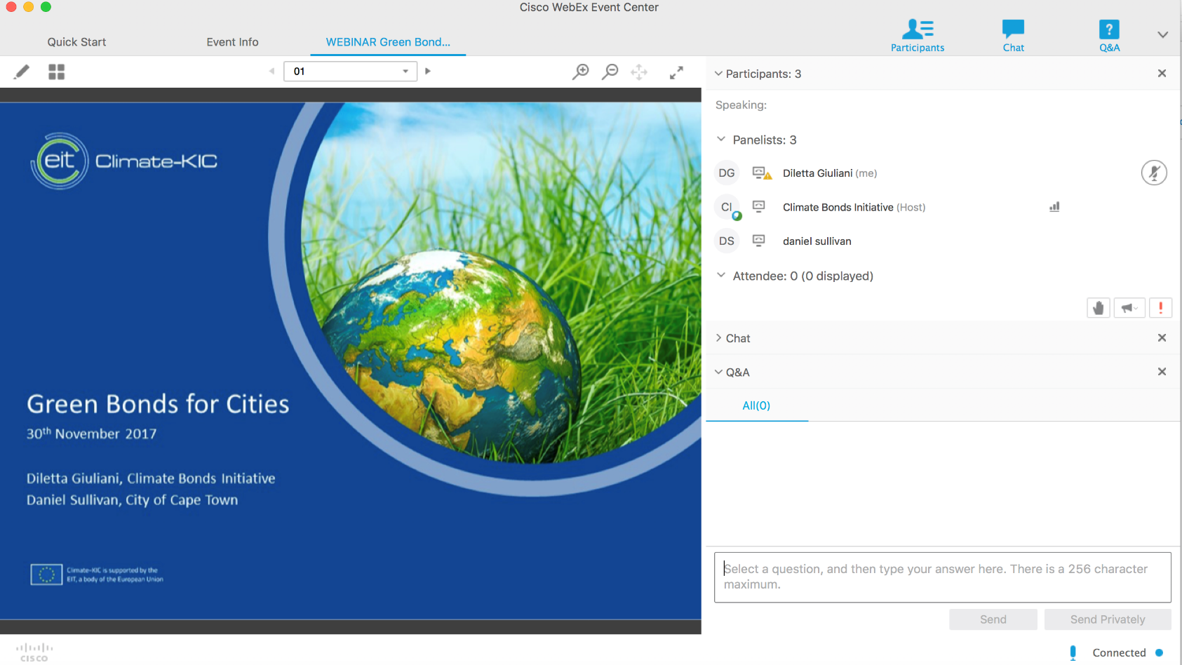
To ask questions
Please type a question any time during the presentation by inserting the question in the Q&A box:
Notes:
Speaker: Sergiu

Slide 3
Climate Bonds Standard
Protected Agriculture - Mexico
Public Consultation Webinar, September 17th
Ujala Qadir, Climate Standards Manager, Climate Bonds Initiative
Katie House, Senior Research Analyst, Climate Bonds Initiative
Lawrence Pratt, Consultant
Enrique Nieto Ituarte, Inter-American Development Bank
Notes:
Speaker: Sergiu

Slide 4
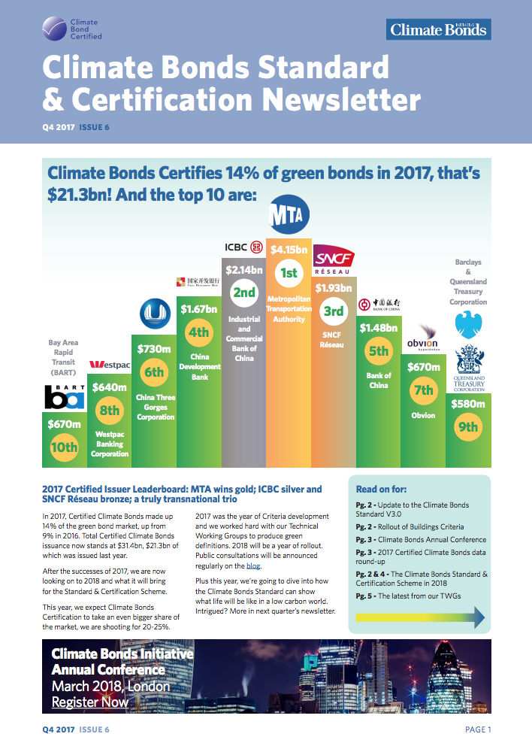
The Climate Bonds Initiative – what we do
We are an investor-focused not-for-profit mobilising debt capital markets for climate solutions:
Outreach to inform and stimulate the market
Policy models and government advice
Efforts in emerging markets to grow issuance
Green innovations e.g. securitization, covered bonds, Islamic Finance
Market data and analysis
Green bonds data base, feeding MSCI/Barclays and S&P DJI indices
State of the Market report, commissioned by HSBC
Regional and thematic focus reports, e.g. China, Canada
Climate Bonds Standard & Certification Scheme
Definitions for investors and guidelines for bond issuers
Assurance through certification
Notes:
Speaker: Ujala

Slide 5
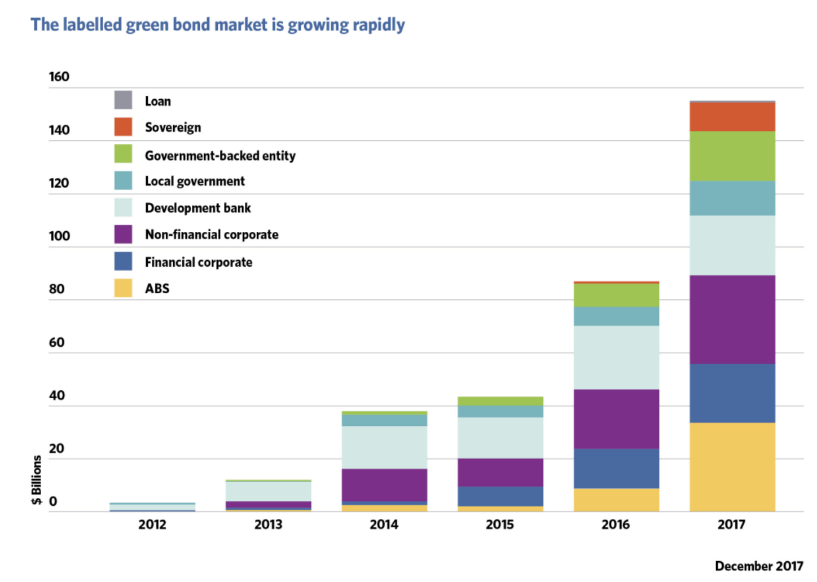
Green Bonds Growth
Proceeds go to green projects
Often an external review
Annual reporting required
New projects or re-financing
Issuers
Investor diversification
Market positioning
Pricing
Investors
Addressing climate risk
Secondary market value
The key figures:
USD155.5bn total green bond issuance; Over 1500 green bond issues; 78% growth on 2016
37 countries from all continents; 239 different issuers; 146 new issuers
USD10.7bn – largest single green bond
Notes:
Speaker: Ujala

Slide 6
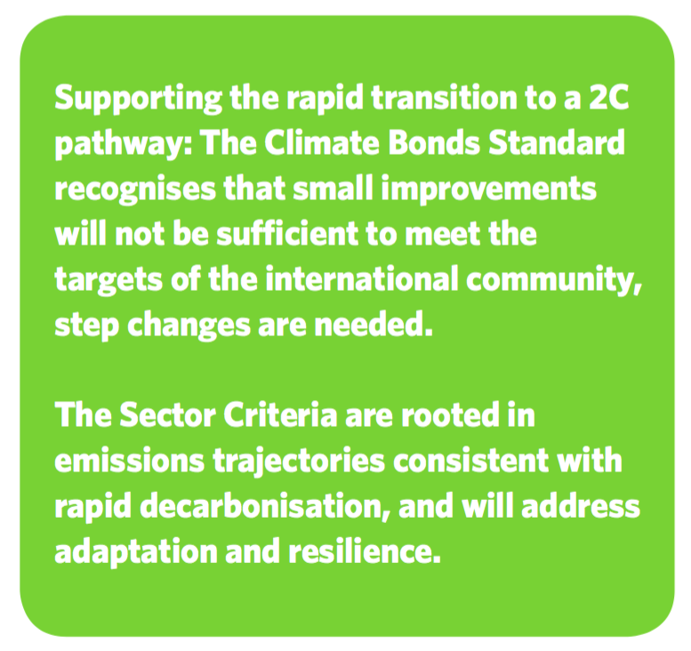
Climate Bonds Standard & Certification Scheme
The Climate Bonds Standard and Certification Scheme is a Fair Trade-like labelling scheme for bonds. It is designed as an easy-to-use screening tool for investors and issuers to assist them in prioritising investments that truly contribute to addressing climate change.
The Climate Bonds Standard is made up of two parts:
Climate Bonds Standard V2.1details management and reporting processes
Sector Criteria detail the requirements assets must meet to be eligible for Climate Bonds Certification
Notes:
Speaker: Ujala

Slide 7
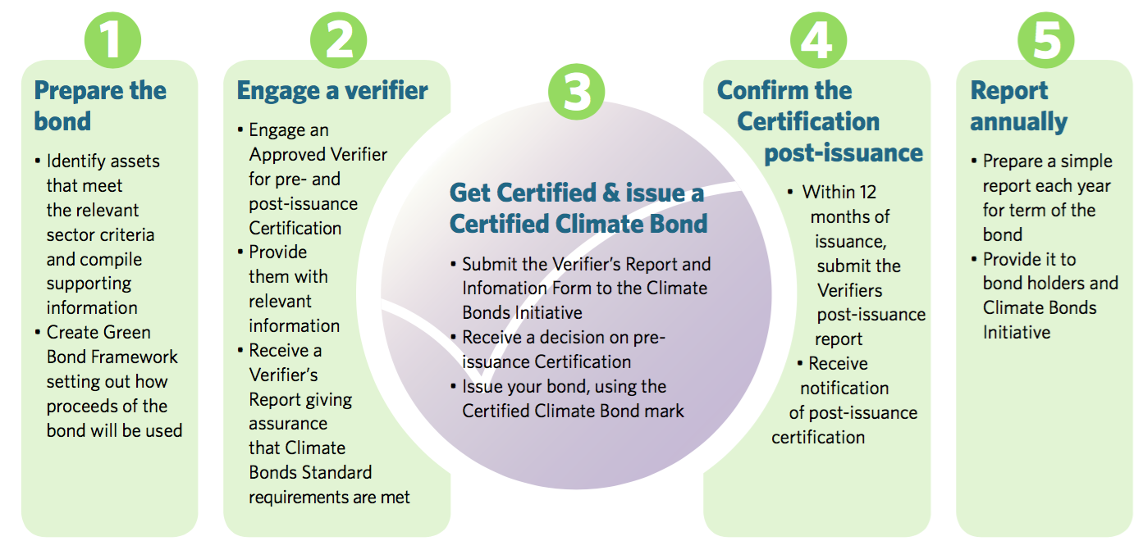
How to get a bond Climate Bond Certified?
See all Certified Climate Bonds at: https://www.climatebonds.net/standards/certification
Notes:
Speaker: Ujala

Slide 8
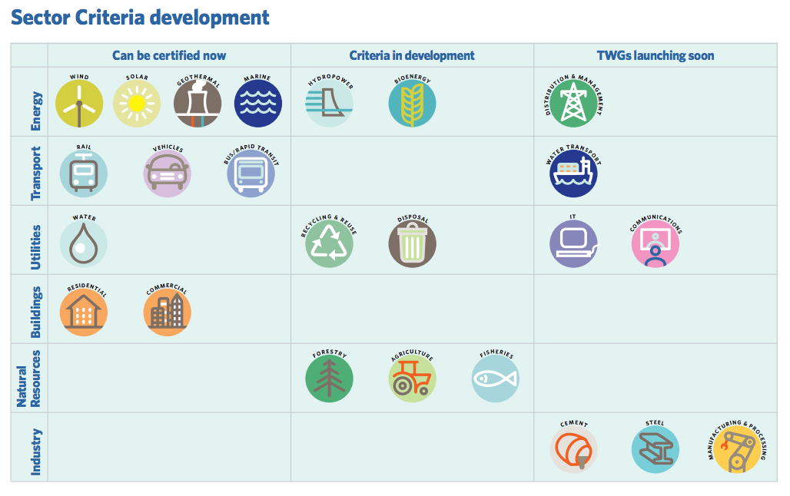
Climate Bonds Sector Criteria
Notes:
Speaker: Ujala

Slide 9
Protected Agriculture - Mexico:
development process
Notes:
Ujala

Slide 10
Mexican Protected Agriculture Criteria:
development process
Technical review
Public consultation
Board approval
Preparation
Drafting
Background research
Feedback on approach and draft Criteria: Are they feasible and practical for issuers and verifiers?
Final refinements to Criteria if needed
Background paper drafted by CBI & IADB
Release to the market
Notes:
Ujala

Slide 11
Mexican Protected Agriculture Criteria: development process
Protected Agriculture Technical Working Group (TWG)
Dr. Christine Negra, Versant Vision LLC Lawrence Pratt, Independent Consultant Juan Manuel Ortega, Independent Consultant Peter Chege, Hydroponics Kenya Rama Chandra Reddy, World Bank Group
Notes:
Ujala

Slide 12
Mexican Protected Agriculture Criteria: research focus and climate alignment
Notes:
Sergiu

Slide 13
Policy Drivers (Mexico)
Severe to extreme water scarcity in most of the country
Highest level Government commitment to more climate-friendly and resilient agricultural production to ensure food security.
Protected Agriculture is an important part of the strategy
Economic drivers – export earnings, increased income from productivity
Notes:
Lawrence

Slide 14
Research Focus (1)
Tomato as indicator crop (importance, reference crop and comparative data)
Business as Usual (BAU) is traditional open field seasonal tomato production
Four Protected Agriculture technologies
Low tech (rudimentary shading on stilts)
Shade Houses (entirely mesh-enclosed structures)
Medium tech (enclosed structures, using soil)
High tech (entire isolate, plants grown in substrates
Notes:
Lawrence

Slide 15
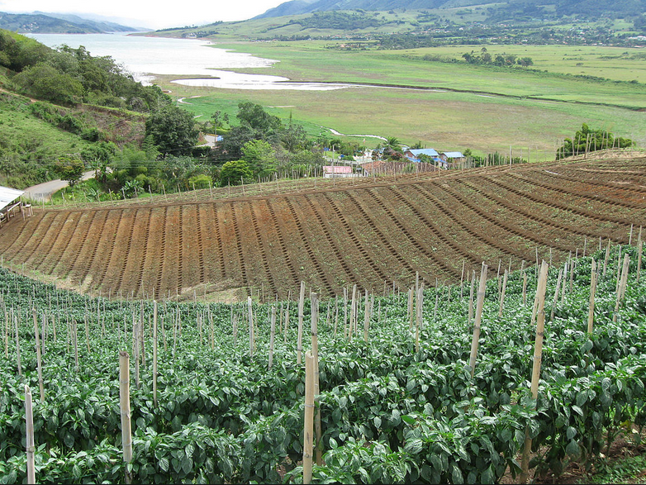
Notes:
Lawrence

Slide 16
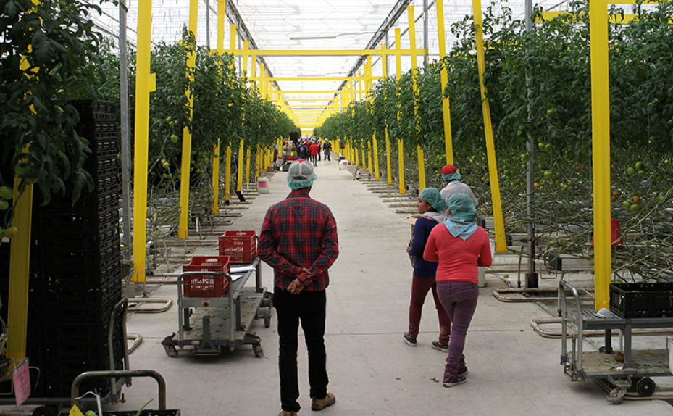
Notes:
Lawrence

Slide 17
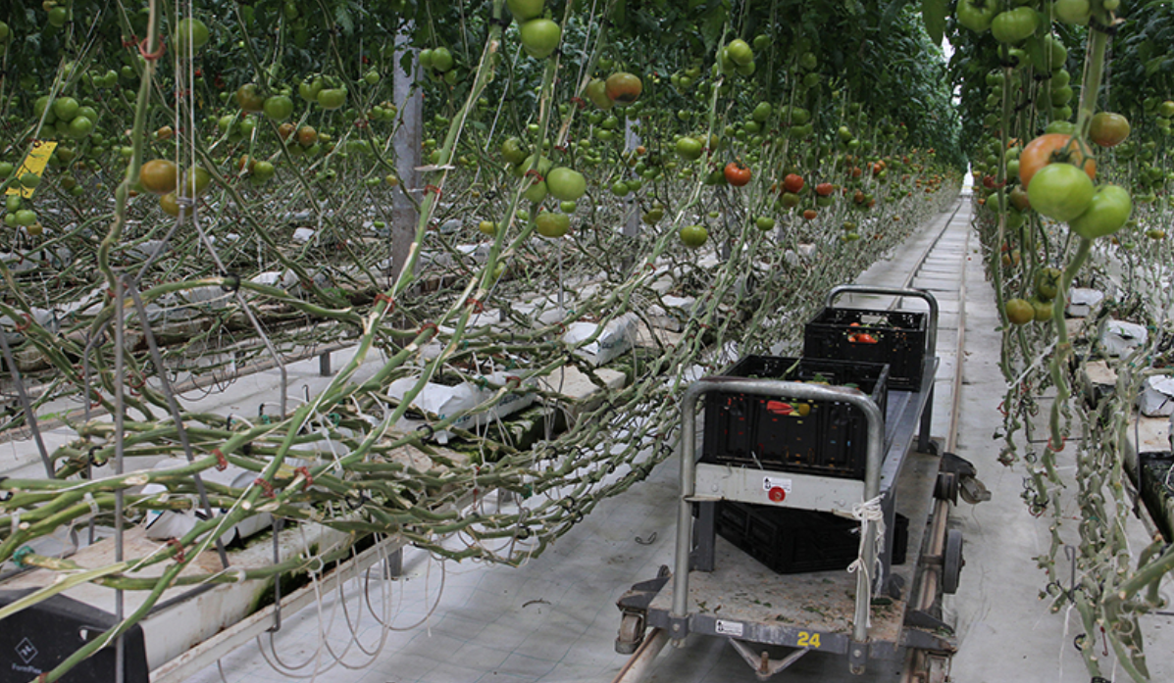
Notes:
Lawrence

Slide 18
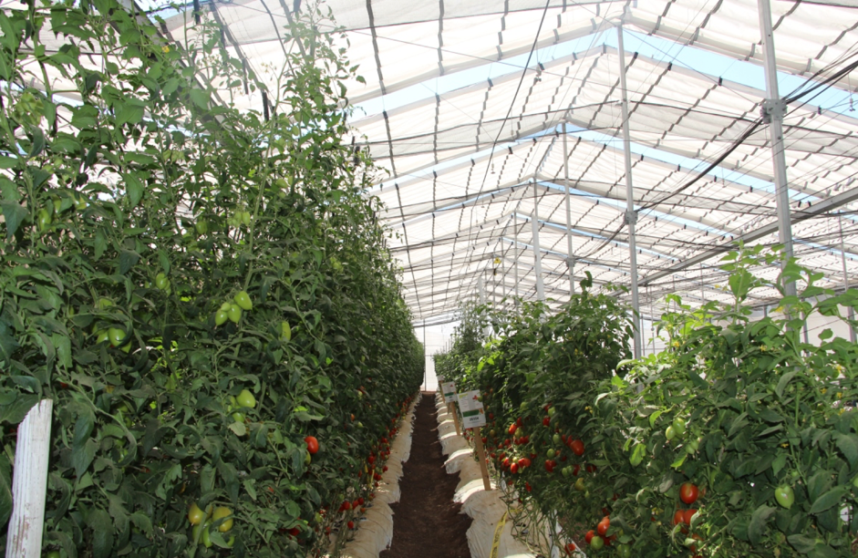
Notes:
Lawrence

Slide 19
Research Focus (2)
Comparisons across multiple sustainability-related dimensions
Productivity
Land and soil requirements
GHG footprint
Vulnerability
Water use
Chemical inputs (fertilizers and pesticides)
Energy use
Waste
Labor issues
All normalized to impact per kg or ton of final product, with % comparisons
Notes:
Lawrence

Slide 20
Research Focus (2)
Comparisons across multiple sustainability-related dimensions
Productivity
Land and soil requirements
GHG footprint
Vulnerability
Water use
Chemical inputs (fertilizers and pesticides)
Energy use
Waste
Labor issues
All normalized to impact per kg or ton of final product, with % comparisons
Notes:
Lawrence

Slide 21
Climate Alignment of Protected Agriculture:
Increased Productivity is the key factor driving improvements.
BAU (open field) | High Tech (current best practices) | Low Tech | Shade House | Medium Tech
22 tons/ha rainfed 40 tons/ha irrigated | 500 - 800 ton/ha (12x to 35x improvement vs BAU) | 100 to 300 tons/ha (2.5x to 13x improvement vs BAU) | Seasonal 120 to 150 tons/ha Year Round 250 to 300 tons/ha (3x to 14x improvement vs BAU) | 400 ton/ha (estimated median) (10x to 18x improvement vs BAU)
Notes:
High tech, medium tech and year-round shade houses demonstrate efficiency gains in the use of energy, water, and chemical inputs, thus lowering GHG emission
Enable a more precise and efficient use of nitrogen-based fertilizers, decreasing waste, improving productivity, and significantly lowers the emissions of nitrous oxide
Waste impacts (e.g. plastic) can be compensated effectively in other areas of the production system when considering embedded versus ongoing emissions
Lawrence

Slide 22
Climate Alignment of Protected Agriculture:
Protected agriculture reduces water consumption per unit of production compared to open-field (m3 of water per ton of tomato produced)
 | BAU (open field) | High Tech (current best practices) | Low Tech | Shade House | Medium Tech
 | 75 m³ /ton | 16 m³ /ton (approx 80% improvement over BAU) | 59 m³ /ton (approx 20% improvement over BAU) | 50 - 70 m³ /ton (approx 7- 33 % improvement over BAU) | 35 m³ /ton (median approx 50% improvement over BAU)
Notes:
High tech, medium tech and year-round shade houses demonstrate efficiency gains in the use of energy, water, and chemical inputs, thus lowering GHG emission
Enable a more precise and efficient use of nitrogen-based fertilizers, decreasing waste, improving productivity, and significantly lowers the emissions of nitrous oxide
Waste impacts (e.g. plastic) can be compensated effectively in other areas of the production system when considering embedded versus ongoing emissions
Lawrence

Slide 23
Climate Alignment of Protected Agriculture:
Protected agriculture is less vulnerable:
BAU multi-year average – 4.4% catastrophic loss due to weather or disease (largely weather driven)
High and medium-tech PA – 0.2% catastrophic loss. 20x vulnerability reduction.
Notes:
High tech, medium tech and year-round shade houses demonstrate efficiency gains in the use of energy, water, and chemical inputs, thus lowering GHG emission
Enable a more precise and efficient use of nitrogen-based fertilizers, decreasing waste, improving productivity, and significantly lowers the emissions of nitrous oxide
Waste impacts (e.g. plastic) can be compensated effectively in other areas of the production system when considering embedded versus ongoing emissions
Lawrence

Slide 24
Climate Alignment of Protected Agriculture: mitigation potential
Protected agriculture can achieve lower GHG footprints per unit of production compared to open-field production because:
 | Cultivation plus construction |  | Cultivation plus plastic only |  | Cultivation only
 | kgCO₂e/ton of tomatoes | Diff. vs. open-field | kgCO₂e/ton of tomatoes | Diff. vs. open-field | kgCO₂e/ton of tomatoes | Diff. vs. open-field
Open-field | 337.71 |  | 337.71 |  | 337.71
High tech | 173.71 | -49% | 161.97 | -52% | 98.19 | -71%
Medium tech | 326.09 | -3% | 302.61 | -10% | 175.05 | -48%
Low tech | 396.85 | 18% | 302.90 | -10% | 272.74 | -19%
Shade-house – year-round | 277.30 | -18% | 245.99 | -27% | 235.94 | -30%
Shade-house - seasonal | 394.80 | 17% | 332.18 | -2% | 317.20 | -6%
Notes:
High tech, medium tech and year-round shade houses demonstrate efficiency gains in the use of energy, water, and chemical inputs, thus lowering GHG emission
Enable a more precise and efficient use of nitrogen-based fertilizers, decreasing waste, improving productivity, and significantly lowers the emissions of nitrous oxide
Waste impacts (e.g. plastic) can be compensated effectively in other areas of the production system when considering embedded versus ongoing emissions
Lawrence

Slide 25
Protected Agriculture - Mexico:
resulting Criteria
Notes:
Sergiu

Slide 26
Scope of the Mexican Protected Agriculture Criteria
PVC film or glass greenhouses
Shade-houses
Supporting infrastructure, such as:
Systems for closure/isolation, precision fertiliser or other chemical application
Non-soil substrates
Air and light control systems
Precision plant nutrition systems
Insect protection
Notes:
Ujala

Slide 27
The requirements of the Mexican Protected Agriculture Criteria: Mitigation
Assets must comply with the mitigation Criteria as follows:
Scale must be greater than one hectare with fully integral (non-permeable) air envelope and production in non-soil substrates; or
Scale must be greater than 10 hectares of shade-house (permeable air envelope) production
Where heating is used, it is only for defense against cold in winter months
Only uses passive cooling, active ventilation is permitted only for managing heat and relative humidity
Where irrigation is used, it must be drip or micro-aspersion only, with monitoring
Commitment to reuse or recycle used plastic sheeting and tubing, with a demonstrable policy or plan
No use of ‘red band’ agriculture chemical products and use of non-EPA and FDA registered products for export market
Notes:
Ujala

Slide 28
The requirements of the Mexican Protected Agriculture Criteria: Adaptation and Resilience
All protected agriculture assets and projects automatically pass on a climate resilience basis
Compliance with best practice is recommended as follows:
Have sealed operations with soil cover and integral air envelope
Produce in substrates
Use water recovery and re-use systems
Notes:
Ujala

Slide 29
Mexican Protected Agriculture: exclusions
Pesticide and/or fertilizer production
Out of scope due to their energy and chemical intensive nature
There is no Criteria to ensure the the production process is low carbon or climate resilient
Installation vehicles
Covered under the Low Carbon Transport Criteria
Can impact the GHG emission profiles of crops if they are not low emission vehicles
Irrigation and other water related infrastructure
Covered under water Criteria, which includes drop and micro-aspersion irrigation
All water infrastructure will remain certifiable under the Water Criteria
Notes:
Ujala

Slide 30
Mexican Protected Agriculture: reporting requirements
The issuer must provide, to the approved verifier, the information necessary to demonstrate compliance with all applicable requirements
Three stages of reporting:
Pre-issuance reporting
Post issuance reporting
Annual reporting thereafter
All requirements must be maintained in compliance for the duration of the bond
Notes:
Ujala

Slide 31
Q&A
Public Consultation is open until 3rd October 2018
Website: https://standard.climatebonds.net/sector/protectedagriculture or
Email katie@climatebonds.net
Notes:
Sergiu

