Slide 1
Green Bonds for Latin America and the Caribbean
Workshop – Green and Sustainable Bonds in Latin America and the Caribbean
Lima, 29 May 2018

Slide 2
Meeting the Requirements of the Paris Agreement
Translate NDCs into energy transition plans
NDCs in LAC: $ 4 trillion in investments required up to 2035
currently available funds are far from sufficient
Crowding in of local private sector / Domestic Resource Mobilization

Slide 3
Green Bonds
What is a Green Bond?
Green Bonds are bonds,
…issued to re-/finance environmentally friendly projects
…earmarked for projects that meet specific criteria (e.g. energy efficiency standards or CO2 savings)
…where the proceeds of the issue are used in a comprehensible and transparent manner
…which provide investors with additional reporting for the financed projects
…which can be issued in the form of corporate bonds as well as project bonds or asset-backed securities

Slide 4
Green Bonds
Possible sectors and projects according to ICMA/Climate Bond Initiative
Categories | Sectors
Renewable Energy | Renewable energy, energy distribution & management, Energy storage
Energy Efficiency | Green building, energy efficient products, processes and systems, waste heat recovery Non-energy GHG reductions
Low-Carbon Transport | National rail and freight systems, urban rail systems, electric vehicles, bicycle transport, transport logistics
Sustainable Water | storm water adaptation investment, investment to deal with rainfall volatility, water treatment and recycling
Waste, recycling and pollution | circular economy activities that lead to lower lifecycle energy and GHG usage
Sustainable agriculture and forestry | Forestry that avoid or substantially reduce carbon loss, and that deliver substantial carbon sequestration, Agriculture that reduces carbon and GHG emission, increases soil based carbon sequestration and improves climate resilience
Climate resilient Infrastructure and climate adaption | bridges, rail, infrastructure to protect against increased rainfall, Information technology and communications

Slide 5
Current activities of KfW in the area of green bonds
KfW promotes sustainability in the capital markets

Slide 6
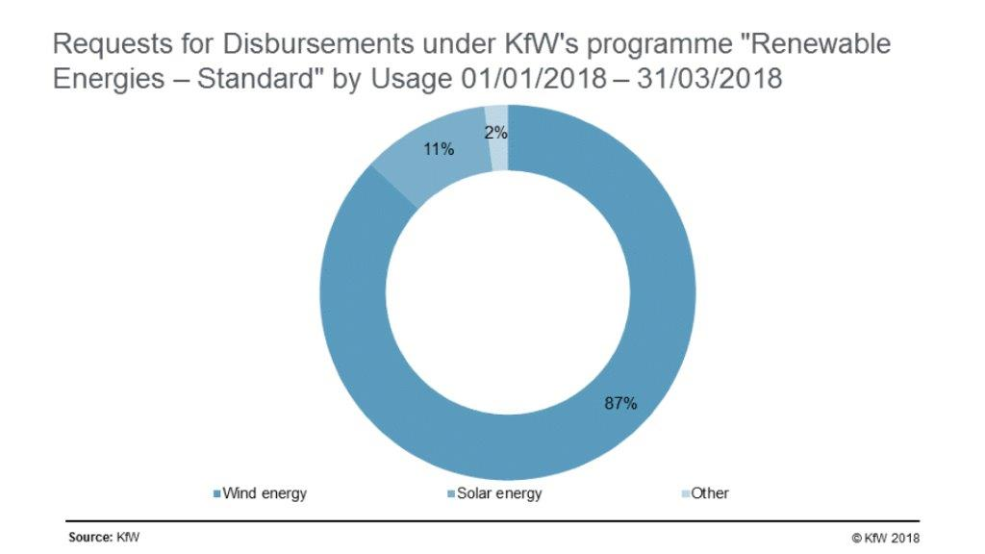
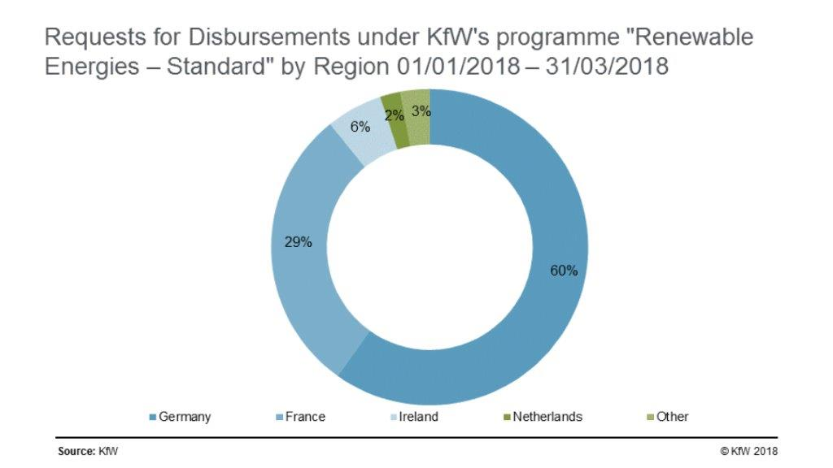
Current activities of KfW in the area of green bonds
KfW one of the largest issuer of Green Bonds (since 2014 EUR 13,4 Bn.)

Slide 7
Latin American Green Bond Fund (LAGBF)
Possible Structure of Anchor Investment Fund
TA
LAGBF
Local institutional investors
Assets
Liabilities
Assets
Liabilities
Green Bonds (max. 30% of a single issuance)
Senior (private int‘l + local)
Other assets
Insurance, bank and pension assets
Mezzanine (DFI, NDB)
Green Bonds
First Loss (KfW/DFI)
Equity
Invest
Green Bonds
Invest
Issuance in local currency
supports
Foreign financing in EUR or USD
Bank / Issuer
No FX-risk
Debt in local currency
Developer / Issuer

Slide 8
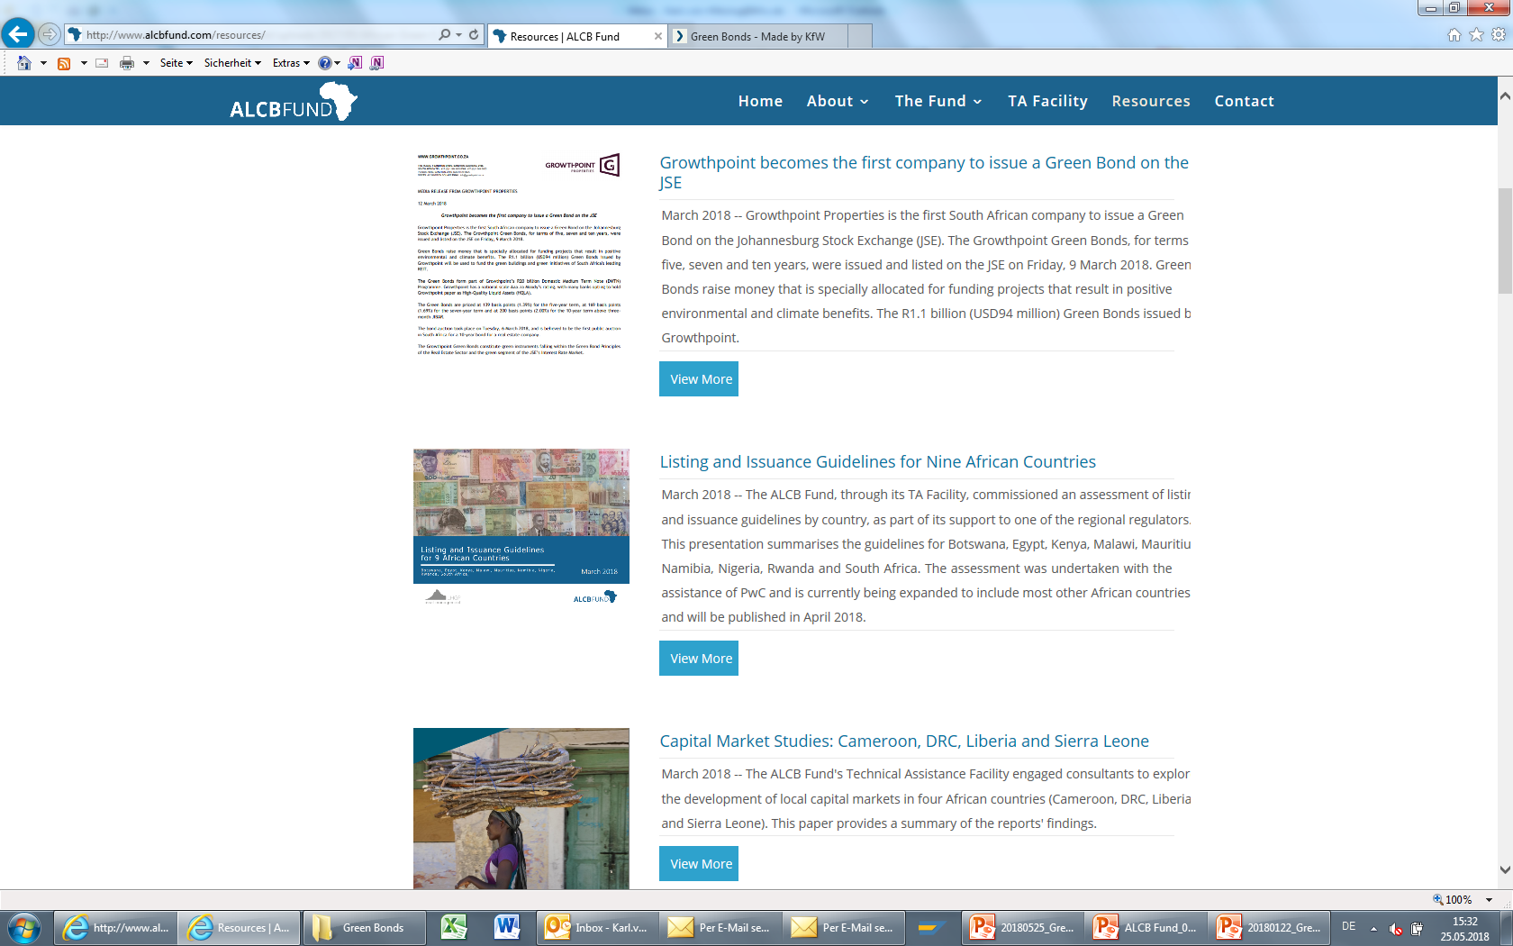
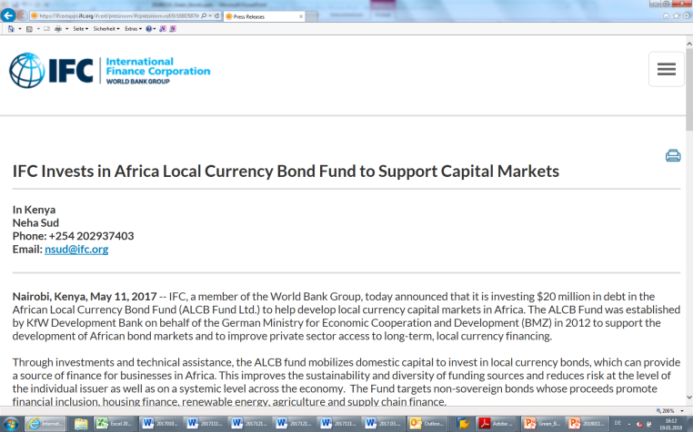
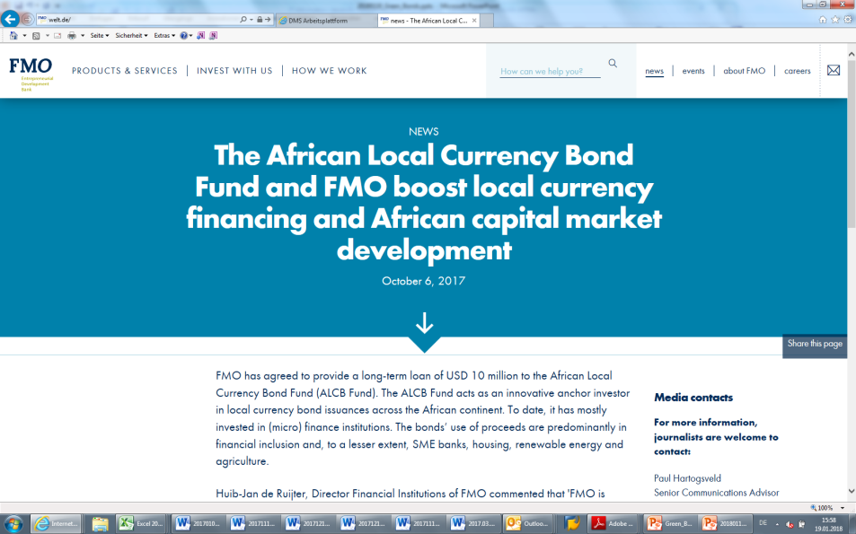
The KfW African Local Currency Bond Fund
Successful example for capital market development through anchor investments

Slide 9
Environmental impact
Green Bonds contribute to the SDGs and climate targets
Green Bonds can help finance SDGs / NDC
Investments in renewable energy and energy efficiency
Investing in climate protection measures such as afforestation etc.
Investment in sustainable infrastructure, such as public transport etc.
Mobilizing international and local investors
CO2 reduction through green bonds
Green Bonds enable large investment in renewable energy and energy efficiency, thereby making a major contribution to reducing CO2 emissions

Slide 10
Effect on capital markets
Green Bonds strengthen the local capital market
Green Bonds mobilize previously inactive local capital
Local currency Green Bonds strengthen local capital markets and eliminate currency risk
ABS-Green Bonds free banks’ balance sheets for additional renewable energy projects

Slide 11
On the road to a LAC Green Bond Fund
Key Features & Next Steps
Key features
Supporting Issuers through Anchor Investment and Technical Assistance
Developing local capital markets through mainly local currency investments
Activating/crowding in local institutional investors in LAC
Financing projects with a measurable positive impact on the energy transition in LAC for NDC finance
High Quality Standards: Green Bonds that meet the Green Bonds Principles / CBI / EU Action Plan
Next Steps
High interest among DFIs and potential investors to join forces
KfW to conduct feasibility study an market research with an international consultant
First Loss Funding of such a fund subject to approval of the German government – Federal Ministry for Economic Cooperation and Development

Slide 12
Latin American Green Bond Fund
Questions?

