Slide 1





Energy Savings Insurance

Slide 2
Understanding
What
What is ESI?
Why
Why is ESI being deployed?

Slide 3
How
How does ESI Work?
Who
Who is taking part in the Programme?
Where
Where is ESI at the moment?

Slide 4

Why is ESI being deployed?
The obstacles ESI overcomes
Lack of Finance
High Risk Perception
Scarcity of products to finance energy efficiency and greener technologies.
Performance risk, technical risk and uncertain returns among others.
Information Faults
No EE Experience
Assymetric and imperfect information send erroneous signals to potential stakeholders.
Lack of experience in the implementation of EE projects.
Low Demand
No interest or low priority on EE on the demand side.
Notes:
The Energy Savings Insurance (ESI) Program overcomes these barriers to investment in EE through the implementation of risk mitigation instruments, its innovative approach is to provide an insurance product that covers projected energy savings for specifically defined and verifiable EE measures as agreed upon in a standard contract between SMEs and technology services providers (TSPs). Its risk-sharing mechanisms compensate firms in the event that promised financial flows associated with EE savings are not realized.

Slide 5



What is ESI?
Mutual benefit and EE
FIs
TSPs
SMEs
Builds Trust
Creates partnership among stakeholders, commitment on actual results.
Notes:
The energy savings insurance is a financial risk mitigation instrument that helps to build trust
between TSPs and firms, and FIs and firms. The insurance acts as the guarantor of the
contract’s performance guarantee and pays a firm the performance guarantee in case a TSP
fails to fulfill its commitment. This instrument reduces a borrower's (a firm’s) risk for credit
payment default.

Slide 6
Programme Mechanisms
Key Steps to Implement
Market Assessment
Financing Structure
Standard Contract
Validation / Verification
Promotion / Communication
Capacity Creation
Energy Savings Insurance
Notes:
The market assessment goal is to identify bankable energy savings projects that incentivize firms to decide to
invest in such a project due to its profitability either with own resources or through loan
Resources.
The financing structure aims to provide financing with competitive and suitable long-term
financing conditions and tackle the lack of financing for EE projects and SMEs. Furthermore,
it is important that the financing is structured to lower the firms’ annual energy and
financing cost, and to ensure that the financing conditions incentivize SME firms to investing
in these types of technologies.
The standardized performance contract overcomes the trust barrier through the
establishment of the “rules of the game”. This is in a market where firms are not used to
buying future energy saving promises and where providers are not used to selling
guaranteed energy savings. Furthermore, the contract also provides the framework for
negotiations between the firm and the TSP and establishes the guarantees and risk
mitigation instruments that improve the credit evaluation process and access to financing.
The validation procedures help to build trust between TSPs and firms, and between firms
and FIs and insurance companies. A third party expert in EE technology conducts the
validation procedures and evaluates the capacity of the project to generate the energy
savings promised.
The promotion/communications plan addresses the lack of priority placed on EE projects
by providing convincing arguments in an accessible way to the target firms.
The capacity building efforts overcome the lack of experience of TSPs and FIs in dealing with
EE projects and in realizing them. Additionally, this mechanism also helps to overcome the
priority barrier as it aims to build TSPs’ and FIs’ understanding of energy efficiency
investment opportunities and risk mitigation instruments.
Finally the insurance mechanism which builds trust between stakeholders.

Slide 7
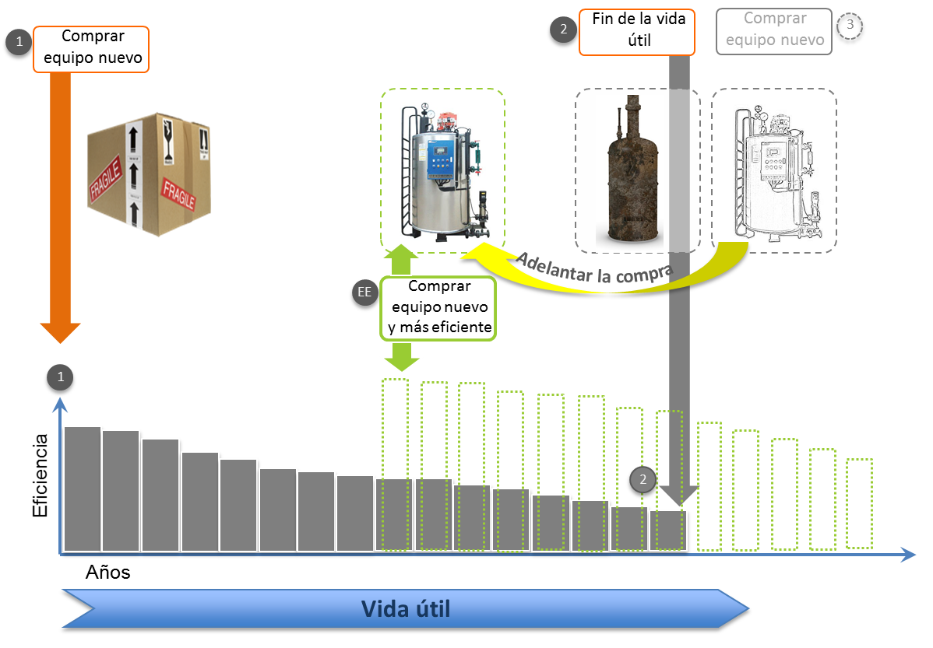
Really, what is ESI?
ESI substitutes inefficient equipment in SMEs
Notes:
With its mechanisms deployed, ESI enhances: i) potential private sector investors to feel confident that their EE projects will generate enough energy savings to pay for the loans assumed and eventually make a profit; and ii) local financial institutions become more aware of the real risk and returns associated with these projects and hence increase their willingness to finance them.

Slide 8
What about cash flows?
ESI guarantees energy savings that pay the loan acquired by SMEs
Notes:
With its mechanisms deployed, ESI enhances: i) potential private sector investors to feel confident that their EE projects will generate enough energy savings to pay for the loans assumed and eventually make a profit; and ii) local financial institutions become more aware of the real risk and returns associated with these projects and hence increase their willingness to finance them.

Slide 9
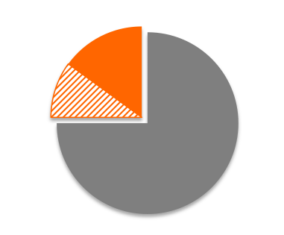
How does ESI compensate SMEs?
Payment and Insurance
Scenario 2
Project total value
Retention
Scenario 1
First payment to supplier
Compensation
Promised savings
$
Achieved savings
Compensation to the client
years
Achieved savings ≥ promised savings
The supplier gets the retention
Achieved savings < promised savings
Retention used to compensate
✓
x

Slide 10
How does ESI compensate SMEs?
Payment and Insurance
Scenario 3
Compensation from
the insurer
Promised savings
Compensation from
the retention
$
Achieved savings
years
Achieved savings < promised savings
Retention and Insurance used to compensate
x

Slide 11
















Who is taking part?
ESI Green Partners
Validators
IFIs
NDBs
SMEs
Insurers
Notes:
Mexico: Validator company: ANCE, insurer: ASERTA.
Colombia: Validator company: ICONTEC, insurer: SURAMERICANA.
El Salvador: Validatos: DQS, insurer: Asesuiza

Slide 12
Where is ESI focused?
Countries – and executing partners
Notes:
NDBs by country

Slide 13



Pilots in Colombia and Mexico
Some supported technologies
Agro-industry
Mexico
Executing partner:
FIRA - Trust Funds for Rural Development
≈ 4,900 enterprises
Target ⇨ 190 projects
Investment ⇨ USD 25 million
Credit Line launched Nov 2015
.
Hotels and hospitals
Colombia
Executing partner: Bancoldex - Bank of Foreign Trade
≈ 1,100 private Hospitals/≈ 6,800 Hotels
Target ⇨ 125 projects
Investment ⇨ USD 25 million
Credit Line launched Jun 2016

Slide 14

Thank you
esi@iadb.org
Inter-American Development Bank
1300 New York Avenue, N.W.
Washington, D.C. 20577, USA.
www.greenfinancelac.org/esi

