Slide 1

Methodology
march, 2017

Slide 2

Designing a balanced MR&V…
We must assume a trade-off …
  Too simple versus too complex
  Too imprecise versus totally accurate
  Cheap versus expensive

Slide 3
Energy Eficiency Projects Scope
Small Equipment
Sustitution
Equipment modernization
EE in complex systems
ESI
Massive
No MRV (estimated)
Small equipments
Cheap
Very small SME
Don´t need to take
an insurance
Semi-Massive
MRV standarized
Medium and
standarized projects
Relative Cheap
SME
Insurable
No massive
Adhoc MRV
Big projects
Expensive
SME
Not insurable

Slide 4

The basis: ISO50006
The new ISO standard oriented to energy baselines and performance indicators
Define energy consumption and use, and the various meanings of energy efficiency
Introduces Energy Performance
Indicators (EnPIs) and Energy Baselines
Give context of quantifying
energy performance

Slide 5
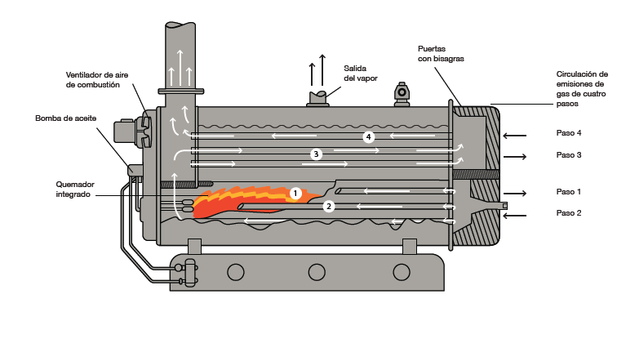
The objective : Quantify energy using indicators
CONSUME
EnPI
Método
PERIMETER
USE

Slide 6
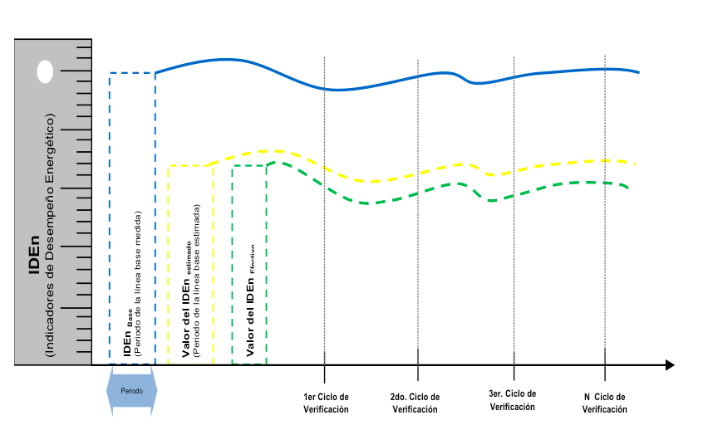
Using standard EE Methodology …

Slide 7
How? Measuring and comparing base line versus new operation
Fuente : Manuales ISO50006

Slide 8
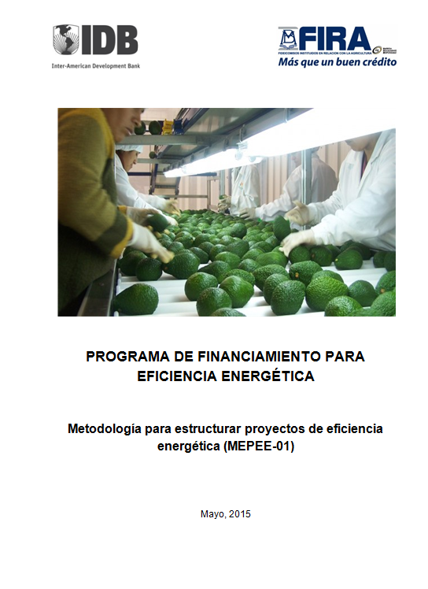
The methodology manuals and tools
To support the project structuring and contract clauses, there are different instruments :
  Manual that describes this methodology and how structure a project to be validated
  Formats that allow structure a project
  Guide to how calculate energy efficiency for each technology

Slide 9
Calculate Energy Savings and
Non-compliance is easy …
Base line EnPI: 0.80 kWh per delivered HP
Proposed EnPI : 0.40 kWh per delivered HP
Measured EnPI : 0.50 kWh per delivered HP
Commit to use : 14,000 delivered HP
Cost of energy : $1.8 per kWh used
The estimated energy saving in the period (6 months)
is 5,600 kWh -> $10,080 MXP.
Non-compliance:
(0.40 – 0.50) X (14,000 HP delivered) X $1.8
The provider must pay $2,520 to the consumer

Slide 10
Considerations
The Methodology sets a fixed price to energy consumed
The consumer agrees to use the equipment in a defined minimun level
The measurement during the base line assesment and verificartion periods is performed using controlled variables and parameters
The contract does not reward a performance beyond savings commitment
Fuente : Manuales ISO50006

Slide 11
THANK YOU !
Ing. Adalberto Padilla Limón
apadilla.energia@gmail.com

