Slide 1

Overseas Private Investment Corporation:
The U.S. Government’s
Development Finance Institution
Using Innovative Financial Instruments to Scale-Up Private Investment in Climate-Relevant Sectors
Lynn Tabernacki
Inter-American Development Bank Headquarters
October 6th, 2014

Slide 2

Overseas Private Investment Corporation
As the U.S. Government’s development finance institution, OPIC mobilizes the participation of U. S. private capital to support sustainable economic development in emerging markets
Since its founding in 1971, OPIC has
supported over 4,000 projects and
provided almost $200 billion of investment
In emerging markets.
  Self-sustaining
  160+ developing countries
  Long Term Project Financing &
  Political Risk Insurance

Slide 3



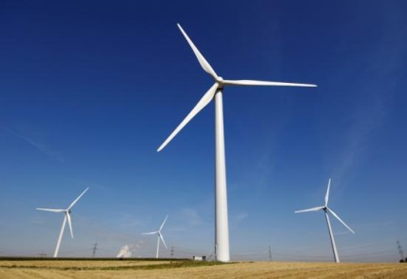
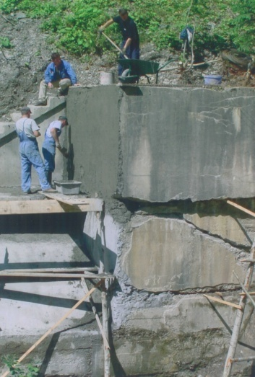
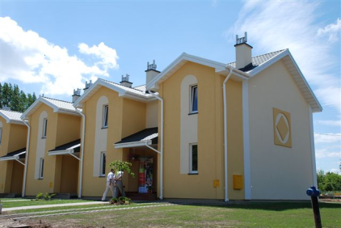
Over $1.0 Billion in commitments to Renewable Energy Projects each year for the last 4 years
Important priority
representing 1/3 of all commitments in each year

Slide 4
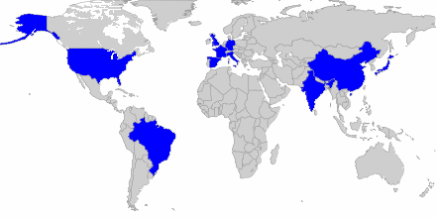
The Global Renewable Energy Market
Total World Market for Renewable Energy Investment in 2013 =
$214 billion
Top 10 countries account for $164 billion in investment,
nearly 77% of all investment in 2013

Slide 5
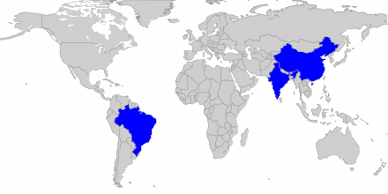
Investment in Developing Countries
Renewable Energy investment in Developing Countries in 2013 was approximately $93 billion*
China, Brazil and India had renewable energy investments in 2013
of $65 billion (70% of total)
* Global Trends in Renewable Energy Investment 2014; Bloomberg New Energy Finance

Slide 6
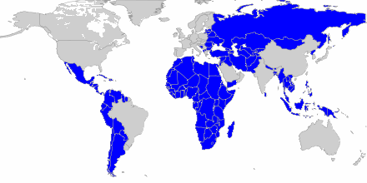
The Obvious Opportunity
Renewable Energy investment in All Other Developing Countries in 2013 was approximately $28 billion
Emerging Markets are the Renewable Energy Frontier

Slide 7
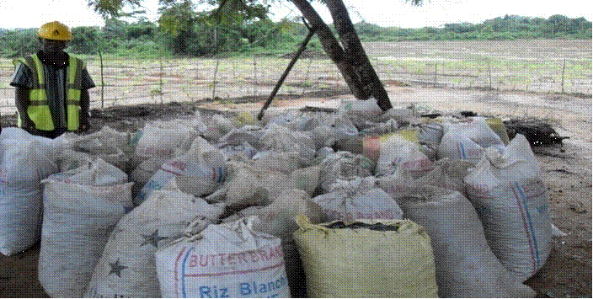
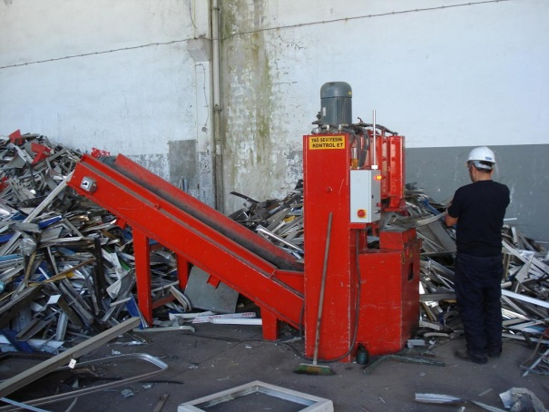
DFI’s Role: Fill the Market Gaps
In many markets, the DFIs must step in when private banks are absent and to provide demonstration effect to build confidence in markets.
Design products for traditional project development and implementation
Support SME investors and small projects generally
Address the gap in equity funding for typical equity risks
Provide technical advice to governments for ensuring bankable transactions

Slide 8
Everything Doesn’t Work Everywhere
The solutions vary and will depend on the attributes of the market.
Each project has its own solutions
Energy Efficiency Solutions
Distributed Generation
Utility Scale Generation
Low cost, immediate, energy savings solutions
Self-generation both on-grid and off-grid
Grid connected for large scale energy usage
Private sector: residential, commercial, & industrial buildings
Public sector: office buildings, hospitals, schools, streetlights
System sizes range by building, village, or region
Varied technologies for residential, commercial, industrial
Government purchases from Independent Power Producers
Energy mix is key to optimizing the system
8

Slide 9
Energy Efficiency Leasing Solution
Current
Billing and Payment
Billing and Payment after LED-Smart Lighting
MONTHLY
STREETLIGHT
ELECTRICITY
CHARGES
MONTHLY
CASH
SAVINGS
Available for Monthly Lease Payment
Budget Allocation for Streetlight Usage
Budget Allocation for Streetlight Usage
MONTHLY
STREETLIGHT
ELECTRICITY
CHARGES
Energy Use 100%
Energy Use 45%

Slide 10
Streetlight Financing trust structure
Budget Allocation for Streetlight Electricity Usage
Maintenance Budget
STREETLIGHT TRUST
(Receives two sources of monthly cash flow from the Budget)
Monthly Payment to Utility
Taxes
Trust
Expense
Total Lease Payment
OPIC Debt Service
Lease Payment Reserve & Maintenance Reserves
Investor Returns
Residual Budget Allocation & Maintenance Savings to Host Government

Slide 11
Streetlight Financing trust structure
Host Country
Increases public safety, reduces accidents and promotes commercial enterprise.
The Utility
Assurance of payment as Budget Allocation flows directly from the Trust.
Demand side improvements delay need for new power generation.
Residual cash flows are returned to the Municipality in both current and long term.
Shows progressiveness in implementing energy efficiency.
The Investor
Provide solutions without major long term expenditure.
Ability to expand business and easily replicate for other markets
OPIC
Access to stable, predictable cash flows for repayment of the debt.
Consistent with mandate to support development by catalyzing the private sector.
Promotes global energy efficiency initiatives.
Access to stable, predictable cash flows for investor returns.
Accuracy in tracking monthly streetlight electricity usage, maintenance and billing.

Slide 12
Distributed Generation Financing Solutions
Distributed Generation project sizes are generally fairly small.
Solutions must keep transaction costs down.
Aggregate
Replicate
Individual projects can bear their own financing
Key project attributes are comparable across portfolio
No project can impact the portfolio’s overall performance
Diversified risks can be achieved
Underwriting risks differ across projects
Necessary across countries/regions where differing legal regimes impact financing
Key project attributes are not comparable across portfolio
It’s possible to bundle a large number of small projects
When:
When:
12

Slide 13



Solutions with Traction
Many projects do not progress simply due to lack of capital for
development and equity risk
Aligned capital
Demand dividends
Green Bonds or Guarantees
More and more funds….

Slide 14





Important Features of Bankable Power Purchase Agreements
For Renewable Energy Power Projects
A bankable power purchase agreement (PPA) is essentially a long term offtake agreement executed with a creditworthy offtaker and having a sufficient tenor to enable repayment of debt by providing an adequate and predictable revenue stream. The following are important features to include or consider in such agreements.
Dispatch Risk: There are two structures generally-accepted by lenders for mitigating the risk that the offtaker may not dispatch the generating facility.
  Take or Pay: The offtaker pays a fixed tariff comprising a capacity charge (a fixed amount that is paid for available capacity (no dispatch required) and an output charge (an amount paid in respect of energy actually delivered). This permits the power producer to cover its fixed costs with the capacity charge, including debt service, fixed operating costs, and an agreed equity return.
  Take and Pay (typical for wind and solar): The offtaker must take, and pay a fixed tariff for all energy delivered (no dispatch required). If energy cannot be physically taken by the offtaker and output is “curtailed”, energy will be calculated and paid for on a “deemed” delivered basis.
Fixed Tariff: It is important that the revenue of any PPA, whether “take or pay” or “take and pay”, be a fixed amount per kWh generated to adequately cover the cost of operating the facility, repay the debt and provide a reasonable return on equity.
Foreign Exchange: In order to avoid subjecting the power producer to currency risk, the PPA should be either denominated in or linked to an exchange rate of the currency of the power producer’s debt, and there should be no limitation or additional approvals required to transfer funds to offshore accounts as required.
Change in Law/Change in Tax: The agreement should explicitly state which party takes the risk of the law or tax regime changing after the date of the agreement in such a way as to diminish the economic returns of the transaction for such party (e.g., increase in taxes on power producers reducing the producer’s returns). In order for PPAs to be bankable, most lenders require the offtaker to take this risk.

Slide 15
Important Features of Bankable Power Purchase Agreements
For Renewable Energy Power Projects (continued)
Force Majeure: The agreement should excuse the power producer from performing its obligations if a force majeure event (an event beyond the reasonable control of such party) prevents such performance. The allocation of costs and risk of loss associated with a force majeure event will depend on the availability of insurance and in some cases the degree of political risk in the country/region.
Dispute Resolution: The agreement should provide for offshore arbitration, in a neutral location, under rules generally acceptable to the international community (e.g. UNCITRAL or LCIA or ICC).
Termination and Termination Payments: The PPA should set out clearly the basis on which either party may terminate the PPA. Termination by the offtaker may leave the project with no access to the market and thus should be limited to significant events. The agreement should provide that if the PPA is terminated for any reason, then in case of transfer of the facility to the offtaker, the offtaker shall provide a termination payment at least equal to the full amount of the power producer’s outstanding bank debt, and in the case of the offtaker’s default, a return on equity.
Assignment: The PPA should allow collateral assignment of the agreement to the power producer’s lenders with the right to receive notice of any default and to cure such default. Additional step-in rights are generally set forth in a separate direct agreement between the lenders and the offtaker.
Offtaker Payment Support: Depending upon the size of the project and the creditworthiness of the offtaker and the development of the energy sector in a certain country, short term liquidity instrument, a liquidity facility and/or a sovereign guaranty will be required to support the offtaker’s payment obligations.
Transmission/Interconnection Risk: The PPA should indicate which party bears the risk of connecting the facility with the grid and transmitting power to the nearest substation. The more significant these risks (due to terrain, distance, populated areas), the more the lenders will require the offtaker to bear all or a significant portion thereof.

Slide 16
Other Attributes of Bankable Projects
OPIC can provide limited recourse fixed-rate debt financing of up to $250 million per project and with up to 20 year tenors.
Creditworthy offtaker
Equity requirement
Experienced and committed management team
Proven technology and creditworthy EPC contractor with a strong track record
Ample availability of renewable resource
Financial projections exhibiting strong cash flows and maintenance of minimum DSCRs
16

Slide 17
Thank You
Lynn Tabernacki
202-336-8502
Our Website
opic.gov
Lynn.Tabernacki@opic.gov
Managing Director, Renewable Energy and Sustainable Development

