Slide 1

Status Update
Green Climate Fund
Hela Cheikhrouhou
Executive Director
Green Climate Fund
Washington DC, 7 October 2014

Slide 2
Outline
I. GCF status Update
II. Collaboration with NDBs
III. Opportunities
COP.20 in Lima – expectations
NY Climate Summit – what we heard

Slide 3
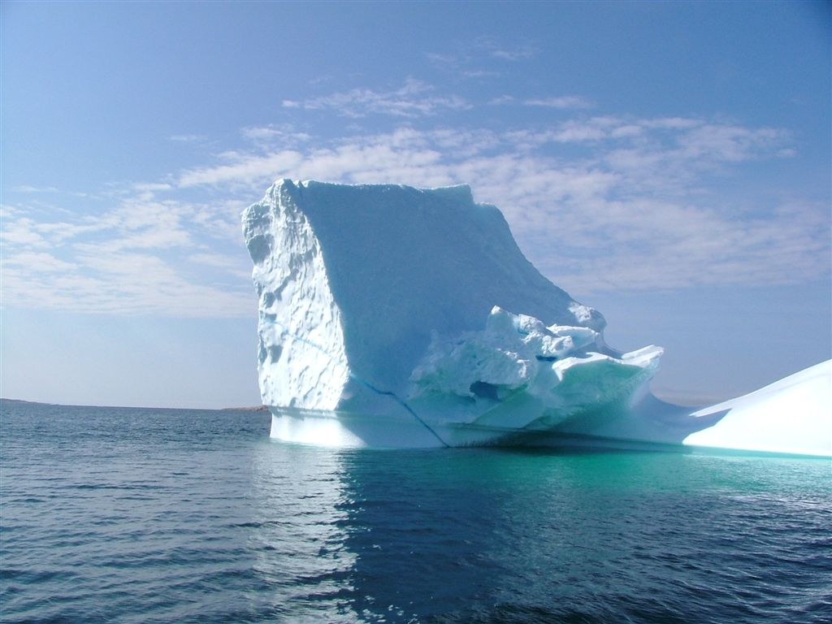
I. GCF Status Update

Slide 4
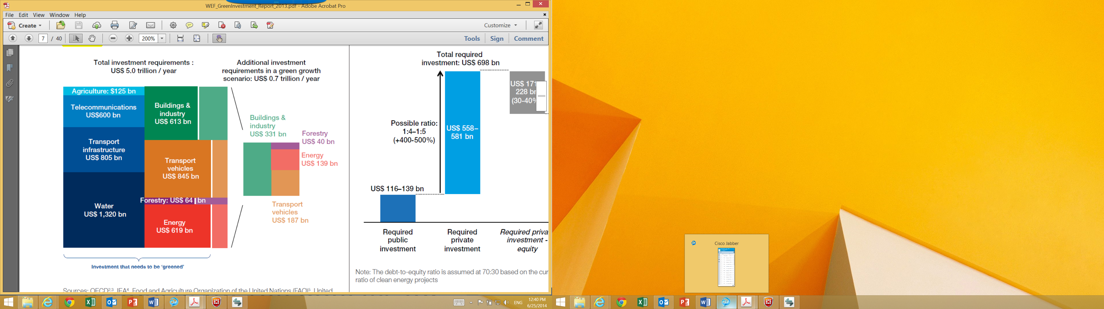
Greening developing countries’ investments is costly
Source: World Economic Forum

Slide 5
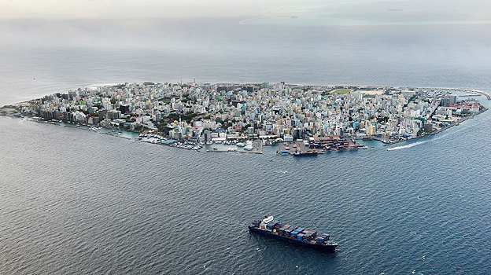
Tens to hundreds of billions of USD in additional finance are needed for adaptation in developing nations

Slide 6
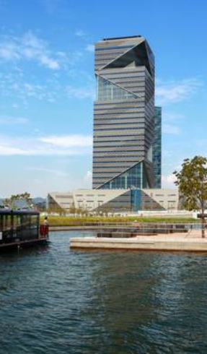
What is the Green Climate Fund?
New multilateral fund for climate finance
Agreed by the 194 Parties to the UNFCCC
Provide support to developing countries
Mitigation – reduce GHG
Adaptation – adapt to unavoidable impact
GCF Headquarters in Songdo, Republic of Korea

Slide 7
Our vision
Promote a paradigm shift towards
low-emission and climate-resilient development
Induce a change in daily decisions
investors and consumers make

Slide 8
Increased resilience of people and communities
Food and water security
Reduced emissions from land use and forests
GCF Strategic Impacts
Reduced emissions in buildings and cities
Increased resilience of ecosystems
Increased resilience of infrastructure
Reduced emissions in energy
Reduced emissions in transport

Slide 9
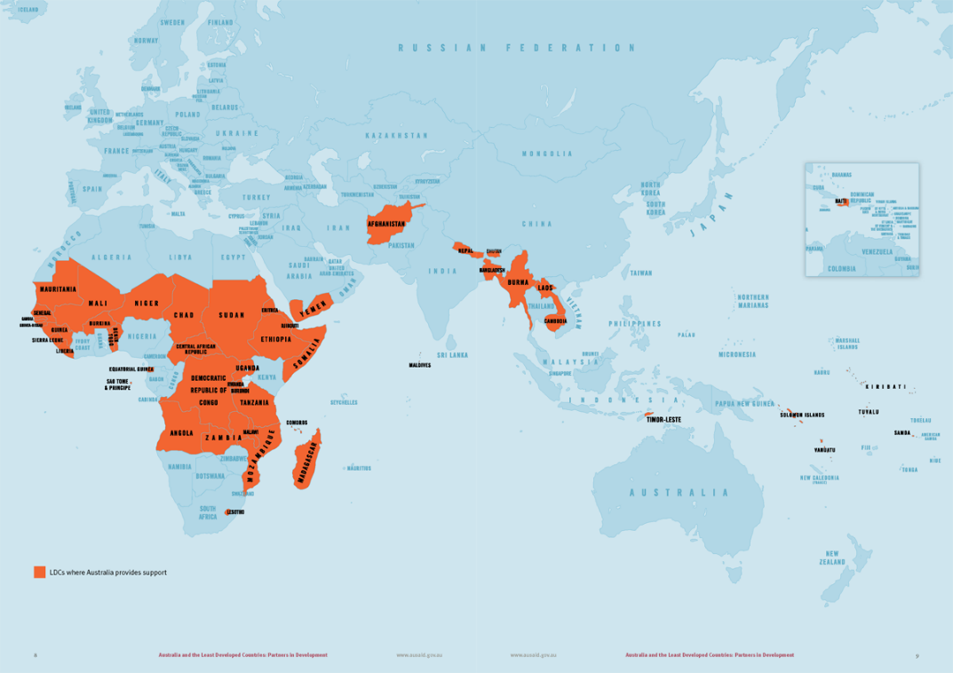
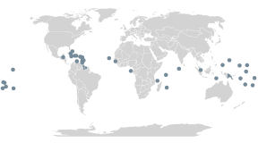
Balance of adaptation & mitigation actions

Slide 10
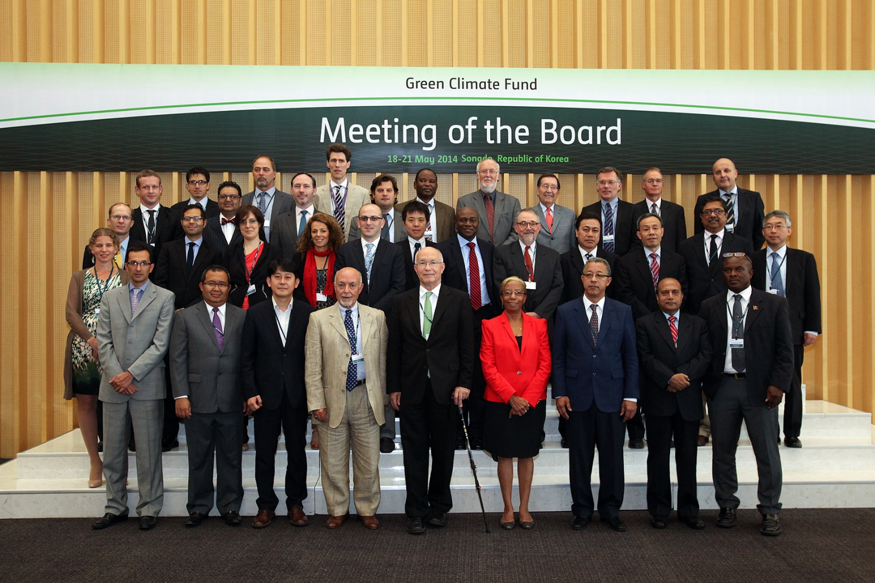
GCF’s Board

Slide 11
Access to funds
Access to resources can be obtained through national, regional and international entities;
Country driven approach through National Designated Authority;
Project and programme based approaches;
Best practice fiduciary, environmental and social standards.

Slide 12

II. Collaboration with NDBs

Slide 13
Collaboration with NDBs
How will it work?
Nomination of National Designated Authorities (NDAs)
NDA to drive strategic prioritization of climate action with the Fund
Funds intermediated by Implementing Entities (IEs) & Intermediaries

Slide 14
Accreditation:
Implementing Entities & Intermediaries
Accreditation process
  Stage I: No-objection & readiness
  Stage II: Accreditation Review and decision
  Stage III: Final arrangements
Complementarity and coherence with accreditation processes of other funds
Specialized fiduciary requirements for programmatic and structured intermediation.

Slide 15
Project & Programme Activity Cycle (I)
Country work programme (Voluntary Step)
Concept Development (Voluntary Step)
Submission of Funding Proposal
Analysis and Recommendations to the Board
Board Decision
Legal Arrangements

Slide 16
Project & Programme Activity Cycle (II)
Post-Approval
Implementation Period
Commissioning / Launch
Impact Period
Debt servicing / Closure

Slide 17
Initial Portfolio Targets
Balance between mitigation & adaptation (50% over time)
Floor of 50% of adaptation funds to
LDCs, SIDS, and African states
Geographic Balance
Maximize engagement with Private Sector
Readiness and Preparatory Support

Slide 18
Initial Investment Criteria
Impact Potential
Paradigm Shift Potential
Sustainable Development Potential
Needs of Recipient
Country ownership
Efficiency and Effectiveness

Slide 19
Coordination between NDBs & NDAs
Funding proposals will be submitted through NDAs – the interface between each country and the Fund.
NDAs will communicate the country’s strategic priorities for financing low-emission and
climate-resilient development across its economy.
NDAs will be the primary source of information about the Fund at the national level: important to ensure close coordination between NDBs and NDAs.

Slide 20
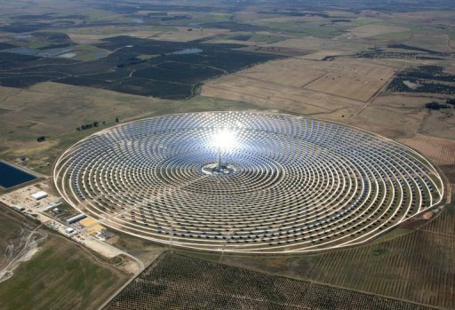
III. Opportunities

Slide 21
Make the best investments viable
...with the least concessionality possible
Without GCF
With GCF
High upfront capital expenditure
Insufficient revenues
Excessive risk
Buy down upfront cost
Cash flows eased
Higher risk tolerance

Slide 22
Mobilizing the Private Sector
$87 trillion
World GDP 2013
$58 trillion
Private sector value added
$0.01-$0.07 trillion
Private finance to climate change
0.02%-0.1%
Private climate flows vs. value

Slide 23
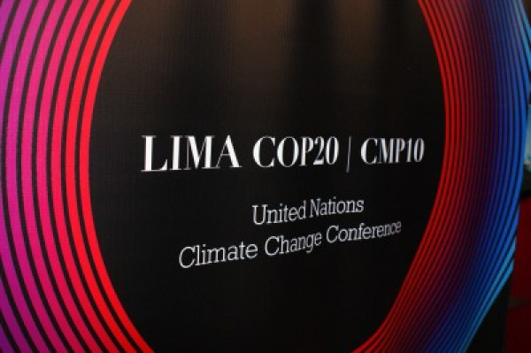
IV. COP.20 in Lima

Slide 24
Managing Expectations
Climate Finance needs to be in place if we are to move towards a deal in Paris
Lima will be a test for whether we are on track
Countries need to meet their responsibilities, so that the Fund can fulfill its mandate

Slide 25


Slide 26
Initial Resource Mobilization
Pledges made to date
Country | Pledge (USD million)
Germany | 1,000
France | 1,000
Korea | 100
Switzerland | 100
Denmark | 70
Norway | 33
Mexico | 10
Luxemburg | 6.5
Czech Republic | 5.5
Total | ~ 2,300

Slide 27
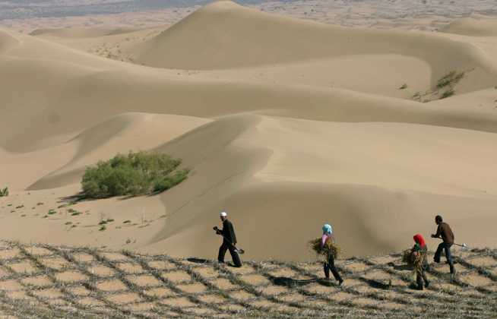
GCF Pledging Meeting
Nov. 20 in Berlin, Germany
Hosted by German Ministers of
Environment & Economic Cooperation & Development
25+ countries participated in GCF’s Initial Resource Mobilization meetings in June and September

Slide 28
Get involved
secretariat@gcfund.org

