Slide 1
unep fi & energy efficiency Finance
Sarah Challe – Energy Efficiency Finance Specialist, UNEP Finance Initiative
Overview
Why energy efficiency finance?
Policy engagement
Mobilization of the financial sector
Sharing best practices: Banks’ energy efficiency financing
November 15th-16th, Lima

Slide 2
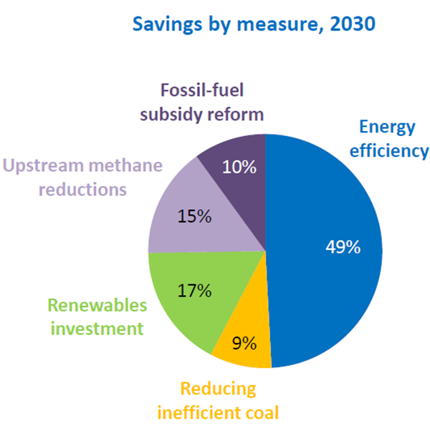
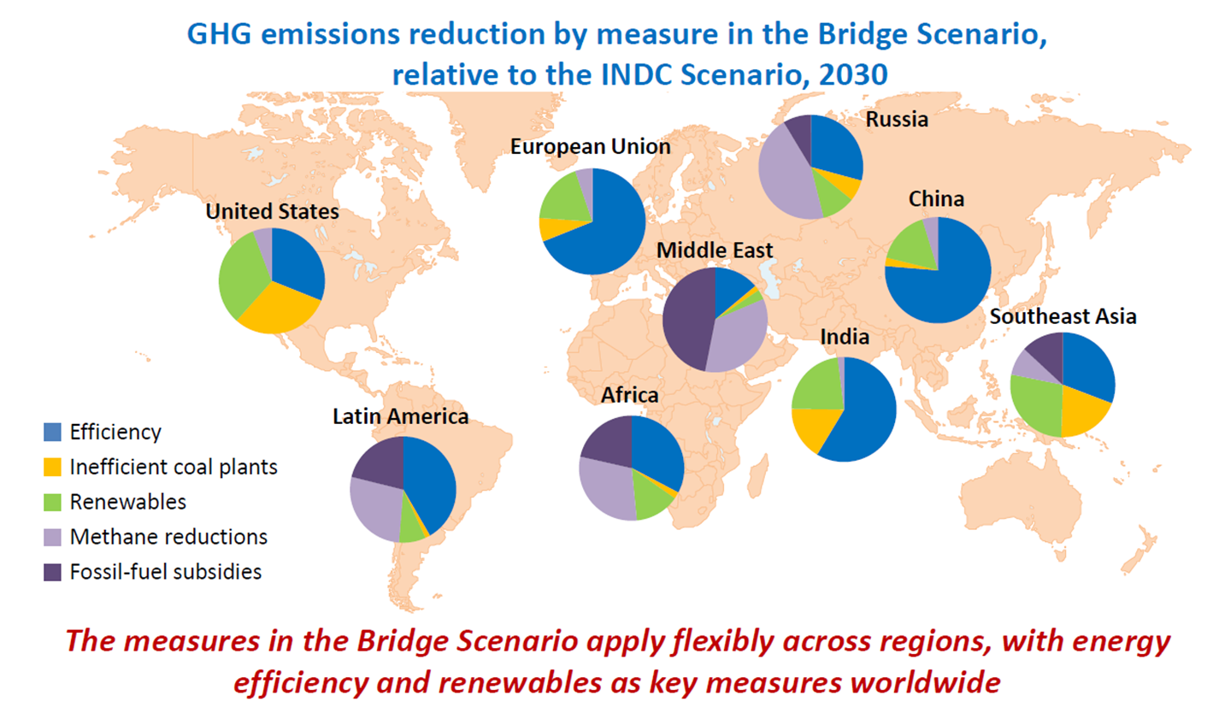
1/ Why energy efficiency finance?
Energy efficiency is the #1 climate action
IEA Energy and Climate Change WEO Special Report 2015
According to Sustainable Energy for All, the energy efficiency investment gap amounts to $430 billion annually

Slide 3
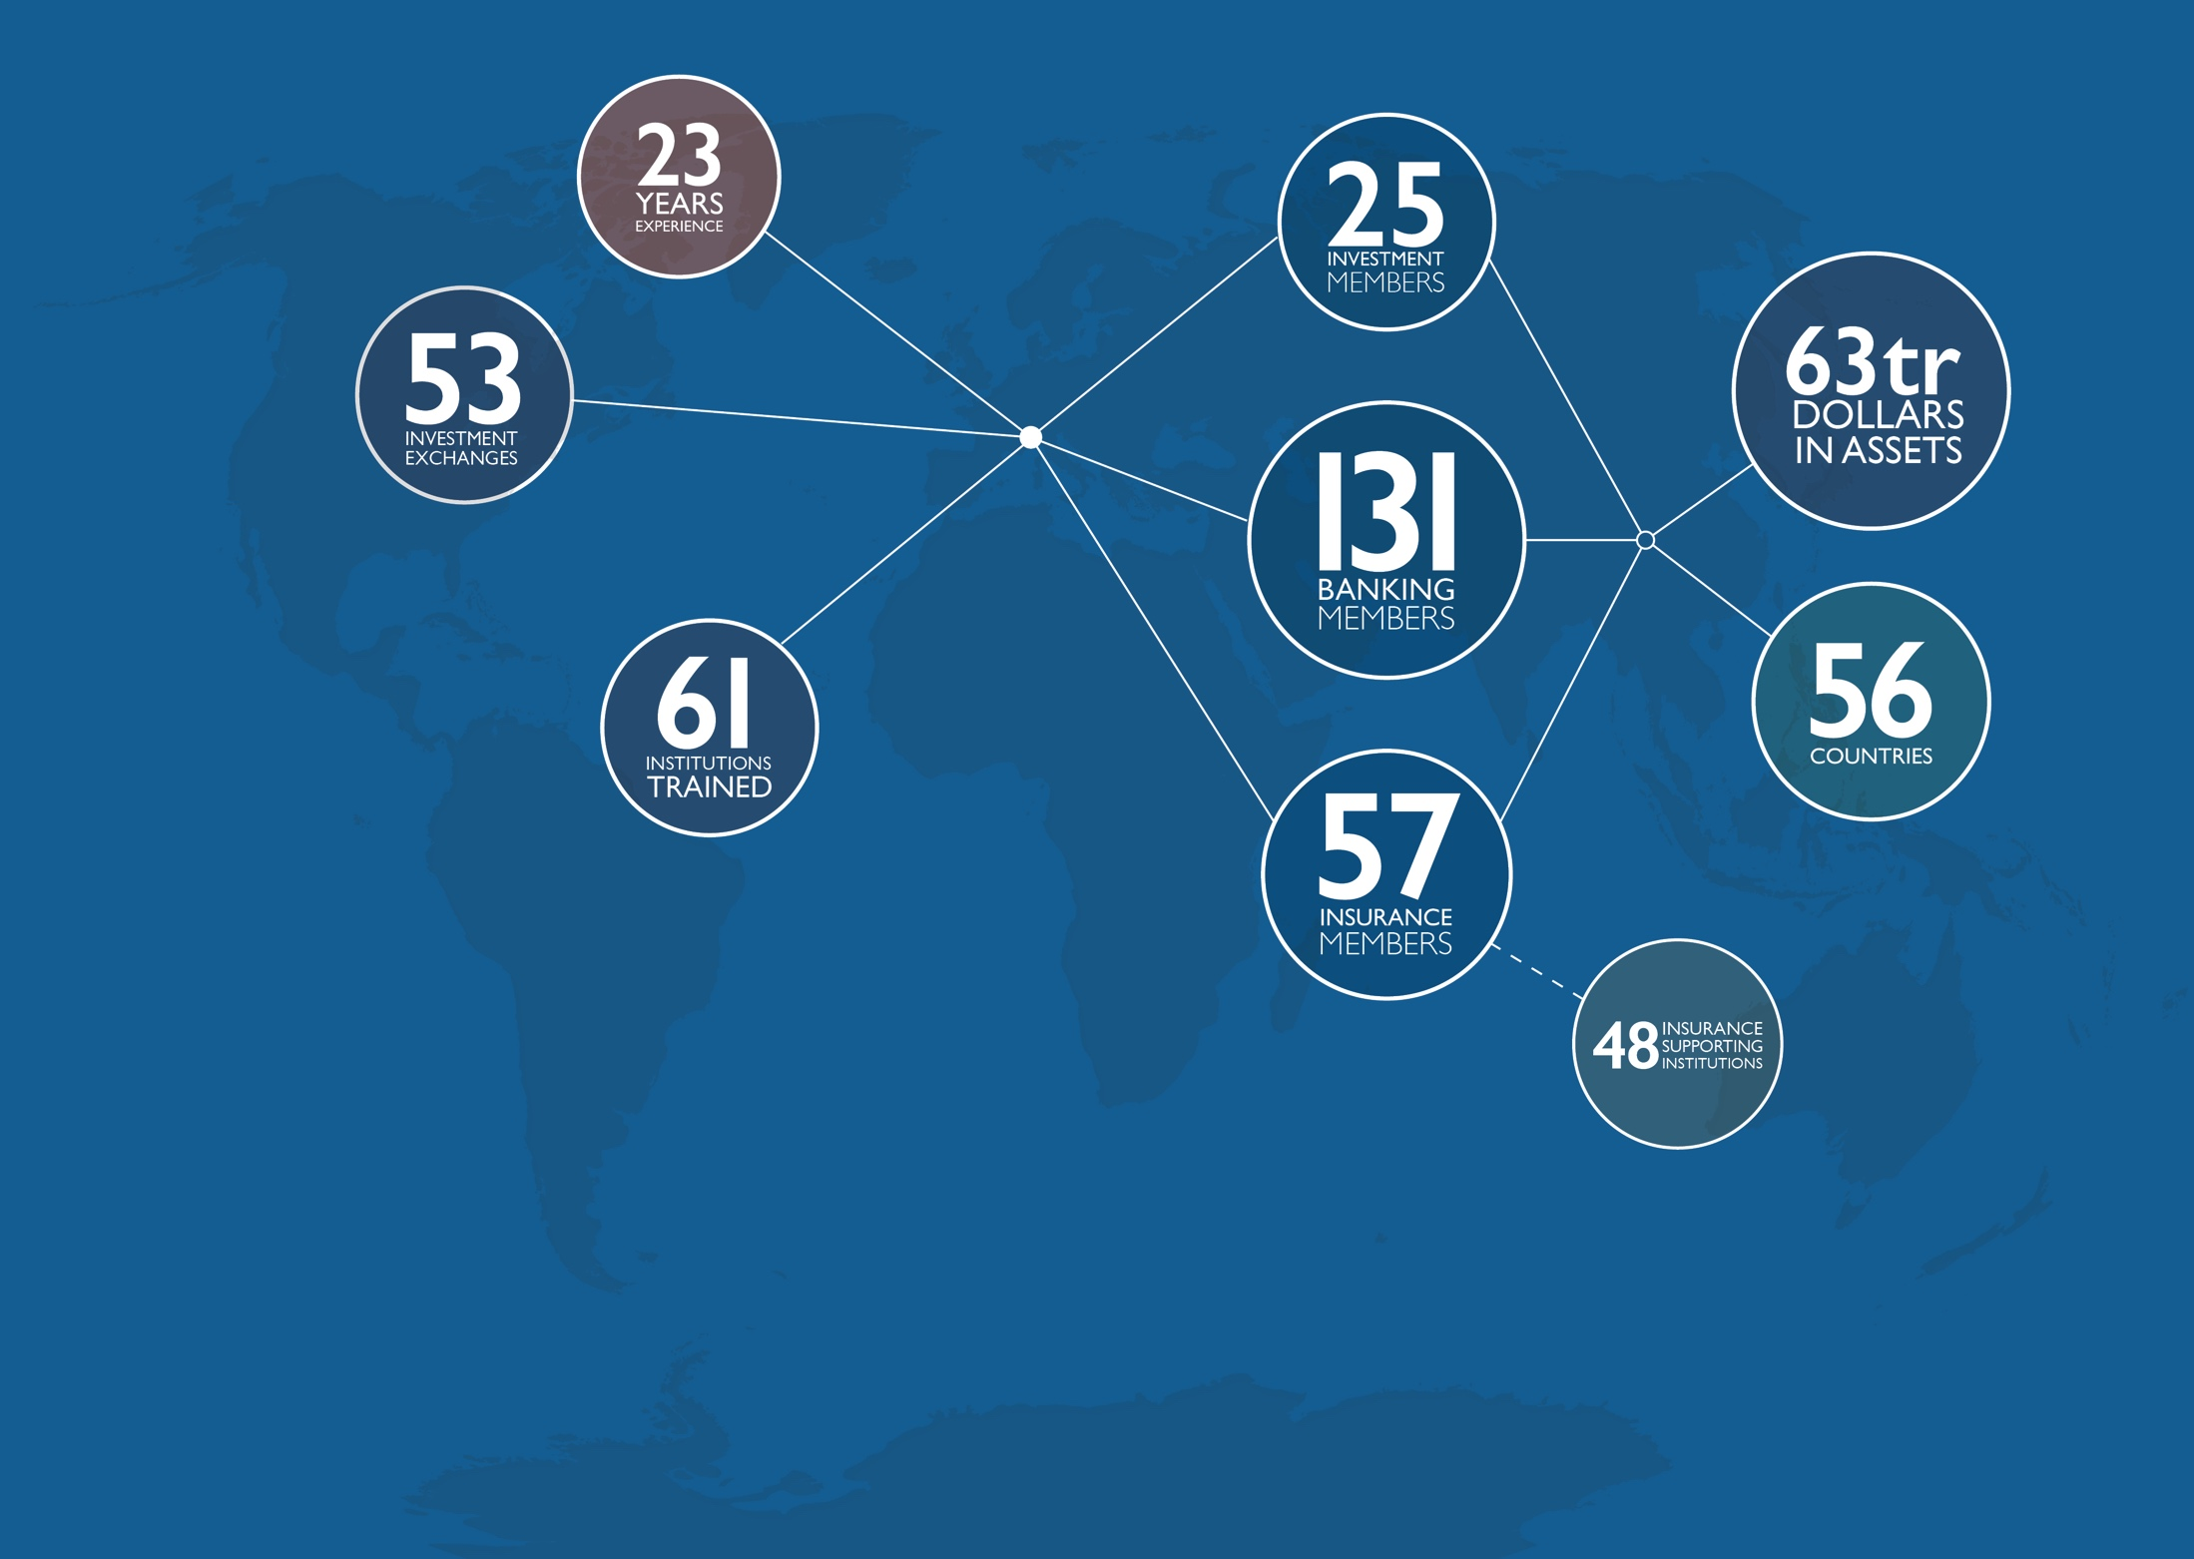
UNEP FI’s leading role in EE FINANCE
A unique partnership between UN Environment and the private financial sector covering banks, investors, insurance
UNEP FI in a nutshell
CHANGING FINANCE – FINANCING CHANGE
Connecting finance with energy efficiency policy
Facilitate exchange of experience and best practices among financial institutions

Slide 4


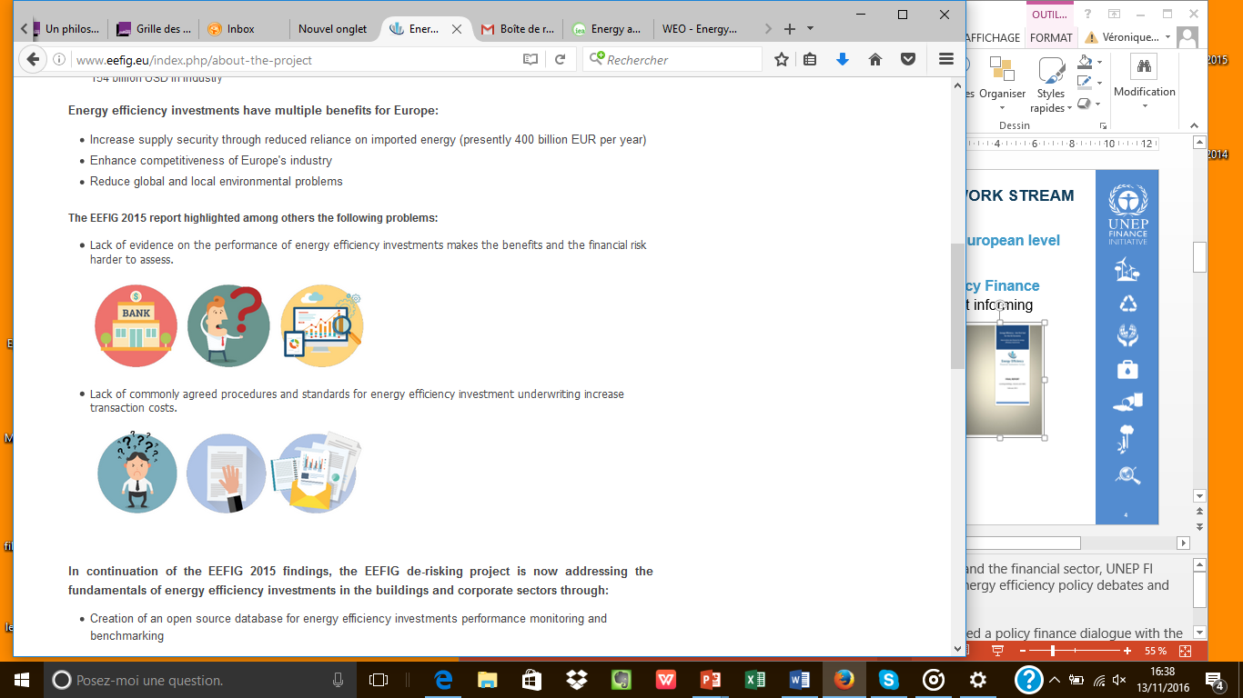
2/ policy engagement (Europe)
Co-convening policy dialogues at the European level
18 months work of the Energy Efficiency Finance Institutions Group → reference Report informing European energy policy
Strengthen investor confidence through increased EE investment information → DEEP database of >6000 projects
Bring policy/finance dialogue to national level in 15 countries next 3 years

Slide 5
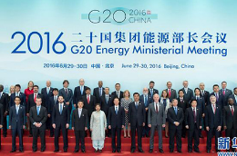















2/ Policy engagement (g20)
Member of G20 Energy Efficiency Finance Task Group (EEFTG) Secretariat
EEFTG gathers 14 countries to promote high-level investment enabling policy frameworks
“Voluntary Energy Efficiency Investment Principles for G20 Participating Countries” welcomed by G20 Energy ministers and embedded in the G20 Energy Efficiency Leading Program adopted in 2016

Slide 6









Extensive outreach: g20 eeftg reached 1,200 experts
EEFTG already engaged with around 1,200 individuals through a programme of 18 workshops, contributions to G20 and related activities in Europe, USA, China and Latin America
95
45
24
470
*Map in this section indicates events
& number of participants
45
135
210
*including Webminar
95
EEFTG Survey
72
*Webinar

Slide 7
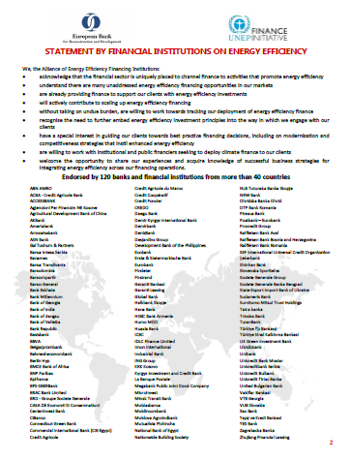
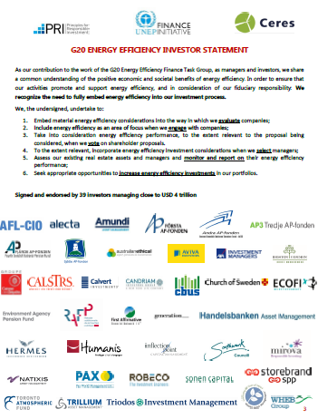
3/ Mobilization of the financial sector
UNEP FI leads the engagement with private finance
Leadership signal through a global mobilization of banks and investors on Energy Efficiency Statements

Slide 8
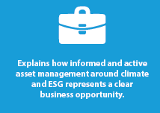
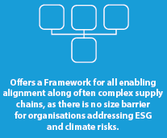
Facilitating learning through tools and dissemination
Support & disseminate innovative initiatives
ex: Energy efficiency mortgages
Capacity building & tools
ex: Sustainable Real Estate Investment Guide, Energy Productivity Index Companies

Slide 9
4/ Sharing experience & best practices
Energy efficiency survey of banks: What did the survey say?
A well recognized opportunity: Large majority of respondents have energy efficiency financing activities and see it as an area of future growth
Awareness raising and supportive policies are crucial to stimulate demand and overcome barriers to market development
Tracking of energy efficiency finance: Banks are deploying efforts to better track the volume of financing going to energy efficiency assets and projects

Slide 10
NEXT steps
Continued policy engagement
  Continued engagement with G20 policy makers
  Policy dialogues in Europe
  Expand mobilization of financial institutions
Enhancing knowledge & sharing best practices
  Work on energy efficiency investment gap data
  Develop and disseminate best practice case studies

Slide 11
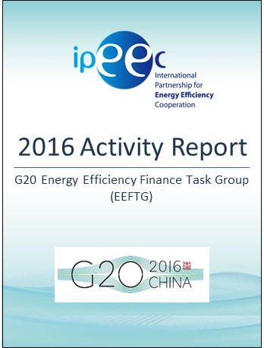
THANK YOU!

