Slide 1
"SOLID WASTE MANAGEMENT FOR ENERGY PRODUCTION"
Héctor A. Rosario A.
General Coordinator, IIBI
March 9th., 2015
Seoul,Korea
Green Technology Center, Seoul, Korea

Slide 2
Ten years ago (on February 10, 2005), with the guidance and vision of the government project designed by the then President of the Dominican Republic, Dr. Leonel Fernández, the Institute for Innovation in Biotechnology and industry, was established through the Presidential Decree 58-05.

Slide 3
MISSION
Conduct the scientific research, technology transfer, innovation, and technical consulting in relevant areas for the national development in order to improve the competitiveness of the nation.

Slide 4
VISION
Being a leader national institution in scientific research and technical consulting, helping to improve national competitiveness internationally.

Slide 5
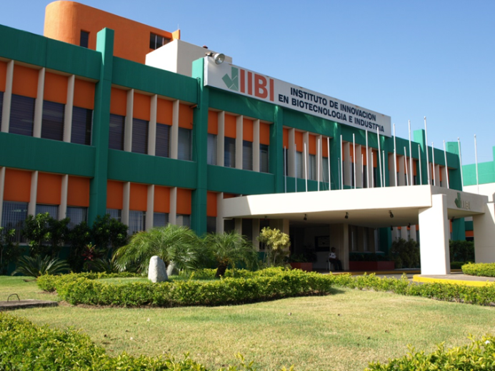
The IIBI is created with an specific mandate to implement institutional research, development and innovation in industrial technologies, emphasizing in biotechnology (agroindustrial, biomedical, environmental, industrial and pharmaceutical), in the Dominican Republic.

Slide 6
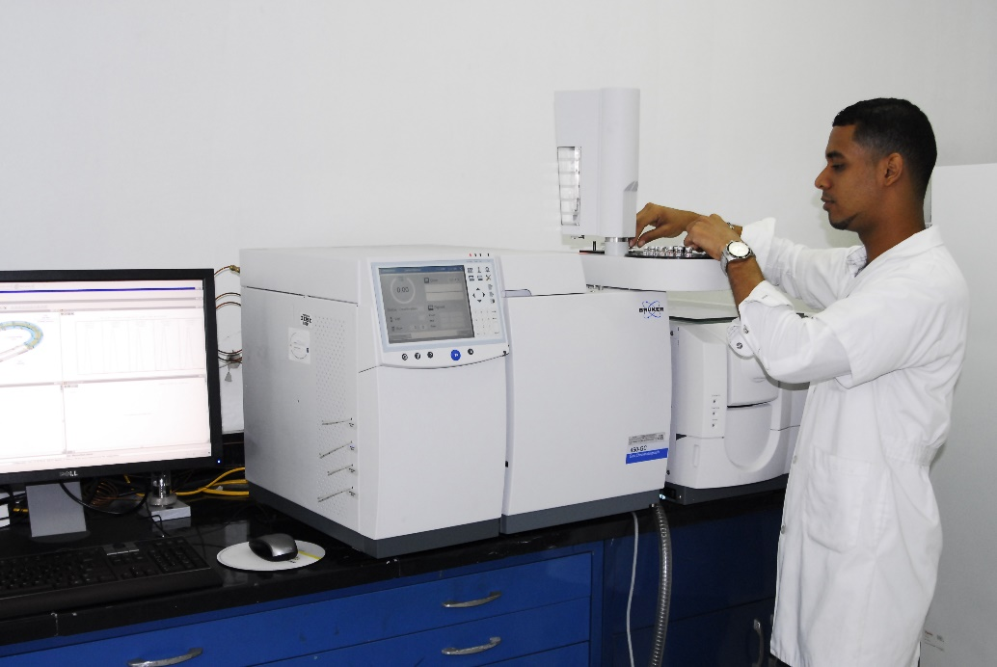
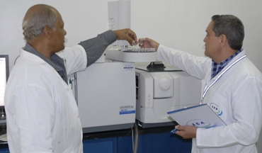
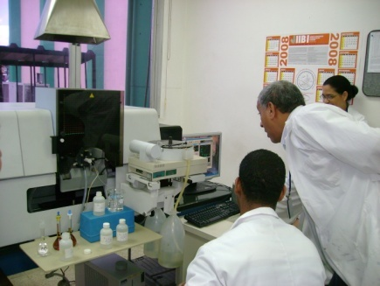
With a team of highly qualified researchers and projects that begin to make an impact in several sectors of the nation, with concrete results in scientific-technological management, the IIBI is set as the principal executant of the national scientific activity.

Slide 7
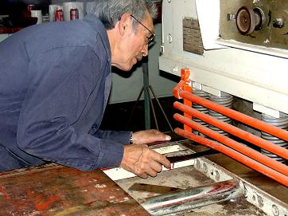
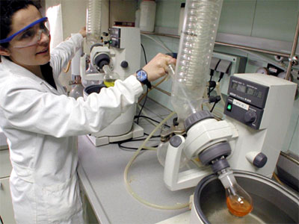
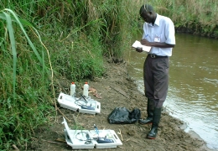
This stems from its dual role as:
a) Entity of research , development and innovation (R + D + i).
b) provider of technology specialized services

Slide 9
COORDINATION OF RESEARCH
• Medical Biotechnology
• Pharmaceutical Biotechnology
• Environmental Biotechnology
• Plant Biotechnology
• Industrial Biotechnology

Slide 10
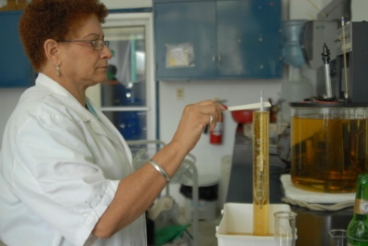
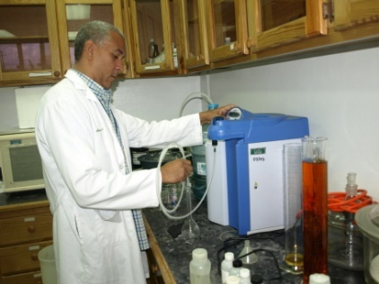
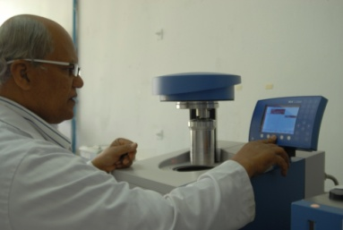
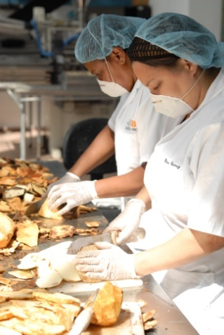
COORDINATION OF SERVICES
• Microbiology
• Physical-Chemical
• Mineralogy
• Chromatography
• Pharmacy
• Pesticide Residues
• Water
• Genetically Modified Organisms

Slide 11
Environmental Biotechnology
• This unit's main purpose is to do research related to the development of biotechnology, aimed at preserving the environment as well as production aspects of aquatic and terrestrial organisms and microorganisms that have the ability to degrade compounds that put into risk our ecosystem, and work on bioenergy.

Slide 12
ENVIRONMENTAL BIOTECHNOLOGY
Alternative Energy: The IIBI has focus this area on bioenergy production through environmental products and industrial processes.

Slide 13
WORK GUIDANCE TO BIOENERGY
• Solid waste from farms in order to produce energy through fermentation of solid waste and / or used microoorganisms isolated in our laboratories.
• Design of research projects for the use of enzymes for energy from cellulose.
• Bio-fuel: IIBI launched investigations to produce fuel from seaweed and waste fat from restaurants and slaughterhouses.

Slide 14
WE ARE WORKING WITH THE FOLLOWING PROJECTS

Slide 15
BIODIGESTOR INSTALLED ON THE CARMELITAS NUNS CONVENT IN MONCION, D. R.

Slide 16
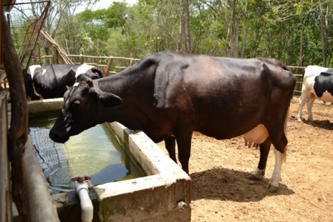

Slide 17
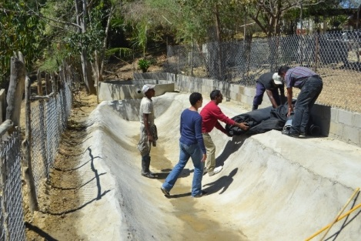
Instalation of a biodigestor in Monción, Dominican Republic

Slide 18
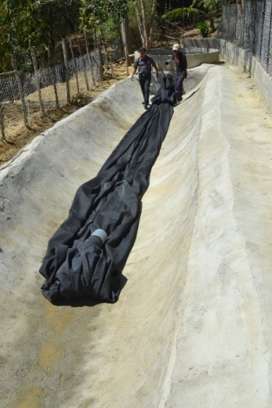
Instalación Digestor en Monción

Slide 19
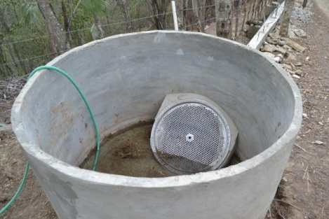
Biodigestor’s Mixture Pond Biodigestor in Monción, D.R.

Slide 20
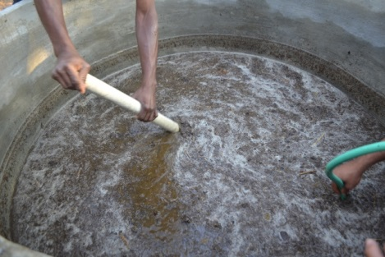
Biodigestor’s Mixture Pond Biodigestor in Monción, D.R.

Slide 21
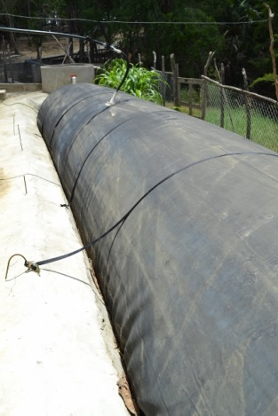
Rubber Biodigestor functioning

Slide 22
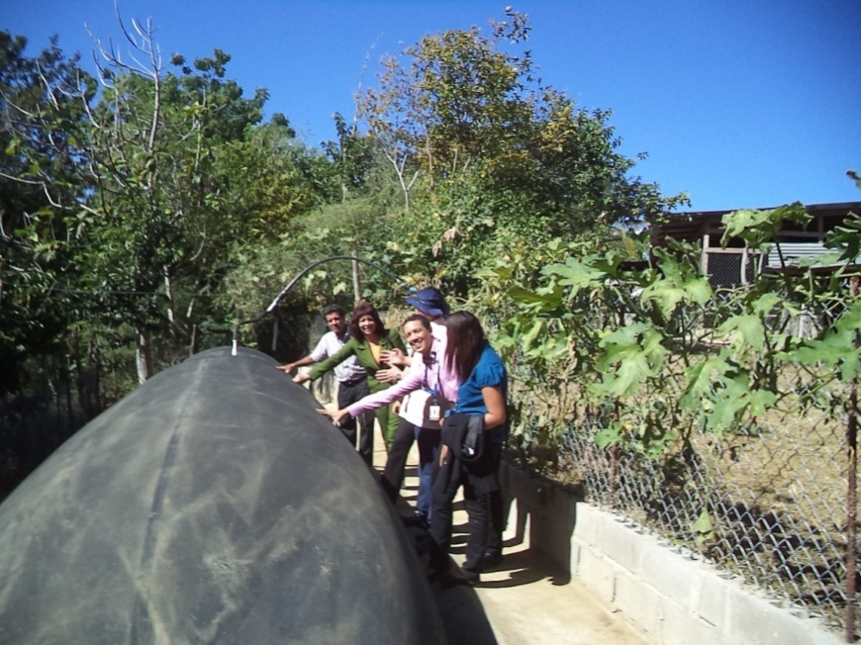
Rubber Biodigestor functioning

Slide 23
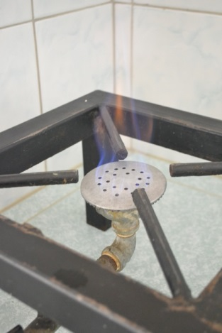
Methane gas test

Slide 24
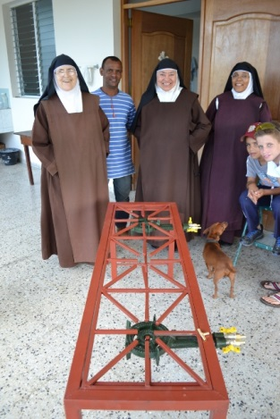
Test of a stove designed by the IIBI

Slide 25
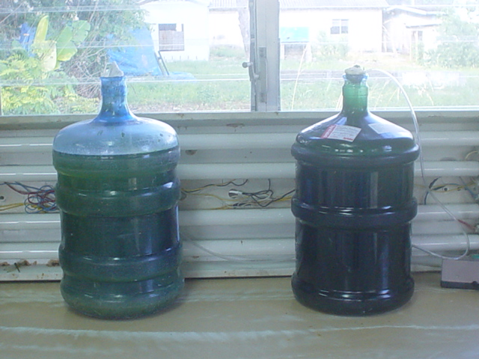
Micro-Algae’s Culture

Slide 26
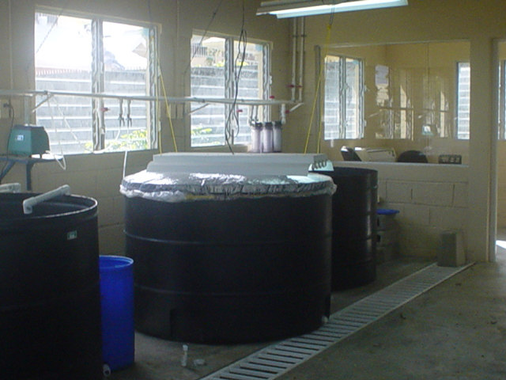
Pond for Micro-Algae’s growth

Slide 27
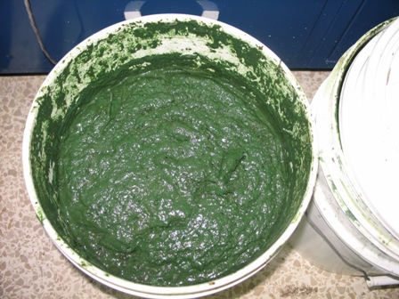
ALGAE
MACERATED MICROALGAE

Slide 28
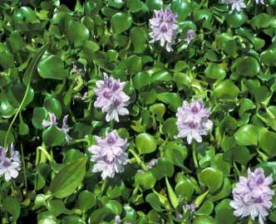
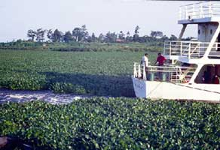
PROJECT: CONTROL OF WATER POLLUTION OF THE OZAMA AND ISABELA RIVERS USING THE LILA (Eichhornia crassipes)

Slide 29
SOLAR HYBRID SYSTEM WITH OVEN AND BIOMASS SOLAR EXTRACTOR FOR DRYING OF COFFEE, COCOA AND TROPICAL FRUITS

Slide 30
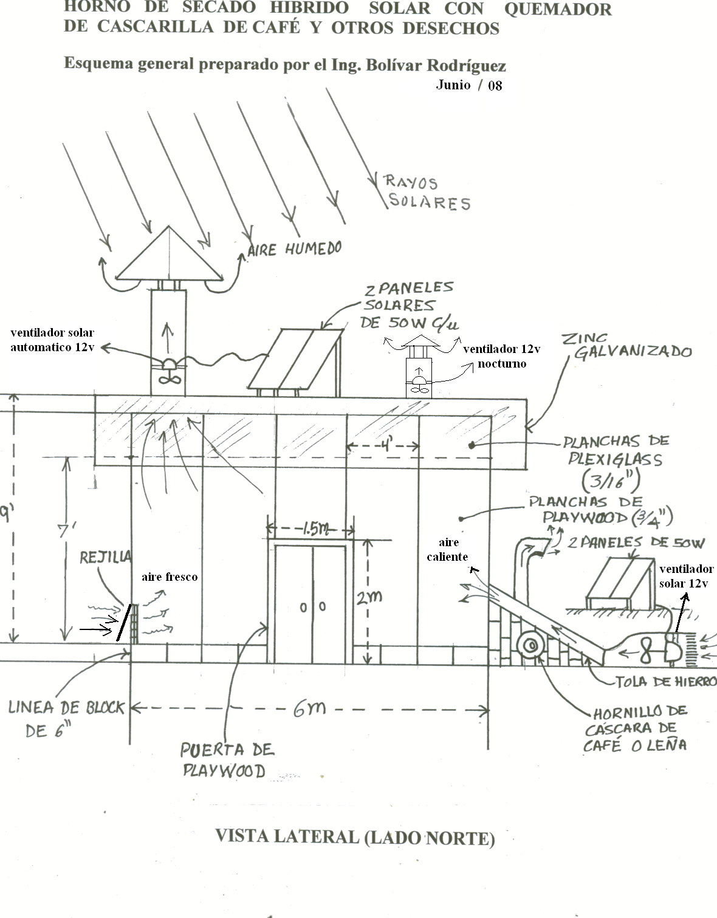

Slide 31
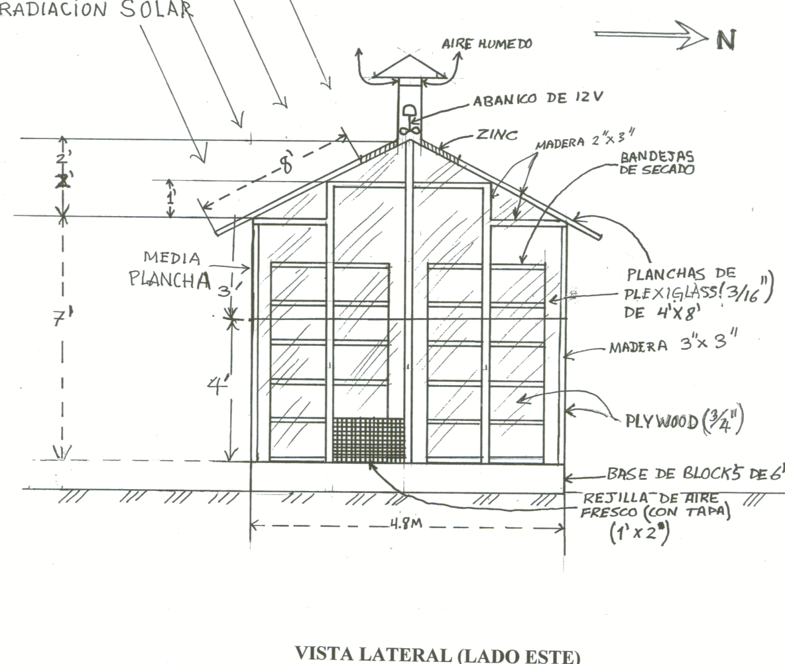

Slide 32
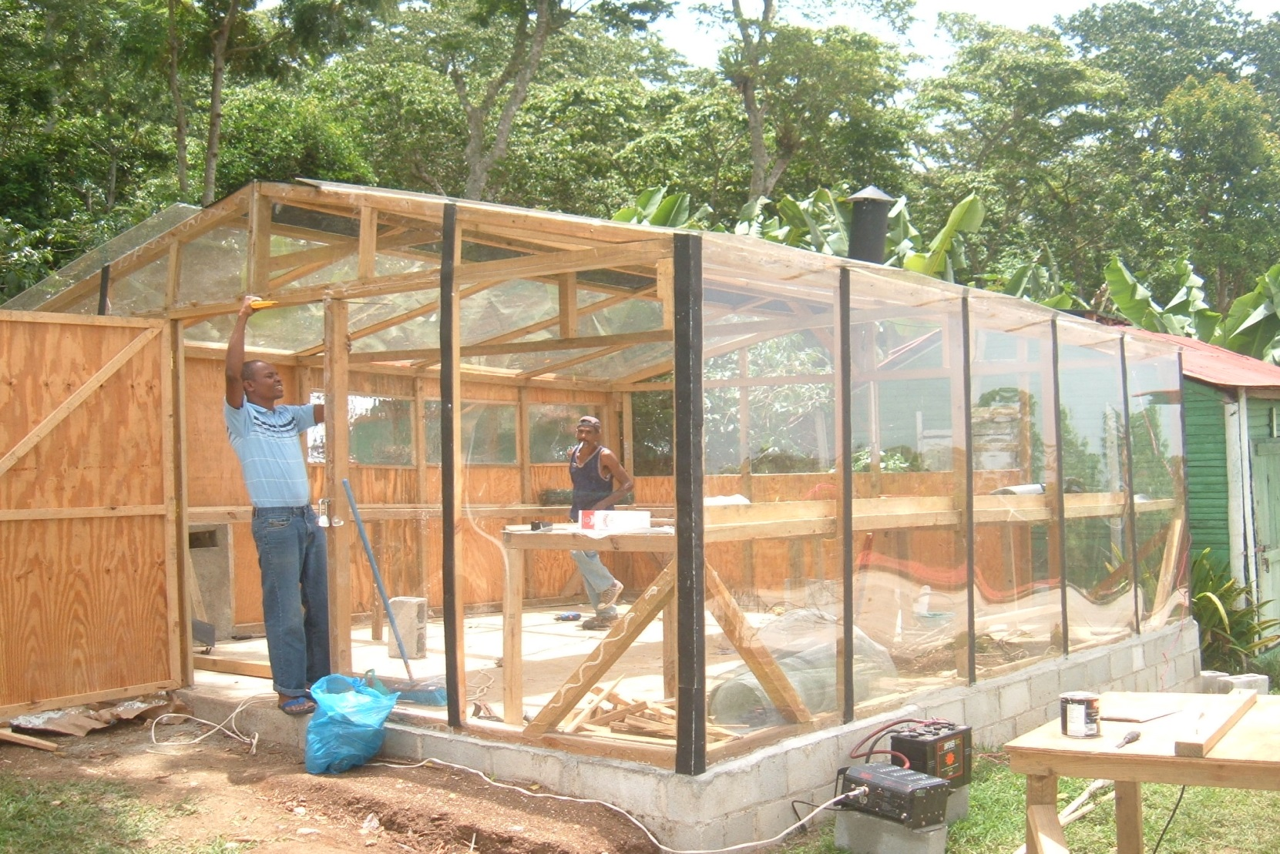
DRYING CAMERA SHOWING THE INVESTOR WITH BATTERY CHARGED BY SOLAR PANELS FOR THE CONSTRUCTION WORK

Slide 33
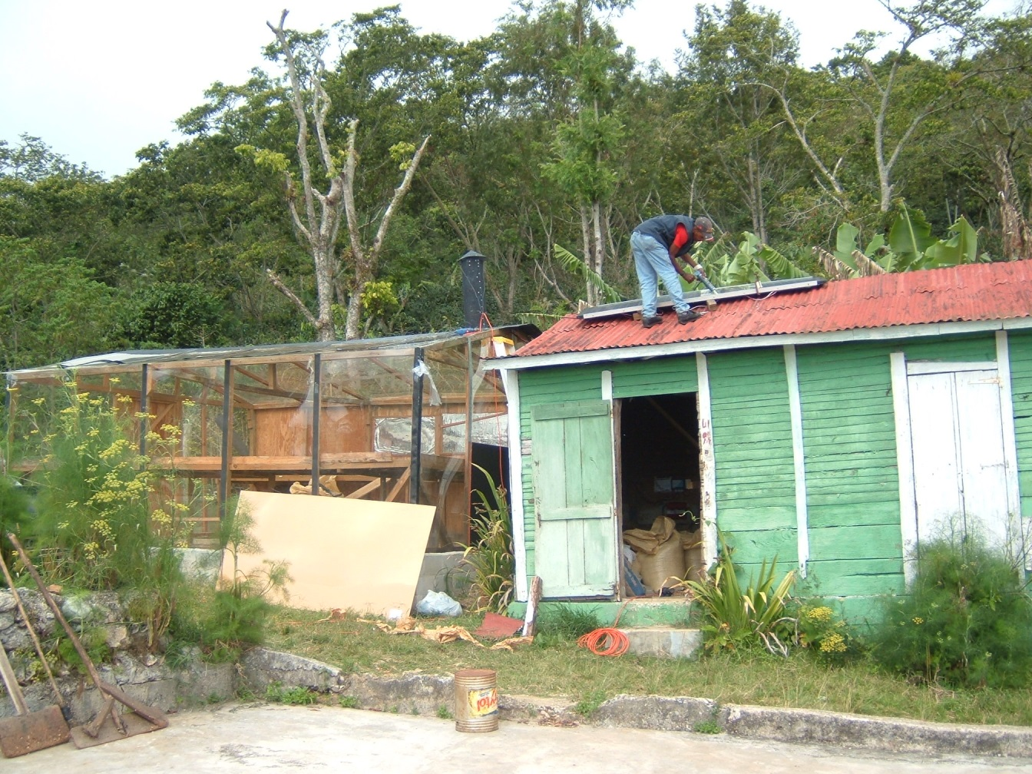
SET OF 4 ELECTRICAL SOLAR PANELS (50 WC / U) AT THE TIME OF BEING INSTALLED AND VIEW OF THE FIREPLACE Foto No. 2

Slide 34
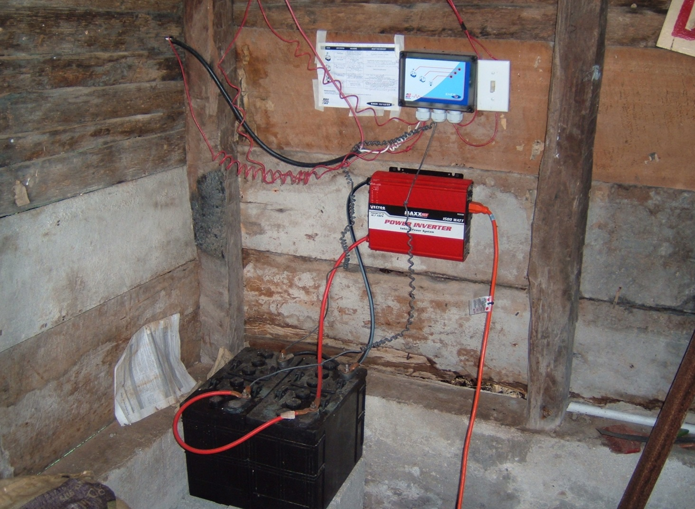
VOLTAGE REGULATOR FOR AUXILIARY EQUIPMENT: WATER PUMP, DRILL AND SAW

Slide 35
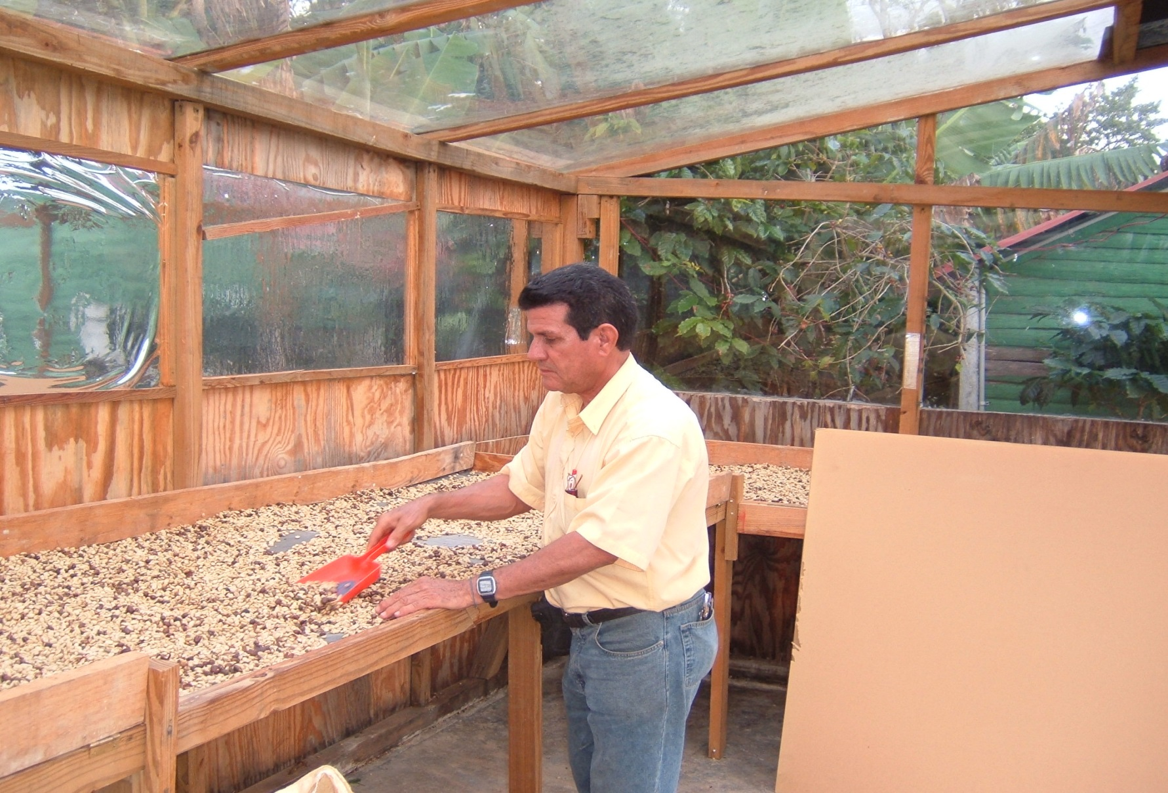

Slide 36
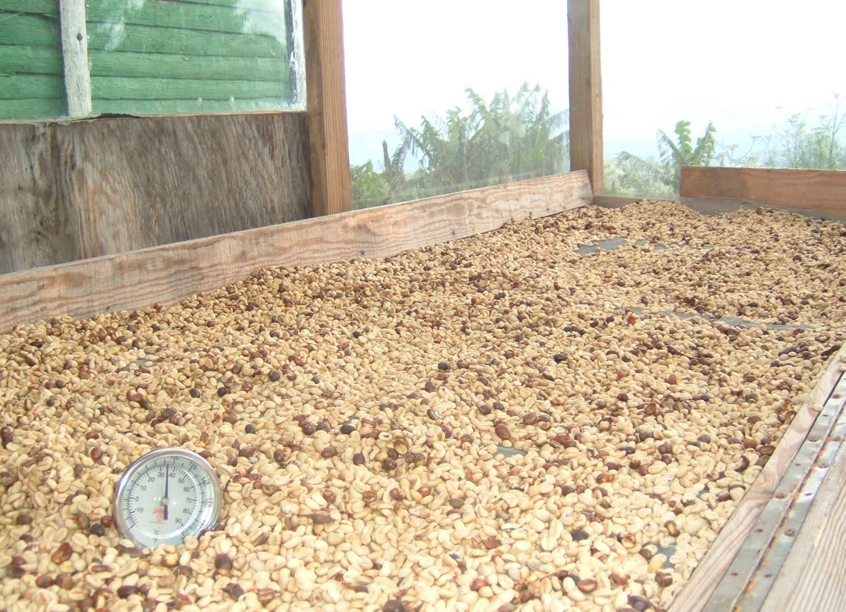
GRAIN TEMPERATURE (38° C) WITH CLOUDY SKY (EXTERIOR TEMP. 21 °C) Foto No 6

Slide 37
SITUATION OF THE PORCINE AND BOVINE MILK PRODUCTION IN ORDER TO PRODUCE ALTERNATIVE BIOENERGY

Slide 38
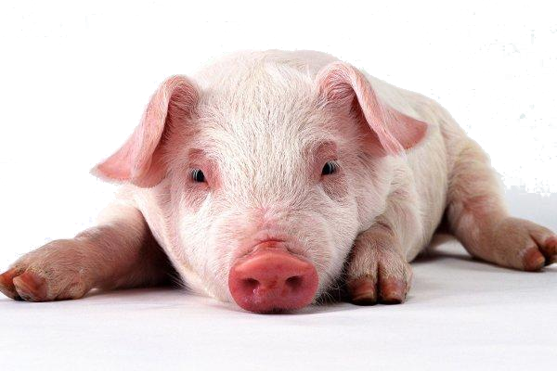
In the 2013, swine production reached 1,044,620 units of 100 kilos, while in 2014 there were 966.556 units, which means there was an additional reduction of 78.064 pigs in relation to the 2013, a decrease of 7.47 percent.

Slide 39
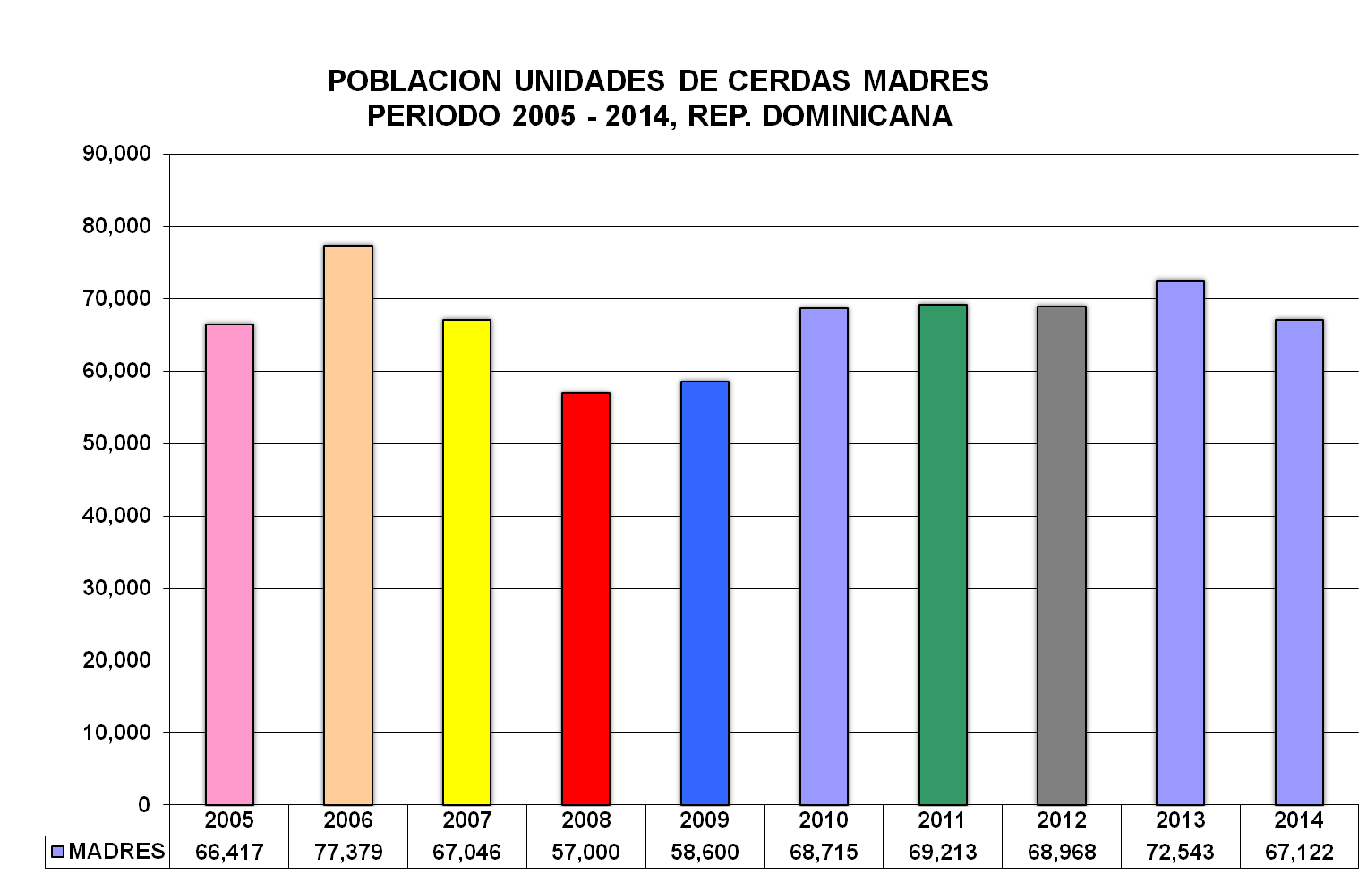
CONAPROPE
MINISTERIO DE AGRICULTURA
CONSEJO NACIONAL DE PRODUCCION PECUARIA

Slide 40
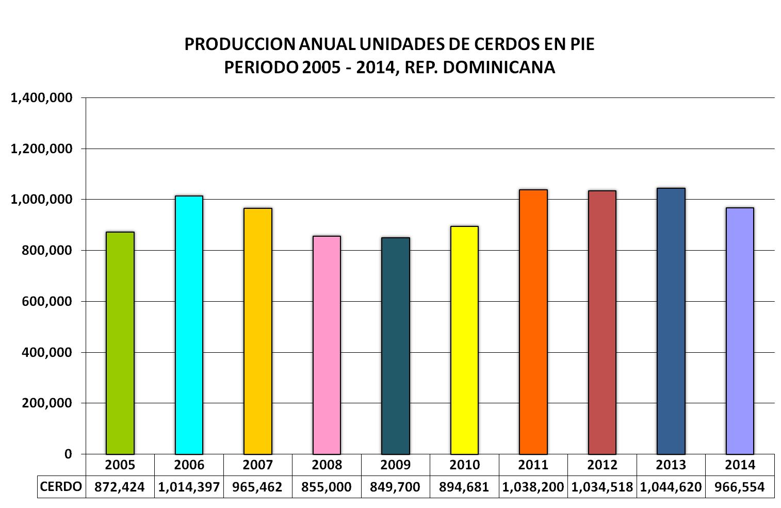
CONAPROPE
MINISTERIO DE AGRICULTURA
CONSEJO NACIONAL DE PRODUCCION PECUARIA

Slide 41
DAIRY FARM
By the 2013 we had a cattle population of 1,750,000 heads of which 856,000 were for the production of milk, spread over 6,000 farms.

Slide 42
ENVIRONMENTAL LAW AND LIVESTOCK PRODUCTION
The Act is supplemented by a series of rules and regulations, related to farming activities. Some of the standards that can be mentioned are: (SEMARENA 2003).
Environmental standards on water quality and discharge control.
Environmental Standard on quality of groundwater and download the sub-soil
Environmental quality standard of the cure and control of the atmospheric emissions

Slide 43
Regulation for the Environmental Management of Swine Farms (SEMARENA 2003), classified as:
1. Swine Farm Type: Farm with capacity for over 350 pig units.
2. Swine Farm Type B: Farm with capacities ranging from 200-349 pig units.
3. Swine Farm Type C: Farm capacity for less than 200 pig units.
4. Swine Farm Type D: Farm Domestic or family subsistence.

Slide 44
This regulation in its Article 5, sets out the distance that swine operations must be constructed; these are the following:
1. At least 50 meters from the perimeter fence of the farm.
2. Spaced not less than 1 kilometer from one to another.
3. The Swine farms must be built over 2.5 kilometer away from inhabited areas and not less than 800 meters of highways, roads, rivers and streams.

Slide 45
In chapter 4 on treatment and disposal of ¨cerdaza¨ cited Article 11 which, "states that pork waste shall be collected, separated, accumulated, used where appropriate and attached to treatment and disposal to avoid or decrease possible pollution of the air, soil and water ".

Slide 46
Droppings volume according to the Productive Stage of the Animal
Stage Manure Manure+urine Volume Volume
kg/day kg/day l/day m3/animal/month
25 -100 kg 2.30 4.90 7.00 0.25
Sows 3.60 11.00 16.00 0.48
Lactating sows 6.40 18.00 27.00 0.81
Boar 3.00 6.00 9.00 0.28 Fattering pigs 0.35 0.95 1.40 0.05
Mean 2.25 5.80 8.60 0.27

Slide 47
USE OF SWINE EXCRETA
1. Organic Fertilization
2. Material energy generator
3. Sources of food for farm animals.
In Dominican Republic just the third is being
used in a low percentage.

Slide 48
PROGRAM Theoretical-Practical Construction Course, Operation and Maintenance of Rubber Biodigestors
Topic 1.
General introduction.
Climate change and its effects on the biosphere.
Environmental benefits of anaerobic digestion.
Family benefits; self-sufficiency in gas and biofertilizer.
Criteria for the selection of the correct place.
Topic 2
What is a family digestor for rural areas?
Basic biochemical process.
Toxic materials.
How a digester is built.
Safety valve.
Different models and materials: Chinese, Indian, Plug-flow, industrial.

Slide 49
Topic 3.
Dimensioning and design of the digestor.
Manure flow calculation and different mixtures.
How good is the waste?
Control of pH and acidity.
Retention Time.
Influence of climate.
Production curves for different wastes.
Topic 4.
Digester Construction Rubber.
List of materials and construction, fermentation tank.
Tina pre-mixed.
Separators and tank bioabono.
Suppliers.
Example of actual cases in the country and abroad.
Brief cost / benefit analysis.

Slide 50
Topic 5.
Installing the digestor (process supported by photographs).
Filling the Digestor.
Leak tests.
Home filled with water and manure.
Collection of biogas.
Storage.
Risks and precautions.
Bio-fertilizer (Biol) and how to apply it in agriculture.
Topic 6.
Periodic maintenance and protection.
Construction of protective fence.
Removal of condensate water and gas filter.
Correction PH and acidity.
Removal of sediments.
Repairing holes.
Common problems and their possible causes.

Slide 51
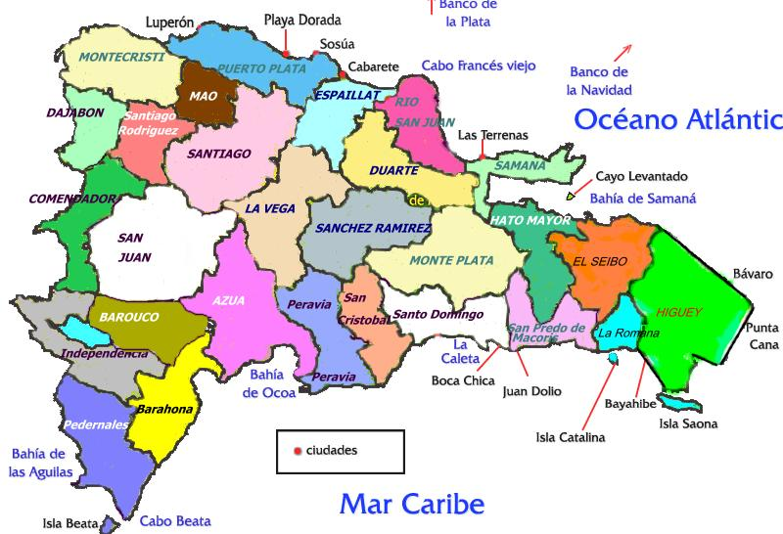
PLACES OF THE DOMINICAN REPUBLIC WHERE WE HAVE WORKED
Monción
Bayaguana
Bani
Moca
Sabaneta
Hato Mayor
Polo

Slide 52
COLABORATION AGREEMENT TO WORK WITH BIO ENERGY

Slide 53
Thank You!

