Slide 1
Dedicated Green Banks To Accelerate Climate Investment & Achieve NDCs
Innovative Financial Instruments to Support EE Financing
Coalition for Green Capital
Jeffrey Schub, Executive Director
November 16, 2016 – Lima, Peru

Slide 2
CGC is the leading expert on Green Bank model & institution formation
Thought Leadership
Advocacy
Consulting
CGC partners directly with governments and NGOs to study, design and implement tailored Green Banks
Helped design & create 6 GBs, which have catalyzed over $1.5 billion in clean energy investment
CEO Reed Hundt, former chairman of U.S. FCC
Supported by major global foundations

Slide 3
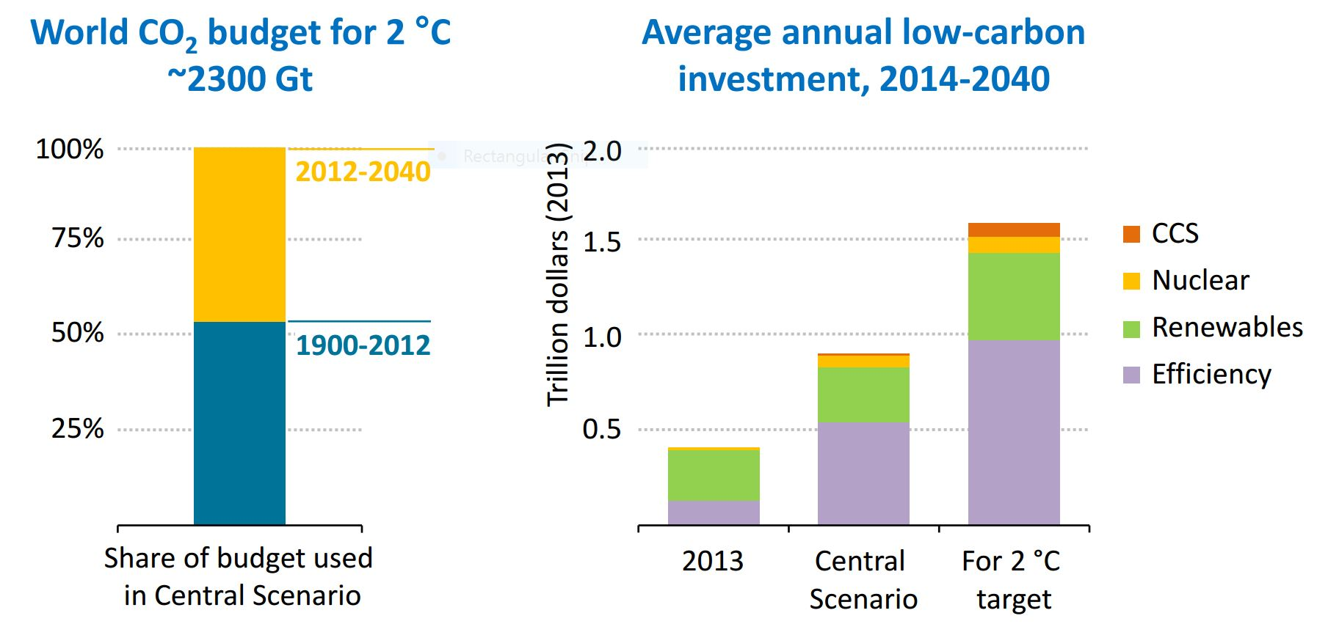
We all know the staggering global investment targets that must be reached to save the planet
Source: International Energy Agency 2015

Slide 4
And now it is up to each nation to find the investment capital it needs to meet local energy and climate needs
NDCs
How to find foreign and domestic capital that produces clean AND affordable power?

Slide 5
National Green Banks can be the dedicated entities needed to attract and deploy that investment
A Green Bank is a financing authority that uses limited public resources to leverage more private investment to produce affordable clean energy.
Multiple
Finance Tools
Market Development
Innovative
Mechanisms
Loans
Credit Enhancement
Warehousing & Securitization
Contractor Training
Info Transparency
Standardization
Demand Aggregation
PACE/Local Improvement Charges
On-Bill Recovery
ESA’s
Efficient & Rapid Market Growth

Slide 6
Why Green Banks? Because of importance of dedicated local institutions
Specific Focus
Prime the Pump
Take 1st or 2nd Loss
Carry Market-Making Costs
Convene & Organize
Local Capital Formation

Slide 7
Operating Green Banks have already driven USD $22B investment, proven the model works
USD 6.3 billion in capital committed or invested
UK Green Investment Bank
CT Green Bank
Japan Green Finance Organization
NY Green Bank
USD 22 billion total capital mobilized for clean energy projects
GreenTech Malaysia
Clean Energy Finance Corporation
Leverage ratios 3x, 4x…11x for certain investments
Source: NRDC and CGC calculation
7

Slide 8
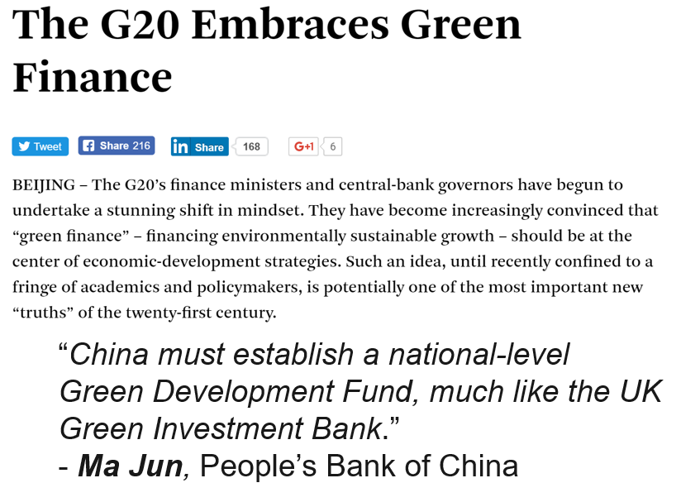
And now Green Bank interest is growing, including in emerging markets

Slide 9
Network of National GBs can use range of capital sources for locally-determined investment needs
Environmental Funds
(e.g. GCF)
Foreign Institutional Investors
(e.g. Pensions)
DEVELOPING NATION
Development Finance Institutions
(e.g IDB)
Green Bonds
$
$
$
$
National Govt
$
National Green Bank
Local Domestic Lender
$
Clean Energy Projects

Slide 10
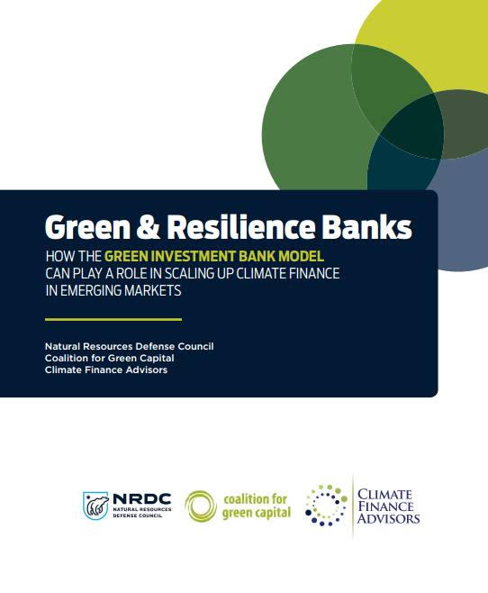
CGC & partners have just described this idea in greater detail in our new paper
Download at www.coalitionforgreencapital.com

Slide 11
And the New Green Bank Network, launched at COP21, is a new hub for Green Bank know-how
International network to connect Green Banks and share best practices
Central hub for know-how
Regular reports on transactions and other news
www.greenbanknetwork.org
Founding Members
Managing Partners

Slide 12
CGC will work with any nation to develop and implement the Green Bank model
Explore Green Bank opportunity and market needs
Design tailored institutional model
Identify international capitalization sources
Implement Green Bank model and services

Slide 13
Thank You & Appendix
Jeffrey Schub, Executive Director
Coalition for Green Capital
jeff@coalitionforgreencapital.com
CGC Twitter: @CGreenCapital
GBN Twitter: @@GreenBankNtwrk

Slide 14
National Green Banks can be the dedicated entities needed to attract and deploy that investment
A Green Bank is a public financing authority that leverages private capital with limited public dollars to accelerate the growth of clean energy markets
Green Bank
Deploy public capital efficiently to maximize private investment
Implement new market behavior and lower price to spark demand
Inefficient Capital Markets
Clean Energy Market
Tepid Consumer Demand

Slide 15
Green Banks use multiple structures to draw in more investment capital at better financing terms
Credit Support
Co-Investment
Warehousing
Project
Senior Private Capital
Green Bank Capital
Green Bank Credit Enhancement
Green Bank Origination
Project
Private Capital
Private Purchase of Portfolio
Project

Slide 16
Many Green Banks are already operating or in development around the world
Operating Green Banks
Green Banks Or Similar in Development or Under Consideration
UK GIB
Australia CEFC
National
India (National)
Ontario, Canada
Washington, DC
Maryland
Nevada
Colorado
Missouri
Pennsylvania
Vermont
Japan GFO
Malaysia GTFS
NY Green Bank
CT Green Bank
RI Infrastructure Bank
CA CLEEN Center
State/Local
HI Green Infrastructure Authority
Montgomery County, MD Green Bank

Slide 17
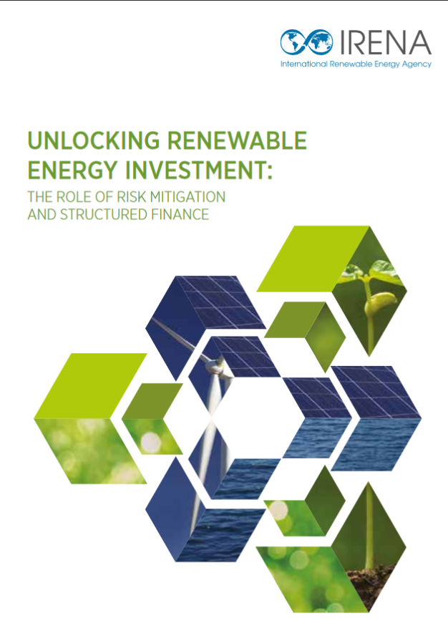
Increasing recognition of Green Bank model by global institutions and experts
OECD Report on Green Banks released at Clean Energy Ministerial (CEM) event May 31, 2016
Felipe Calderon of Global Commission on the Economy and Climate includes Green Bank model in four-point climate plan in Financial Times June 28, 2016

