Slide 1
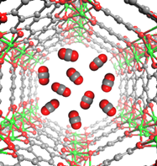
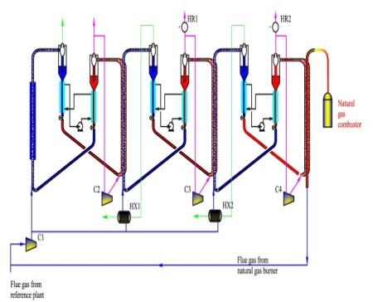
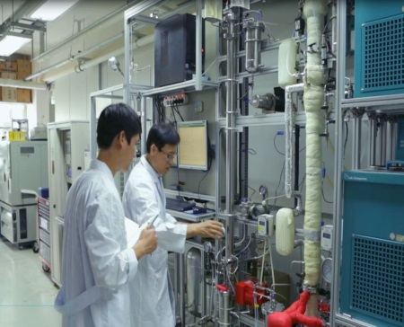
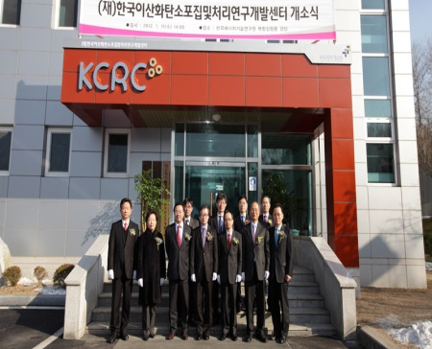
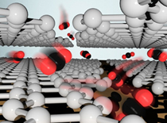
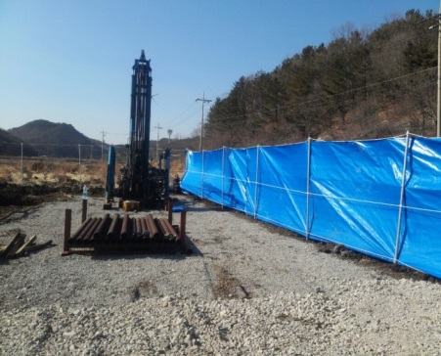
Korea CCS R&D Strategy & Korea CCS 2020 Project
Dr. Hwansoo Chong
Korea CCS R&D Center

Slide 2
Presentation Outline
I
National CCS R&D Plan
II
Korea CCS 2020 Project
III
Korea CCS R&D Center

Slide 3
National CCS R&D Plan

Slide 4
Low Carbon, Green Growth
Serious Situation with Global Warming & Climate Change
Need New Growth Engine for Economic Take-off
Rapid Growth Trend of Green Industry Sector
Respond to International Effort to reduce Greenhouse Gas Emissions
Current administration presents
“Low Carbon & Green Growth”
as a new National Vision

Slide 5
GHG Reduction Goal of Korea
Announced mid-term GHG Reduction Goal (19 Nov., 2009)
Anticipative Measure
Voluntary Reduction Goal
Reduce GHG by 244 mil. tons
Reduce 30% of BAU by 2020
Unit : million tone CO₂
30%
Major Means for Reduction
- Supply next generation Green Car such as electric car and fuel cell car
- Expand supply of state-of-the-art high efficiency products
- Accerelate CCS Early Deployment

Slide 6
How to Reduce GHG?
Reduction Goal by Sector (%)
Industry | Conversion (Power Generation) | Transport | Building | Agriculture, Forestry & Fisheries | Wastes | Public & others | Country as a whole
18.2 | 26.7 | 34.3 | 26.9 | 5.2 | 12.3 | 25 | 30
Reduction Goal by year
-10%
-30%
BAU
After reduction
Total national emission will reach maximum in 2014, and from 2015 emission will start to be abated to realize the decoupling of economic growth and greenhouse gas emission

Slide 7
Objectives & Implementation Tasks
In July 2010, National CCS RD&D Plan was established for development of innovative CCS technologies and the promotion of commercialization
Commercialization of plant and securing of international competitiveness for CCS technology by 2020
Objective
(상용화)100만톤급 포집-수송-저장 통합 플랜트 실증완료
- Demonstration of 1Mt-CO₂ integrated capture and storage systems
(Select one or two domestic CO₂storage sites by 2015)
- Development of original technology for CCS cost below $30/t CO₂
(Capture: Below $20/t CO₂ / Transport-Storage: Below $10/t CO₂)
Implemen-tation Tasks
Advancement of R&D to develop innovative and core technology
Promotion of early deployment and commercialization
Development of whole cycle in management of environment & commercialization

Slide 8
CCS RD&D Roadmap
2010
2015
2020
Technology Development
Capture
2nd Generation Tech.
Develop 0.5MW level)
Development of
3rd Generation Capture Tech.
(Capture cost: 10~20$/tCO2)
3rd Generation Tech.
Verification
(0.5MW level)
Cost Reduction (linked to Demonstration)
Transport.
Storage
Integrated research for
Capture-Transport-Storage
(0.5MW, 10,000t level)
Following-up Control &
Safety Evaluation
Tech.
Basic Base
Research
Development of Innovative Storage Tech. (Transport∙Storage cost: 10$/ tCO2)
Conversion
Basic Base
Research
Biological Conversion & Use tech. dev.
Tech. Verification
Chemical Conversion & Use tech. dev.
Tech. Verification
Demonstration
Large scale
Demonstration
Post-combustion pilot plant
(10~30MW)
Integration of Capture-
Transport-Storage
(100~300MW, 1 Mt level)
Commercialization
Pre & Oxy- combustion pilot plant
(10~30MW)
Integration of Capture-
Transport-Storage
(100~300MW, 1 Mt level)
Storage site exploration
Basic data
Survey
Potential storage capacity
evaluation & underground
(land/marine) exploration
Storage site construction
& management

Slide 9
Investment Plan
Total investment for $ 2.6 billion from 2010 to 2019
(Government – $ 1.4 billion (52%), Industry – $ 1.2 billion (48%))
Core Technology Development | Commercialization | Environment Management & Base Establishment
$ 263.6 million (10%) | $ 2.1 billion (79%) | $ 286.3 million (10%)
● Development of CO2 capture technology ● Development of conversion technology ● Integrated research on capture & storage | ● Demonstration of large scale capture technology ● Survey on storage site ● Demonstration of large scale storage | ● Development of whole cycle in environmental management ● Enhancement of Public acceptance ● Education and Training
Company participation: Proof of large scale capture (Gov. – 20%, Company – 80%), Proof of large scale storage (Gov. - 60%, Company – 40%)
Notes:
Technology Development
Commercialization 290 billion won (10%) Environment Management & Base Establishment
2 trillion 275 billion won (79%) Conversion Technology Development 315 billion won (11%)
Proof of large scale capture Integrated Research on Capture-Storage (60 bil. won) Whole cycle environment management
(1 trillion 460 billion won) (175 billion won)
Selection of Storage site & proof of Storage Development of key tech. for Capture
(815 billion won) (130 billion won)
사회적….
Social accommodation capability enhancement, international cooperation and manpower cultivation
(140 billion won)
Civil participation: Proof of large scale capture (Government – 20%, Civil – 80%), Proof of large scale storage (Government - 60%, Civil – 40%)

Slide 10
Role by the Ministry
MSIP
(Capture) Develop core technologies, demonstrate small scale projects less than 0.5MW
(Storage) Develop core technologies connected with capture, small scale demonstration
of less than 10,000 tons
(Conversion) Develop next-generation biological and chemical conversion technology
(Ministry of Science, ICT and Future Planning)
(Capture) Develop core technologies aimed at commercialization, carry out medium to large scale demonstration of over 0.5MW
(Exploration) Land and underground exploration, provide exploration data of the Ministries concerned through KNOC
(Storage) Develop core technologies for commercialization connected to capture, medium scale demonstration of over 10,000 tons
MOTIE
(Ministry of Trade, Industry & Energy)
(Capture) Jointly participate in land and underground exploration and evaluation of other Ministries․ (Environmental protection DB establishment)
(Conversion) Fix CO₂ emitted from environment facilities, fix CO₂ using wastes
(Storage) Prevent CO₂ leakage at the time of storing underground, develop monitoring and harmfulness evaluation technology and demonstrate it (Joint implementation with MSIP & MOTIE)
ME
(Ministry of Environment)
MOF
(Exploration) Carry out marine & underground exploration and evaluation
(Storage) Prevent CO₂ leakage at the time of storing at offshore underground, develop monitoring and harmfulness evaluation technology and demonstrate at offshore underground (Joint implementation with MOTIE)
(Ministry of Oceans and Fisheries)

Slide 11
Strategies & Platform
MSIP
(CCS R&D Center)
(Dec 22 2011)
- Core Research & Network
- Analyze technology trends &
Play roles of CCS think-tank
National CCS R&D
Network
MOTIE
(CCS
Association)
ME/MOF (CCS
Environment Center)
(Nov 22 2010)
- Control, license and permission
related matters
- Law and system related matters
- Industry Cooperation Group
- Commercialization & Promotion of Industry
Notes:
CCS R&D Center
- Basic Original Research Network
- Technology Trend analysis & Platform creation
Green Growth Committee
Industry Cooperation Group CCS Association CCS Environment Center
- Commercialization & Promotion of Industry MKE ME/MLTM
- Control, license and permission related matters
- Law and system related matters

Slide 12
Korea CCS 2020 Project

Slide 13
Overview
Project Overview
(Period) Nov. 1, 2011~May 31, 2020 (Approx. 9 years)
(Budget) Total $151 million
(Support Tasks) 54 tasks
(Participating Institutions) 39 institutions, universities and corporates including KIER, KRICT, KIST, Seoul National University, Korea University, Yonsei University, KAIST, Univ. of Texas, Univ. of California at Berkeley
(Participants) Approx. 650 researchers with master and doctorate degrees
Project Objective
Securing leading CCS technology in the world through the development of innovative original CCS technology
(Capture) Securing of more than 4 kinds of original technology for 3rd-generation CO₂ capture within 30% of power generation cost increase rate (US$ 20/tCO₂ level as of 2010) by 2020
(Storage) Completion of CCS technology through the implementation of CO₂ capture-storage integration project
(Conversion) Securing of more than 2 kinds of original technology for CO₂ conversion and use that are applicable to massive CO₂ sequestration
(Base Creation) Establishment of Think-tank platform center through CCS base creation

Slide 14
Roadmap for Technology Development
1st Stage (‘11-’13)
2nd Stage(‘14-’16)
3rd Stage(‘17-’19)
New CCS technology concept proof
(proof of concept)
CCS Lab. Scale technology development
(lab scale dev.)
Massive emission source pilot scale proof
(pilot development)
Final Goal
Proof of more than 4 kinds of innovative capture technology through new materials compounding and process modeling
Proof of bench scale for more than 4 kinds of CO₂ capture technology (1Nm³/h scale)
Secure economic analysis data
Proof of prototype for actual environment of CO₂ capture technology
(100~2,000 Nm³/h scale)
Develop more than
4 kinds of CO₂
capture technology
that can be licensed
Capture
Storage
Establish design & engineering technology before CO₂ injection
Establish CO₂ injection & operation technology
Establish management technology after CO₂ injection
Proof of CO₂Storage
possibility at Korea
Peninsula stratum
& secure storage
technology
Conversion
Develop more than
2 kinds of CO₂
conversion
technology for
massive sequestration
Proof of more than 4 kinds of organic/inorganic conversion technology for CO₂
Proof of bench scale for organic/inorganic conversion technology for CO₂
Pilot proof of more than 2 kinds of organic/inorganic conversion technology for CO₂
Base
Establish initial R&D Management/Support System for Project team
Reinforce outcome management of Project team and maintain R&D base
Establish CCS R&D base of global level
Establish CCS
Think-tank
platform center
Technology development will be systematically implemented based on Level & Gate System starting from Proof of concept for technology (TRL3) stage to Proof of actual environment pilot (TRL6) stage.

Slide 15
Korea CCS R&D Center

Slide 16
History
PRESENT
June : Start 2nd Stage 1st period of Korea CCS 2020 Project
2014
June : Start 1st Stage 3rd period of Korea CCS 2020 Project
2013
June : Start 1st Stage 2nd period of Korea CCS 2020 Project
January : Open KCRC
2012
November : Start 1st Stage 1st period of Korea CCS 2020 Project
2011
September : Select Korea CCS 2020 Project
2008
April : 3rd Stage of CDRS Project Started
2005
April : 2nd Stage of CDRS Project Started
2002
July : Establishment of the CDRS
October : 1st Stage of CDRS Project Started
PAST

Slide 17
KCRC’s Mission
Leads and coordinates a program of underpinning research on all POST-CO2 CAPTURE aspects of CCS in support of basic science and Korea Government efforts on energy and climate change
● Korea government-funded CCS R&D Center
- Conduct CCS R&D for the benefit of the public
- Develop CCS technologies with collaboration of universities, institutes, and
industry
● National CCS focal point & think-tank
- Build a global network where academics, industry, regulators and other
stakeholders collaborate to analyze problems, carry out world-leading
research, and share knowledge
Notes:
The KCRC's primary mission is to

Slide 18
Mission Into Plan (8 targets Needed To Achieve 1 goal)
Develop
CCS National R&D Strategy and Policy
Educate Graduate & Undergraduate Students
Develop innovative CCS technologies
Manage CCS R&D Project
Build
CCS Public Acceptance
Enhance
International Collaboration
Perform IPR-Based Technology Transfers
Set-up Globalized Test Platform & Protocol
Publish
Issue Reports Related to CCS& Energy

Slide 19
Commitment to…
● Objectivity
Together with research groups affiliated with our center we apply stringent standards of objectivity in performing CCS R&D
Be achieved through our advisory committee and through world-class researchers from independent research and technical authorities from around the world
● Innovation
We incorporate unique combinations of scientific discovery, creative and adaptive application, accidental insight and experience gained in the real world.
Be committed to driving innovation through collaborative research and the effective application of results
● Result
We produce a variety of products that range from advanced post-combustion CO2 capture technologies, papers, patents, newsletters, comprehensive reports, to research guideline to shape the robust future in CCS
Secure resources for the next greatest innovation in energy and environment

Slide 20
Roles and Activities
Developing innovative technology
Secure over 4 types of core CO2 tech. (3rd generation)
Demonstrate first CO2 capture-transport-storage integration system
Develop over 2 innovative tech. for CO2 conversion for large emitters
Think tank in CCS-Energy-Environment
Planning and management of R&D and outcomes
Set-up a test and optimization platform
Build solvent/sorbent/ membrane-based CO2 capture plant linked to a coal-fired power plant
Establish analysis system for environment safety and develop material performance
Set-up CCS big data system

Slide 21
Thank you for your attention!

