Slide 1
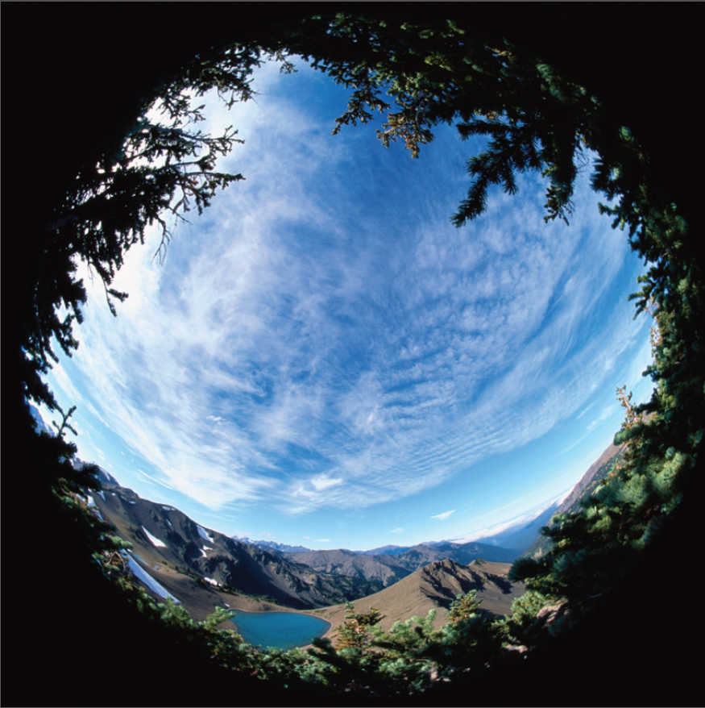
International Climate and Environmental Finance: Role of the GEF
Claus Astrup
Tuesday, October 7
Inter-American Development Bank

Slide 2
Content
Background: An urgent agenda
A brief history of the GEF
Reflections on GEF-6 replenishment
GEF Strategy-GEF2020
Collaboration with National Development Banks—Case Study: Development Bank of Southern Africa

Slide 3
Background: A changing context

Slide 4
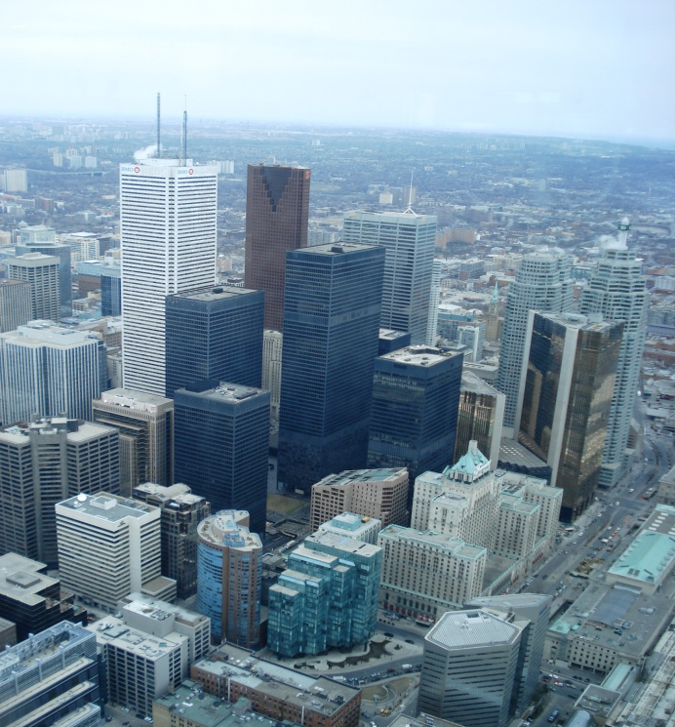
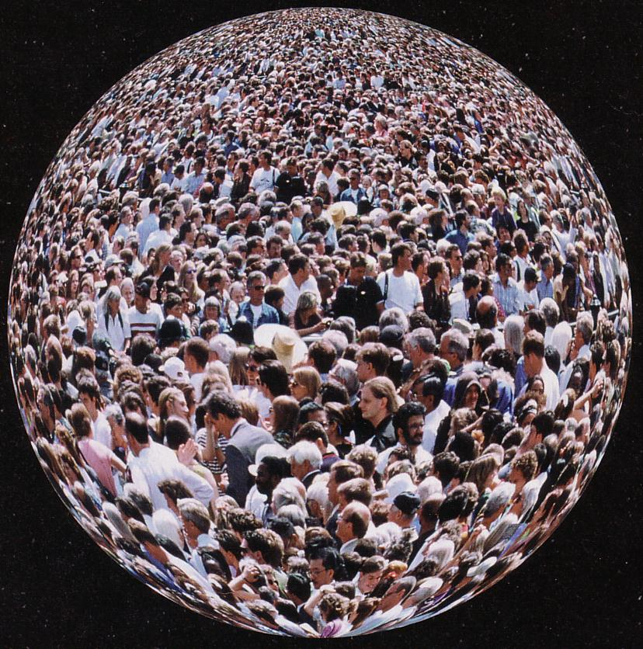
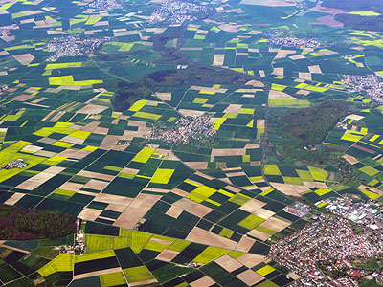
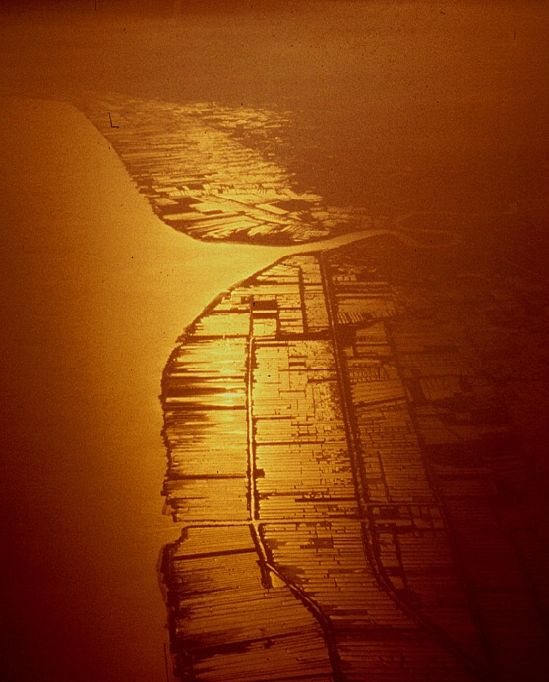
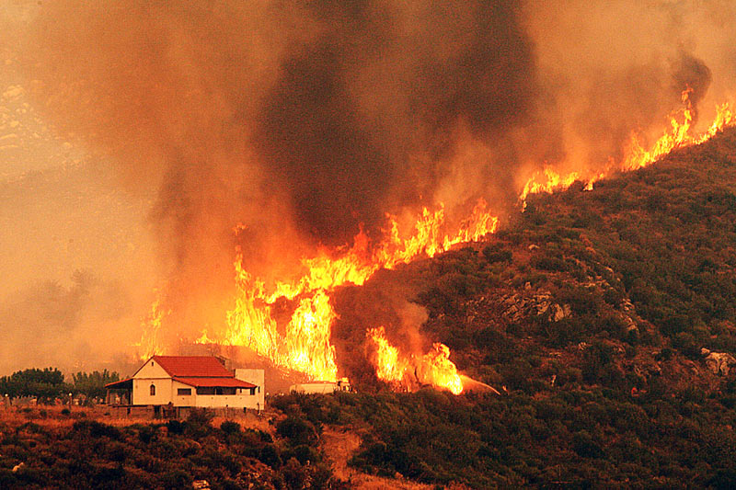
Antrophocene – humans influence
the functioning of the Earth
Notes:
The reason for the Rio+20 conference was that it is more and more clear that we are now in a A new global era, human activities have expanded to the degree that we are not only shaping local and regional ecosystems, but now also the functioning of Earth as a whole, reflected e.g. in the climate change debate

Slide 5
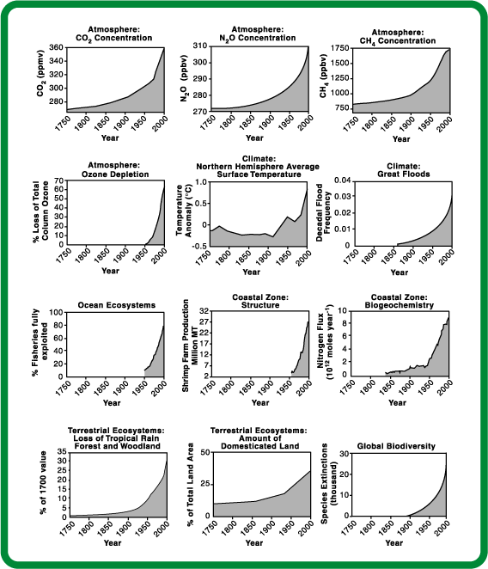
Deterioration Across Virtually all Environmental Domains
2010-2020
CO₂ concentrations
Overfishing
Land degradation
Loss of Biodiversity
Water Depletion
The Planetary Response to the drivers of the Anthropocene
1900 1950 2000
Notes:
We can see an increase not just in green house gas emissions but also Increase in overfishing and loss of biodviersity etc in the same time,

Slide 6
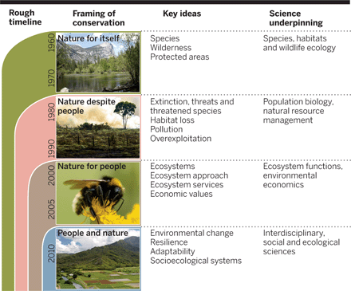
A changing view on conservation
Source: Science Sept 2014

Slide 7
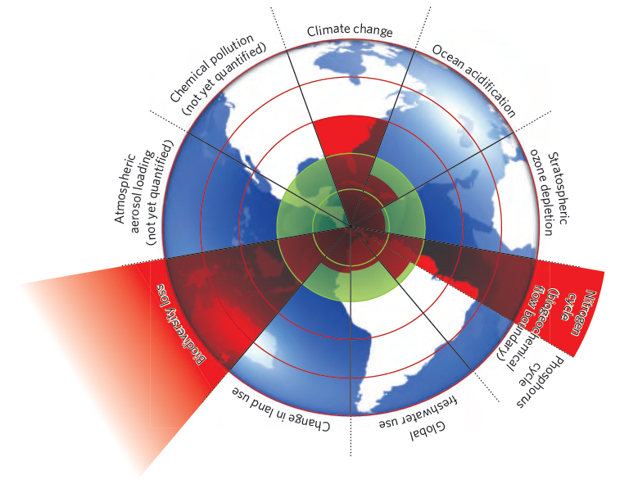
Planetary Boundaries

Slide 8
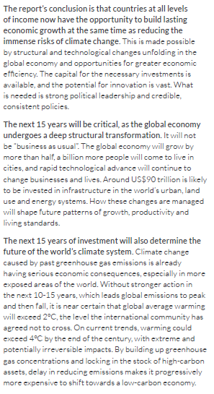
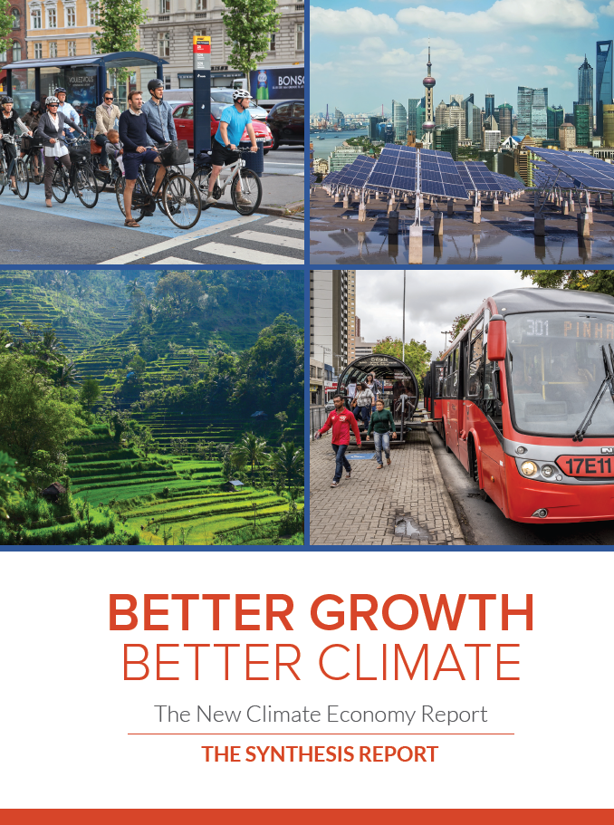
The Economy and the Environment—what (if any) is the trade-off?

Slide 9
A brief history of the GEF

Slide 10
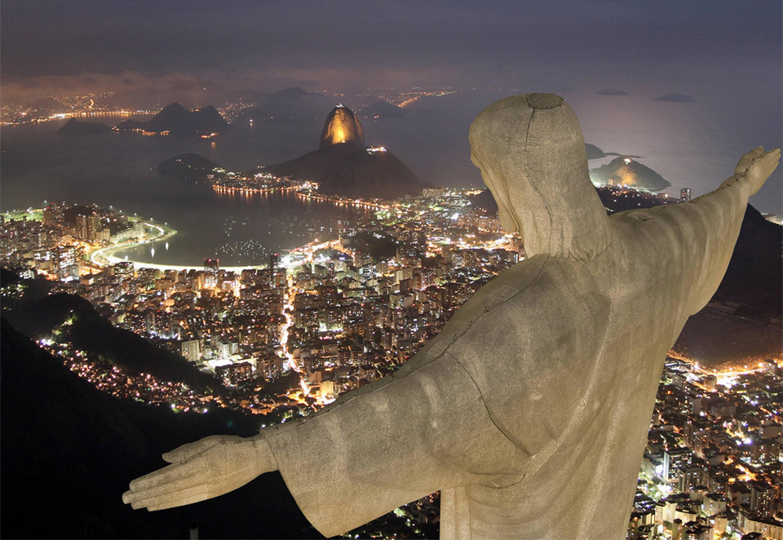
The Global Environment Facility--GEF
Born out of the Earth Summit in Rio 1992….
Notes:
The GEF is at the center stage of this discussion not because it is the most financially well-endowed multilateral fund, but because it is the only financial mechanism whose central mission is to address the global commons across most of its dimensions.
We have made some good efforts
Rio Summit and 3 Environmental Treaty
GEF’s creation is a part of the effort

Slide 11
The Global Environment Facility (GEF)
Originally financial mechanism of the three “Rio” multilateral environmental agreements (UNFCC, CBD, CCD), later followed by Stockholm Convention (POPs) and Minamata Convention (Mercury). Special funding for International Waters and Forests
Global: 183 member countries; funding for 144
Network of partner agencies: Originally WB, UNDP, UNEP; now 14
Independent (and ahead-of-its-time) governance structure
Principally a grant-making institution
6th Replenishment of the GEF (“GEF-6”) completed in April 2014 (more about this below)

Slide 12
Reflections on the GEF-6 Replenishment

Slide 13
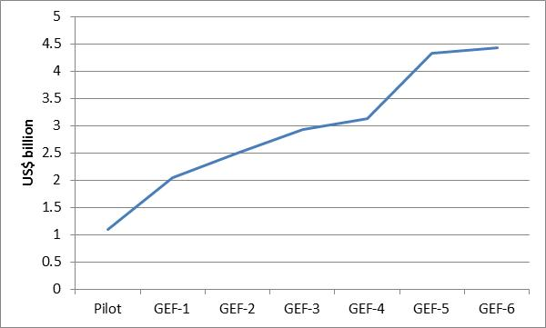
GEF-6: Largest replenishment to date
=> US$4.4bn for 2014-18....Increase over GEF-5 was modest on account of global macro/fiscal situation…

Slide 14
Source of funds
Increases across the board, but particularly among MIC-5 (albeit from a low base)

Slide 15
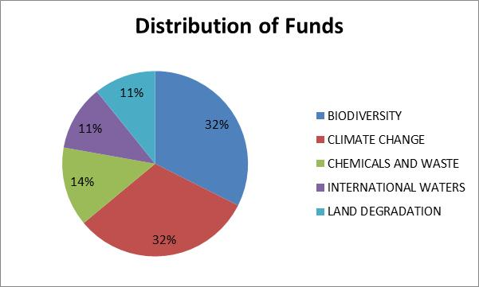
Use of funds—GEF Focal Areas
Note: Excludes corporate programs

Slide 16
Use of funds—GEF Recipient Countries
=> Trade-off: “Impact” vs ”equity”?

Slide 17
GEF Strategy—GEF2020
The “how” of the GEF: Four Key Strategic Priorities

Slide 18
1. Address Drivers of Environmental Degradation

Slide 19
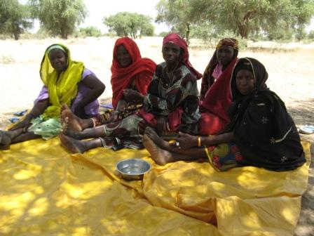
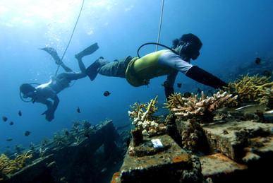
2. Deliver Integrated Solutions
Integrated approach programs (IAPs) in GEF-6:
  Sustainable Cities
  Deforestation out of Commodity Supply
  Fostering Sustainability and Resilience for Food Security in Sub-Saharan Africa
An increasing portfolio of multi-focal area projects and programs

Slide 20
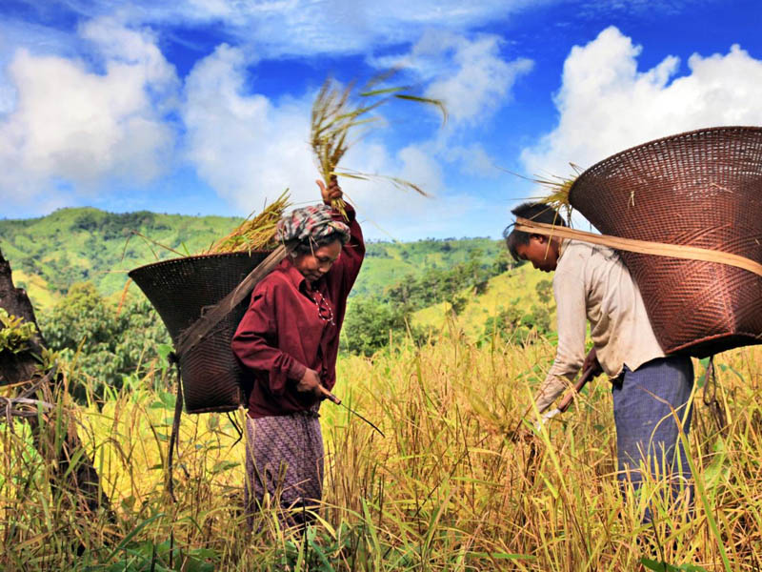
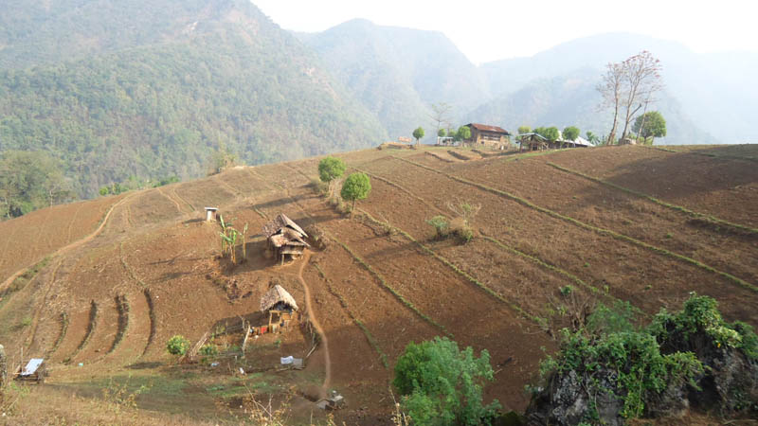
3. Enhance Resilience
GEF Adaptation Program:
  LDCF, SCCF
  124 countries worth
  US$1.2 billion
  National adaptation plans (NAPs)
  Ecosystem based adaptation

Slide 21
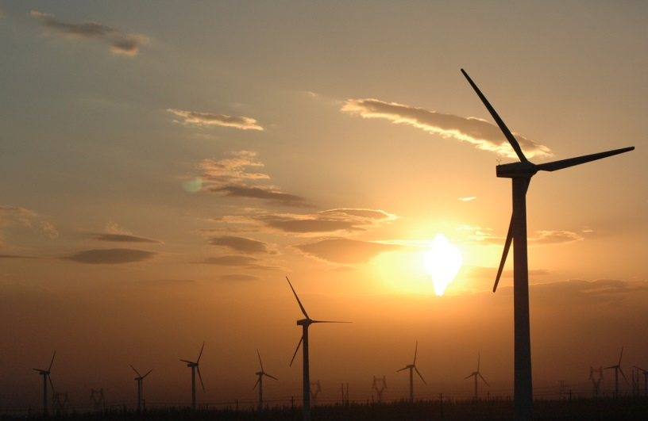
4. Ensure Complementarity, especially in Climate Finance
Increasingly complex climate finance architecture
GEF “niche”:
  Transforming policy and regulatory environments; build institutional capacity
  Demonstrate new technology and business models
  De-risk partner investments
  Build multi-stakeholder alliances

Slide 22
Collaboration w/ National Development Banks
Case Study: Development Bank of Southern Africa (DBSA)

Slide 23
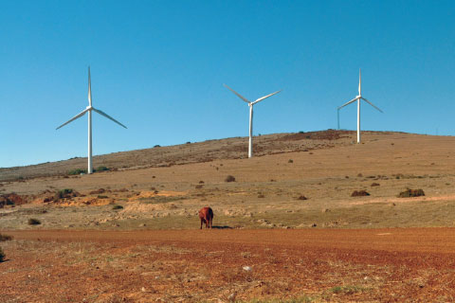
DBSA—Company Profile
The DBSA, owned by the government of the Republic of South Africa, is a leading development finance institutions in Southern Africa.
At end-2013, the DBSA had development assets of R55.5 billion spread across 13 SADC countries, mainly in the energy, roads, water, transport and social infrastructure sectors.
Supported development of more than 2,500MW renewable energy in 2013
manages South Africa’s Green Fund established in 2012; so far approved projects worth almost R700m.

Slide 24
DBSA—Past Collaboration w/ GEF
South Africa Wind Energy Programme (SAWEP), (2002-2008), followed by the Renewable Energy Market Transformation Project
  DBSA was Executing Agency for both projects
  Projects focused on helping build the regulatory and institutional capacity for expansion of the South African wind sector through IPPs, and for development of a commercial solar water heater sector.
  => From 2008 to 2013 South Africa had the fastest growing wind market in G20

Slide 25
DBSA: A new chapter with GEF
In May 2014, DBSA became accredited GEF Project Agency (“direct access”)
    => Significant potential for synergies
From DBSA’s view point: GEF contributes scope for innovation and risk-sharing approaches; GEF provides the opportunity to expand DBSA’s focus to thematic areas aligned with GEF (e.g. ecosystem services); GEF Accreditation provides opportunity to benchmark DBSA’s fiduciary, environmental & social safeguards against international standards.
From GEF’s point of view: DBSA has strong investment track record and ability to leverage private sector investments, especially in climate change mitigation; DBSA has strong footprint in Southern Africa
STILL BRAND NEW—SO STAY TUNED!

Slide 26
Thank you!

Slide 27
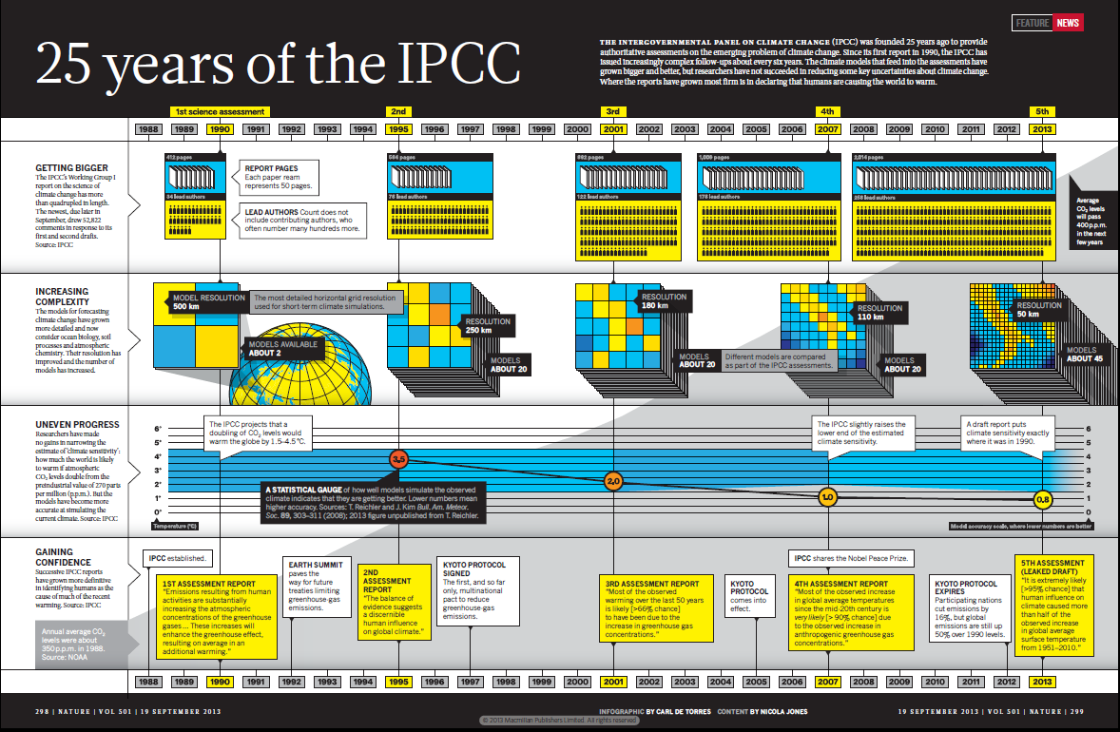
Higher scientific confidence

