Slide 1
Brazil’s Initiatives on Promoting CERs cancellation for Big Event’s Emissions Compensation
LAC Carbon Forum
Bogotá, September 5th 2014

Slide 2
Cancellation of CERs gives the possibility of getting into a market prior limited to voluntary schemes;
Brazil’s strategy on enhancing demand for CERs is mainly focused on big events:
Pilot project on the Rio+20 Summit (Ministry of Foreign Affairs, UNDP and CAIXA)
FIFA World Cup (Ministry of Environment; states, municipalities and private sector involved)

Slide 3
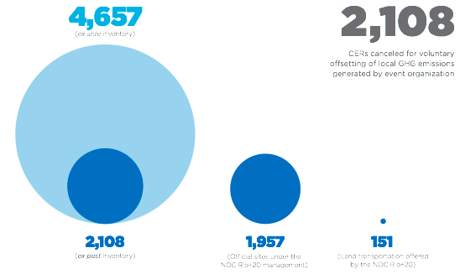
Rio+20
Source: Ministry of External Relations

Slide 4
Management Plan of GHG Emissions for the 2014 FIFA World Cup
Three steps:
Emissions inventory
Mitigation Plan
Compensation strategy: Public Call for donation of CERs from Brazil-based projects of the CDM, cancelled voluntarily to offset GHG emissions during the 2014 Soccer World Cup.

Slide 5
Public Call
Legal Instrument for donation: Partnership Agreement
Minimum donation of CERs: 5,000 (five thousand CERs).
In exchange for the donation of CERs, ‘Official Donors’ will
have their brand names registered in a list of “Official CERs Donors to Offset GHG during the 2014 Soccer World Cup”
also be entitled to use the Selo Sustentabilidade – Baixo Carbono, according to the provisions for use and constraints, as established by Directive 70, of 19 February 2014, of the Ministry of the Environment.

Slide 7
Public Call
The donated CERs must be voluntarily cancelled by the donors off their registration account according with the procedure adopted by the CDM Executive Committee (Annex II of EB 69).
The cancellation certificate, in “Purpose/beneficiary of the cancellation”, must read as follows:
“This operation of voluntary cancellation of Certified Emission Reductions units issued by the Clean Development Mechanism is made under the “Selo Sustentabilidade - Baixo Carbono” National Greenhouse Gases Compensation Strategy conceived by the Brazilian Federal Government, following the principles of sustainable development, common but differentiated responsibilities and environmental integrity.”
The cancellation certificate must be sent to the Ministry of Environment within 90 (ninety) days as of the date the Partnership Agreement was signed.

Slide 8
FIFA World Cup
1,406,430 tCO₂e
(ex ante inventory)
Deadline for presenting CERs’ cancellation certificate: November 14,2014
59,216 tCO₂e
(Direct Emissions from public sector’s activities)
545,500 CERs donated

Slide 9
Thank you!
beatriz.s.silva@fazenda.gov.br

