Slide 1




SE4ALL &
ENERGY EFFICIENCY
John Christensen
UNEP DTU Partnership

Slide 2
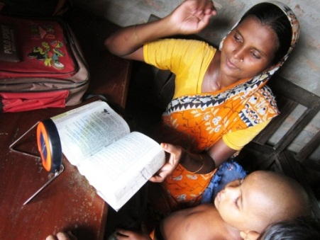
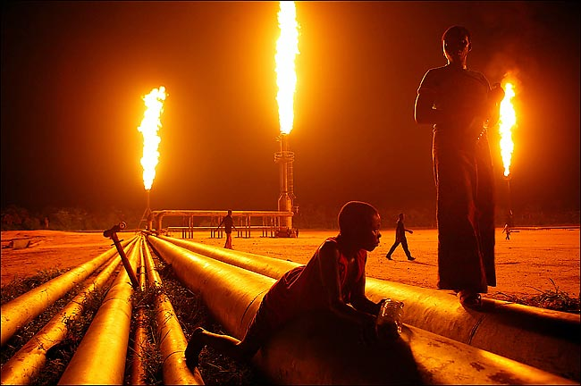
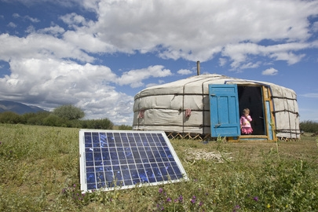
Our Global Energy System Must Meet the Needs of Today…and Tomorrow
  SE4ALL a Multi-stakeholder partnership between governments, private sector, civil society
  Launched by UNSG in 2011 after 2 years of preparation with 3 interlinked objectives until 2030
    Ensure universal access to modern energy services
    Double share of renewable energy in global energy mix
    Double global rate of improvement in energy efficiency
Notes:
Why are we here today and why do we need SE4All?
The world faces three great energy challenges in the coming decades.
First, ending energy poverty. We need to ensure every person has access to electricity and modern energy sources for cooking and heating.
Second, we need to strengthen economic growth in a way that‘s equitable and satisfies growing energy demand.
Third, we need to slow the warming of our planet by reducing global emissions.
In essence, we need to turn on the lights for every household, while turning down the global thermostat.

Slide 3
SE4ALL organizational structure and functions
Advisory Board
UN Secretary-General
Co-chairs
World Bank President
Approx. 40 Members
(Public & Private Sector / CSO Leaders)
Finance
Energy
Access
Renewable
Energy
Energy
Efficiency
Executive Committee
Direct communications and link
Chairperson
Approx. 10 Members
Global Facilitation Team (GFT)
Chief Executive
Team Members
Hubs and Support Teams
Regional Hubs
Thematic Hubs
Meeting with Danish Industry representatives
UN City, Copenhagen, 7 March 2014
3

Slide 4
SE4ALL organisational structure and functions
Advisory Board
UN Secretary-General
Co-chairs
World Bank President
Approx. 40 Members
(Public & Private Sector / CSO Leaders)
Finance
Energy
Access
Renewable
Energy
Energy
Efficiency
Thematic standing
committees
Executive Committee
Energy Efficiency standing committee
Direct communications and link
Chairperson
Approx. 10 Members
UNEP
CO-LEAD
ACCENTURE
Danish Gov.
Global Facilitation Team (GFT)
Chief Executive
Team Members
Hubs and Support Teams
Regional Hubs (3)
Thematic Hubs (5)
4

Slide 5
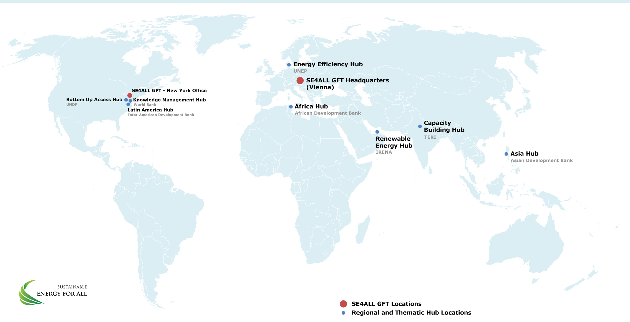
SE4ALL organisational structure and functions
5

Slide 6



Key components and Stakeholders
An Inclusive Agenda
All parties must act…
…and work together to realize a world with Sustainable Energy for All
Governments
National governments
Public institutions
Cities and municipalities
Multilateral organizations
Bilateral development partners
Global Action Agenda, with a set
of Action Areas, will facilitate dialogues and guide action towards SE4ALL goal globally
Country Action to accelerate progress toward nationally-tailored sustainable energy for all objectives, based on country’s own action plans and programmes
High-impact opportunity initiatives to mobilise multi-stakeholder partnerships, commitments and investment linked to key Action Areas
Businesses
Energy companies
Financial players
All companies
Energy
access
Energy
efficiency
Renewable energy
Civil society
Organization
Academic institutions
Individuals
Monitoring and Progress Tracking to recognize achievements, share lessons and ensure accountability
6

Slide 7
Catalyzing Country Action
Country Opt-In
Stock-taking &
Gap Analysis
National Action
Plans & Programs
Implementation & Monitoring
More than 80 countries already involved spanning four continents
Streamlined process to catalyze action: gap analysis, creation of national actions plans, implementation, monitoring
Benefits
Investing in access will help countries build a more productive, sustainable economic future.
Providing universal modern energy access does not have any significant impact on energy or climate security
Great potential for renewables as well as energy efficiency gains
Notes:
.

Slide 8
Country Level Action
Region | Africa & Middle East (43) |  | Americas & Caribbean (19) | Asia Pacific (14) | Europe & CIS (5)
Developing Country Partners (81) | Angola Benin Botswana Burkina Faso Burundi Cameroon Cape Verde Central African Republic Chad Congo Cote d’Ivoire Democratic Republic of Congo Equatorial Guinea Ethiopia Gabon Gambia Ghana Guinea-Bissau Guinea-Conakri Kenya | Lebanon Lesotho Liberia Malawi Mali Mauritania Mozambique Namibia Niger Nigeria Rwanda Sao Tome and Principe Senegal Sierra Leone Somalia South Africa Sudan Swaziland Tanzania Togo Uganda Zambia Zimbabwe | Argentina Barbados Belize Bolivia Colombia Costa Rica Dominican Republic Ecuador Grenada Guatemala Guyana Honduras Jamaica Nicaragua Peru Saint Vincent and the Grenadines Suriname Trinidad and Tobago Uruguay | Afghanistan Bangladesh Bhutan Cambodia Fiji Indonesia Laos Malaysia Mongolia Myanmar Nepal Pakistan Philippines Sri Lanka | Armenia Kyrgyzstan Montenegro Tajikistan Moldova
RED = Rapid Assessment completed
November 11, 2013

Slide 9
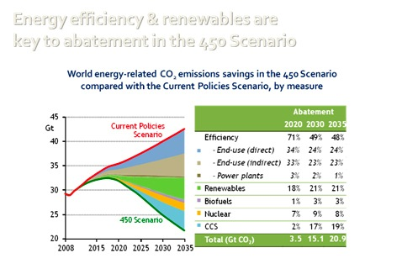
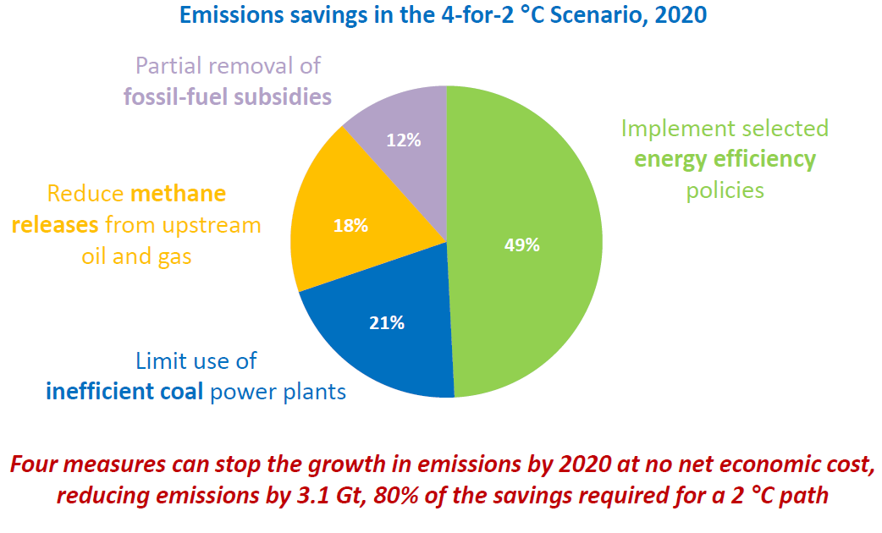
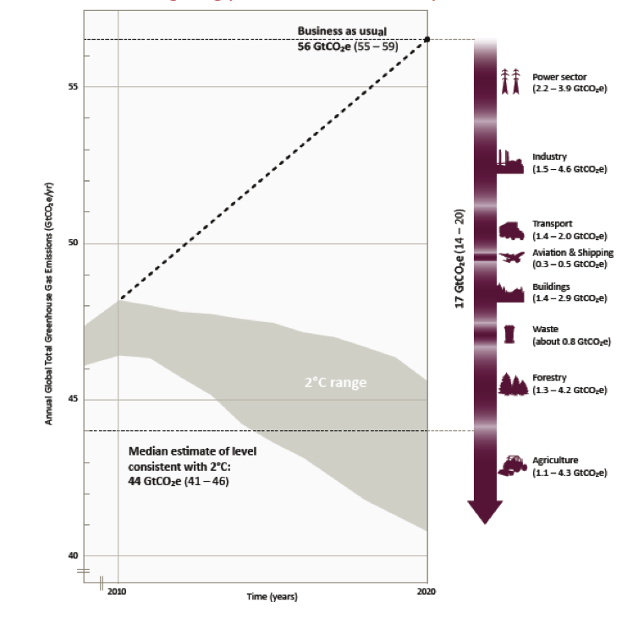
Can EE Deliver on Ambition
(IEA and UNEP studies)

Slide 10


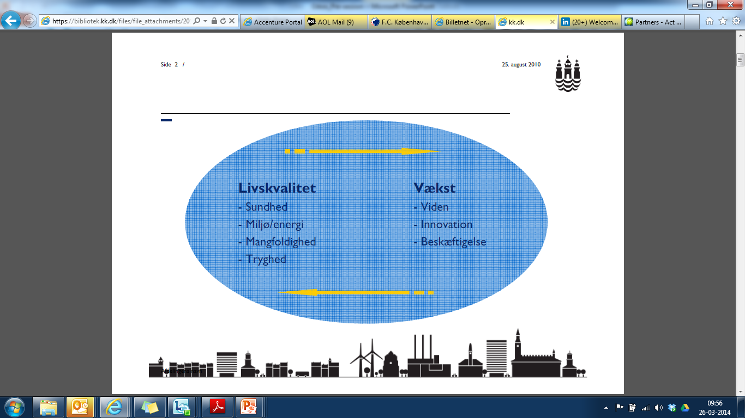

Adoption of Energy Efficiency technologies drives development
Investments in Energy Efficiency…
Reduce energy
imports
Create jobs
Reduce
company costs
Improve
livelihoods
Investment in Energy Efficiency drives growth and development while enhancing energy security

Slide 11
SE4ALL EE Accelerator Platform
Work program focus for the EE Committee:
Display concrete transformational initiatives/instruments in support of the SE4ALL efficiency objective.
  Global Public-Private Alliance on Accelerating Energy Efficiency
  Focus on the interphase between sector/technology initiatives, policy and consumption aspects (countries, cities, companies) and finance - in a phased approach.
    Focus on buildings, lighting and appliances, district energy systems, industry and transport
    Umbrella approach with individual groups engaged on each topic, each group will have an industry co-lead
    Implemented in cooperation with governments, cities and major private consumers.
  Umbrella approach expected to be presented at UN SG CC Summit
  Larger showcasing envisaged in Paris 2015.

Slide 12
The key challenge is now to engage counterparties to get action at scale
The Accelerator value proposition:
The accelerators is a platform and mechanism for overcoming market failures and promoting investments
It provides access to proven solutions addressing financial- technical- and political barriers
It provides access to financial-, technical and political partners
The Accelerators are engaging cities and local governments to undertake operationalization

Slide 13
We invite to join in the effort to mobilize additional accelerators
SE4ALL is looking to support the further development of existing- and the establishment of new Accelerators
  Additional partners will strengthen the value proposition to counterparties within existing Accelerators.
  More Accelerators can be envisioned to provide a full scope of areas to drive the adoption of Energy Efficiency technologies.
The Energy Efficiency Committee is looking to support the maturation of the Accelerator across sectors

Slide 14
Where we are now
Formal SE4ALL structure established
Global Facilitation Team still in formation stage
First report issued on baseline for targets and methodology for global tracking of progress, second assessment in progress
Accountability Framework also in place to track commitments and respective progress (bottom-up tracking)
National assessment underway (incl. preparation of Action Agendas and Investment Prospectuses)
EE Committee initiated – Established and EE Platform approved
Several actions and commitments under SE4ALL political umbrella
Still some way to go – but moving fast
14

Slide 15
Energy Efficiency Hub – Set-up and activity focus
Danida political engagement and provision of initial and core funding
UNEP overall responsibility with DTU and Danida as partners
UNEP DTU Partnership executing in close coordination with UNEP EE programs
    Copenhagen Centre on EE
    Governance by funders
    Collaboration with SE4ALL GFT elaborated
Inception phase from 9/2013 to 7/2014 - establish work program, institutional links and recruit staff
3,5 year Danida core funding approved in 7/2014.
Norway and Germany interested
UNEP as Global Champion for the energy efficiency target
Global Knowledge Centre on Energy Efficiency and Platform for sharing information, best practice experiences and expertise links
Analytical Underpinning of the SE4All energy efficiency target – assessing ways of reaching the target, tracking action and HiO progress
Advisory services – supporting EE activities in opt-in countries and through regional Hubs
Facilitating private sector engagement focusing on the EE Accelerator Platform
Communication and outreach on EE and global target by UNEP, supported by the Hub
15

Slide 16
Thank You!
John M. Christensen
UNEP
UN City, Copenhagen, Denmark

