Slide 1
Climate Markets
Taller
Oportunidades para la Bancas de Desarrollo de América Latina y el Caribe en los Mercados Sostenibles
ALIDE, BROU, y BID
Montevideo, Uruguay. 25 de julio de 2012

Slide 2
Climate change is today a global financial challenge
Since 2009, governments broadly agree that it will be costly to solve climate change
By 2020, US$100bn needed annually for investments in climate mitigation and adaptation (“Copenhagen Accord”)
Governments in developed countries to play a catalytic role, but private sector in developed countries to contribute a significant portion of the US$100bn
Markets, including carbon markets, are key instruments for mobilization of private capital for climate-friendly investments
Strong need for innovative finance at scale to meet the climate challenge

Slide 3
Introducing IFC
We create opportunity for people
– to escape poverty and improve their lives
The world’s largest private sector-focused development bank.
Established in 1956, over half our 3,438 staff work from over 100 offices in 92 countries.
We invest, advise, mobilize capital, and manage assets.
  Committed portfolio for FY11: $55.2 billion; 1,737 firms.
  Investments in FY11: $12.2 billion for IFC’s own account, $4.7 billion mobilized.
  Under management within the Asset Management Company: $4 billion.
  Advisory expenditure for FY11: $333.8 million
IFC started formal environmental and social screening of its investments in the early nineties and became the acknowledged world leader on these issues when the Equator Principles were launched in 2004.
One of the biggest challenges to development today is climate change. While public policy is key, the private sector must also play a leading role. That is why…
Climate Business is a core priority for IFC

Slide 4
IFC has offices in over 100+ countries offering investment and advisory services
Moscow
Almaty
Washington
Istanbul
Mexico City
Cairo
New Dehli
Santo Domingo
Dakar
Hong Kong
Bogota
Nairobi
São Paulo
Johannesburg
Buenos Aires
IFC HQ/Regional Hub
IFC Hub Offices
IFC Regional Operations Center
IFC Country Offices

Slide 5

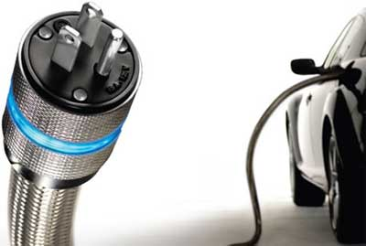

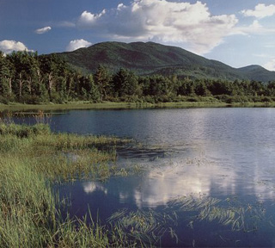


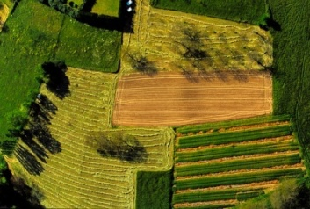
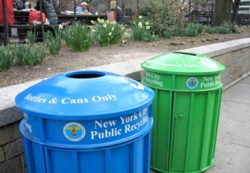
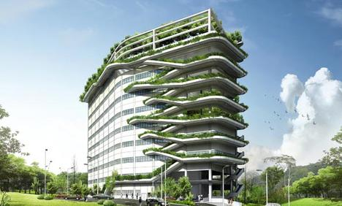
How does IFC define climate business?
Solutions for climate mitigation / adaptation and sustainable development
ENERGY: Low carbon generation, energy efficiency, storage, smart grids, sustainable energy access
TRANSPORTATION: Energy efficient components, fuels and logistics
WATER: Capture, treatment, conservation, wastewater treatment, access
AIR & ENVIRONMENT: Carbon credits, trading and offsets
BUILDINGS: Low carbon strategy, energy efficiency, sustainable materials.
MANUFACTURING: Green chemicals, RE/EE supply chain, cleaner production.
AGRICULTURE & FORESTRY: Land mgmt, low carbon and adaptation strategies, biomass.
RECYCLING & WASTE: Recycling and waste treatment services
Climate business will only scale and have impact with significant private sector participation – that is where IFC has an important role to play

Slide 6
IFC’s Climate Business Agenda
Thought Leadership
Convening the private & public sector, development banks, academia and setting standards
  Criteria for green bonds and investment indices
  Methodologies for carbon accounting
Capacity building for private and public clients
  Climate risk assessments
  Regulatory and transactional advice
Business Opportunities
Expand in new sectors, beyond renewable energy, including adaptation
Invest in new and transferable technologies (North-South and South-South)
Develop scalable climate business models (often leveraging financial institutions and funds)
Innovation
Advisory services and blended finance support change by addressing regulatory, knowledge, skill and risk perception barriers
Develop new climate finance products (beyond carbon finance)
Develop efficient mechanisms to leverage public funds with private investment

Slide 7
IFC’s Climate Business investment commitments FY05-11 ($6.5 billion)
By industry
By sector

Slide 8
IFC’s Climate Business investment commitments FY05-11 ($6.5 billion)
By Region
East Asia 24%
South Asia 14%

Slide 9
IFC integrates its approach to serve Climate Businesses
Climate Business Group
Climate Business Department
+ Coordinated Communications
S. Miller
Global Industries
Infra
MAS
Advisory Services & CES
Blended Finance
Africa
FM
EMENA
E Asia
S Asia
LAC
CES
Regions
Climate Strategy & Business Dev’t
specialists and investment officers
M. Broadwater
Strategic business dev’t for RE, EE, Waste, Water, Green Buildings, Embedded IT
Additional capacity for deal execution in new sectors
Coordinated Knowledge Management
Cleantech Investments
venture / growth stage investment officers
N. Jinsi
Cleantech sector expertise
Venture/ growth capital structuring expertise
Capacity for deal execution
Climate Finance & Policy
finance, climate, policy & metrics
V. Widge
Innovation in climate finance products (inc. adaptation)
Think tank on policy metrics (reporting, climate risk analysis, etc)
External engagement and thought leadership (e.g. MDBs, UNFCCC, business groups)
M. Landy &
C. Armstrong
S. Swann
J. Graham
L. Da Silva
N. Zegger
Advisory Services
A. Narayanan
J. Kellenberg
V. Bhagat (PPP)
R. Sturm (SBA)
P. Malhotra

Slide 10
What products does IFC offer Climate Business firms?
Commercial Finance (Equity, Debt and Mezzanine)
  Renewable energy generation and supply chains
  Resource efficiency (Energy, Waste, Water)
  Credit lines and guarantees for Financial Institutions to on-lend to SMEs
  Climate Change Private Equity Funds
  Cleantech growth capital
  Carbon Finance
Blended Finance
Advisory Services
Convening industry players for research / standard setting

Slide 11
IFC has a long track record in blended finance.
blended finance
Over a decade of innovation and more than $700 million under management from GEF, CIF, Canadian Climate Change Fund and other bilateral donors for climate.
FY12: $3 billion IFC and private sector investment mobilized by $130 million in donor funds. That is a leverage ratio of~23 times.
Examples of intervention types:
Concessional debt to accelerate technology roll-out
  e.g. La Ventosa wind farm in Mexico
Risk sharing facilities
  eg. to help lenders scale up renewable and energy efficiency portfolios, such as CHUEE in China
Patient equity
  e.g. for young cleantech companies such as a micro-turbine manufacturer in India and an energy efficient water purification company in India, Bangladesh, Phillipines and Ghana
Competition prizes
  e.g. for companies innovating light and energy solutions for underserved / off-grid populations.

Slide 12
Advisory services programs address barriers to market development
advisory services
Awareness and skills for firms: e.g. cleaner production advice to firms
Capacity building for public policy makers: e.g. feed-in tariffs with IBRD
Market transformation initiatives which address regulatory, skills and knowledge, and access to finance barriers simultaneously: e.g. Lighting Africa.
Transaction support to demonstrate new business models:
  PPPs for concessions in renewable energy generation/access, energy distribution, solid waste, water, forest management
  Long term engagement with key market players to understand & address risk perception
  Product development in forestry and land-use could ultimately result in a GHG abatement impact that is larger than that achievable by IFC in the RE/EE sector
Manage and deploy knowledge for replication and scale-up
  Best practices and lessons learned

Slide 13
advisory services
IFC’s Advisory Services approach is market-driven.
IFC Advisory Services catalyze market development at various points along the innovation curve, tailoring interventions to market needs.
Break-even
PPP support
Regulatory reform
Financial Market Development
Market Intelligence, Industry Standards
Profitability
Proof of concept
Refining Business Models
Commercial Scale Up
Intervention | Support regulatory reform initiatives which set enabling environment to enable commercial investment. (eg, feed-in tariffs, green building codes) Demonstration projects designed to catalyze replication at scale | Support innovative business models which enable technology and services to reach new markets Provide market intelligence on where business opportunities exist, and on what tools/products exist to help project development Support market aggregation to catalyze rapid uptake and foster competition Support public private partnerships | Support commercial banks in developing products which underpin a sustainable commercial debt market for climate investment Identify opportunities to leverage concessional funding through modified waterfalls to move commercial finance sustainably into the frontier
13

Slide 14
The carbon market opportunity
Carbon markets are important tools for delivering on IFC’s climate business targets going forward
Carbon markets presents new business opportunities for companies and financial institutions in emerging markets
Since market start-up in 2005, the total value of the global carbon market has been steadily increasing (2011=$176bn)
Carbon is cross-cutting key sectors (power, manufacturing, industry, buildings, transportation, waste, ag, forestry, etc.)

Slide 15
Steady increase of global market value, US$bn
176
159
144
135
63
31
11
Source: World Bank, 2012: State and Trends of the Carbon Market 2011.
Notes:
15

Slide 16
EU and other markets increasing value
(in Billion US$)
Secondary
CDM + JI
post-2012 CDM
New Zealand
N. America
2.0
0.4
0.5
23.1
+12%
-18%
+63%
+249%
pre-2013 CDM
EU ETS Allowances
JI
AAU
1.0
147.8
0.3
0.3
-32%
-36%
-49%
+11%

Slide 17
IFC has long experience in carbon finance
IFC has more than 8 years of experience with carbon finance
Investment activities:
  Manager of two carbon funds for the Government of the Netherlands. $135 million worth of carbon credits have been purchased
  Signed three carbon delivery guarantees for a total of 2.2 million credits
  In June 2011, close of €150 million Post-2012 Carbon Facility
  US$5M equity investment in BioCarbon (forestry-C credits)
  IFC also offers debt financing to projects & programmes that rely on carbon revenue from sale of post-2012 credits

Slide 18
Key features of global AS program for FIs
Strategic goals:
  Build knowledge, tools and partnerships needed to be successful in sustainability markets
  Build capacity to integrate revenues into credit appraisal
  Support a new business line and expand client base and relationships
  Development of a portfolio of bankable project/program opportunities
Main income streams for FIs:
  Provide finance to projects which generate credits
  Manage credit risk associated with transactions
  Purchase and trade credits with potential for significant returns
  Fee earnings from sales of credits to buyers and off-takers
  Provide advice on financial structuring of projects / programs generating credits

Slide 19
Advisory services program to enable FI enter sustainability markets
Program aims to enable FIs to offer financial products tailored for domestic markets for environmental/sustainable development products, and carbon credits
Program provides appraisal capacity, transactional support, pipeline review, and aggregation instruments for FIs in emerging markets
The advisory program components could be enhanced with investments products - credit lines, First Loss, guarantees, etc.
Implementation period: 2012-2014

Slide 20
Wholesaling via domestic FIs
3-pronged approach
International Carbon Market
Structured Carbon Products
Capacity Building
Direct Funding and/or Risk Sharing Facilities
CER Off-take Arrangements
Local Financial Institution
Project A
Project B
Project C
Project D

Slide 21
Transformation of carbon markets
The global carbon market is changing…
  Oversupply of credits in the EU
  Only new projects in Least Developed Countries allowed in EU post-2012
  Japan pursuing bilateral approach with developing countries
  National carbon markets emerging in Australia, South Korea, and
  California is leading the US market at the regional level
…while new markets are emerging in developing countries
  DCs seem willing to take climate action at national level
  15 countries have joined the World Bank’s Partnership for Market Readiness
  DCs have put in place renewable energy portfolios (Chile), energy efficiency certificates (e.g., PAT in India)
  Several countries in LAC are moving towards domestic ETS: Brazil, Chile, Columbia, Costa Rica, and Mexico

Slide 22
GREEN BONDS

Slide 23
Rationale for ‘green bonds’
Need for large-scale financing toll targeting investment opportunities at portfolio, sector, regional levels
Responding to climate change requires implementation of interventions that require significant upfront capital investments
  Carbon finance is back-loaded, i.e. and payments-on-delivery/performance payments
Ability to tap traditional financial markets will be key
Move from single project financing towards flexible investment programs linked to markets for sustainable management, and carbon assets

Slide 24
Rationale for ‘green bonds’ (cont’d)
Need for standardized products that can tap into significant money
Investment products must be attractive to mainstream bond investors (size, rate, tenure, risk rating)
Asset-backed issues across a range of technologies, regions, and sectors (forestry, renewables, energy efficiency, water, etc.)
Since 2006, over US$15bn have been raised through green bond issuances*
* Source: Della Croce et al, The Role of Pension Funds in Financing Green Growth Initiatives (OECD, 2011).

Slide 25
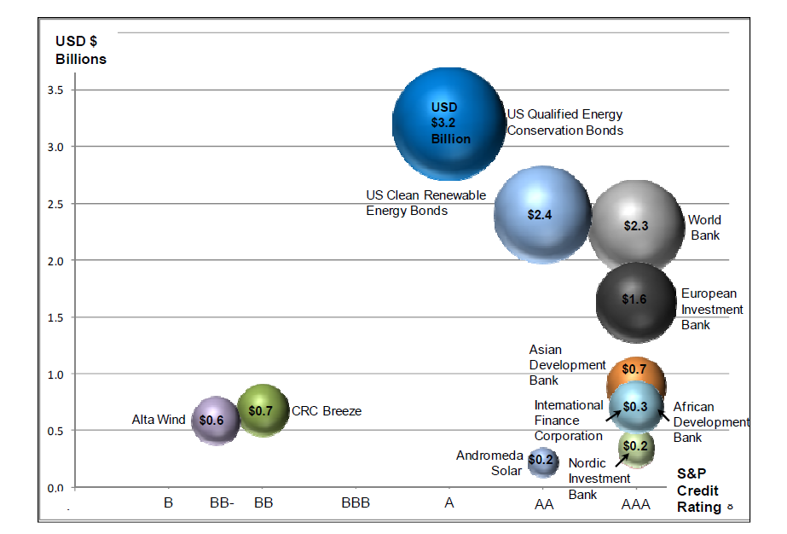
Major green bond issues since 2006
Source: Della Croce et al, The Role of Pension Funds in Financing Green Growth Initiatives (OECD, 2011).

Slide 26
What IFC has done in this space so far
First Green Bond issued in April of 2010. Proceeds of the four-year US$200 million fixed bond were set aside in a separate Green Account for investing exclusively in climate-friendly projects in developing countries
Eight more issuances of Green Bonds have occurred, the last being in September of 2011, raising US$555 million. To date, proceeds from the Uridashi Green Bonds have supported 21 climate-related investments across 4 continents
IBRD has issued US$2.5bn in green bonds stating in 2007 (retail) and 2008 (institutional). Currently one of the largest issuers.
EIB has issued around 1.2bn in Climate Awareness Bonds starting in 2007.

Slide 27
Various types of bonds:
Examples from forestry sector
Model (A): A bond backed by government income from forestry concessions
Model (B): A bond backed by a portfolio of sustainable forestry
Model (C): A bond backed by sustainable forestry loans issued by local banks
Model (D): A zero coupon bond backed by a sustainable forestry portfolio
Source: Forum for the Future and Enviromarket: Forest-Backed Bonds Proof of Concept Study. 2007

Slide 28
Example #1
  10 year bond issued by IFC
  Principal guaranteed by the IFC (Aaa/AAA/AAA)
  The bond is a IFC carbon-linked green bond. Principal proceeds are earmarked to REDD projects. Projects will reduce emissions of greenhouse gases and/or sequester greenhouse gases
  The coupon will be a variable coupon linked to carbon credits generated by an REDD Investment Pool. Redemption at par. Principal paid by the IFC at maturity
  The IFC may not guarantee the carbon credit flow under the contemplated structure

Slide 29


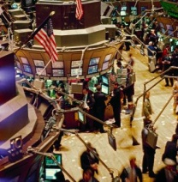
Indicative Structure
IFC discounts the coupon over 10 yrs and receives PV of fix rate coupon
USD [X]m
Annual VER Proceeds
Bond Investors
USD[X]m in year 10
VER Proceeds
Management Facility
VERs
Investment Committee
REDD Financing Pool
Private FI
Investment Committee evaluates REDD projects submitted to the REDD Investment Pool & negotiates an adequate VER/Prepayment ratio
REDD Financing Pool will prepay for VERs against an off-take agreement
VER Sold
REDD Project #1
REDD Project #2
REDD Project #3
REDD Project #4
Carbon Market
Private FI manages the monetization of VERs in the carbon market

Slide 30
Example #2
Country A Government to pass national environmental legislation, including legal framework Sustainable Development Credits (SDCs)
Companies operating in Country A may use SDCs to comply with sustainability law and regulations
A SPV to issue a ‘green’ euro-denominated bond in capital markets to finance environmentally sustainable projects
Principal and interest to be repaid to investors in SDCs recognized and registered in national system in Country A
Government may offer bond buyers a floor-price for SDCs
Sponsor proposal to IFC for product enhancement by addressing SDC delivery issues.

Slide 31
Determinants of success
EXTERNAL ISSUES:
  Market terms: price, coupon, yield
  Demand: buyer interest
  Supply: availability of high-quality projects
  Carbon market issues: regulations, prices
  Competition: for buyers; for projects
OTHER ISSUES:
  Acceptable risk
  Tenure, currency, etc.
  Standard vs. customized product
  IFC Internal policies
  Sector expertise

Slide 32
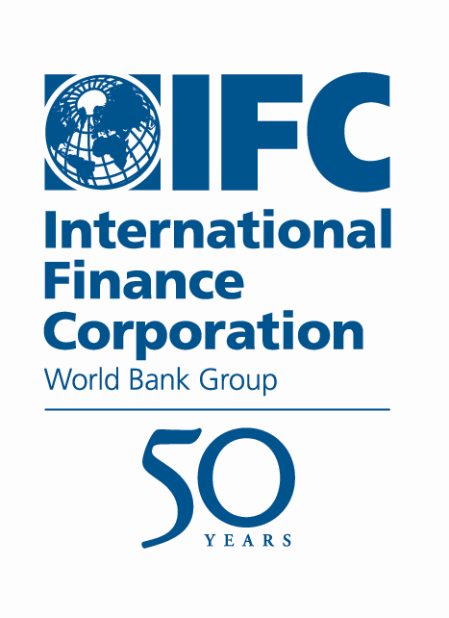
For additional information, please contact:
Climate Business Group
2121 Pennsylvania Avenue NW
Washington, DC 20433, USA
+1 202 458 0134
carbonfinance@ifc.org
www.ifc.org/carbonfinance

